Slide 1
Managing HazMat Impacts and Modernizing Recovery: Virginia’s Helene Experience
Holly Brown, Program Specialist
Office of Pollution Response & Emergency Preparedness
Virginia Department of Environmental Quality

Slide 2
Agenda
How do local, state, and federal government work together to recover from disasters?
How does DEQ support HazMat recovery efforts?
What can localities and solid waste management organizations do to prepare?
How can technology advancements disaster debris recovery efforts?

Slide 3
How do local, state, and federal governments work together to recover from disasters?

Slide 4
General Paradigm
Local
State
Federal

Slide 5
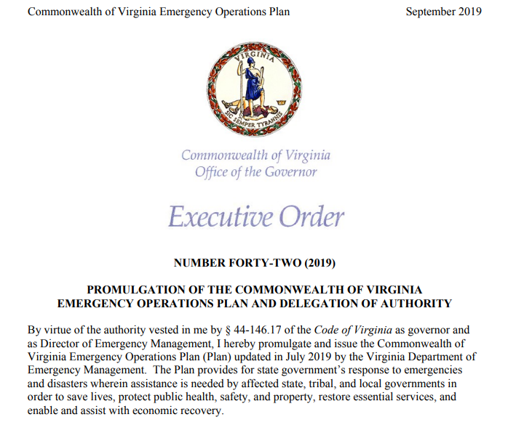
Executive Order 42 - COVEOP
Establishes:
Emergency Operations Plan and the Hazard Specific Annexes (HazMat, Wildfire, Earthquake…)
Virginia Emergency Support Team
Roles and responsibilities for each agency

Slide 6
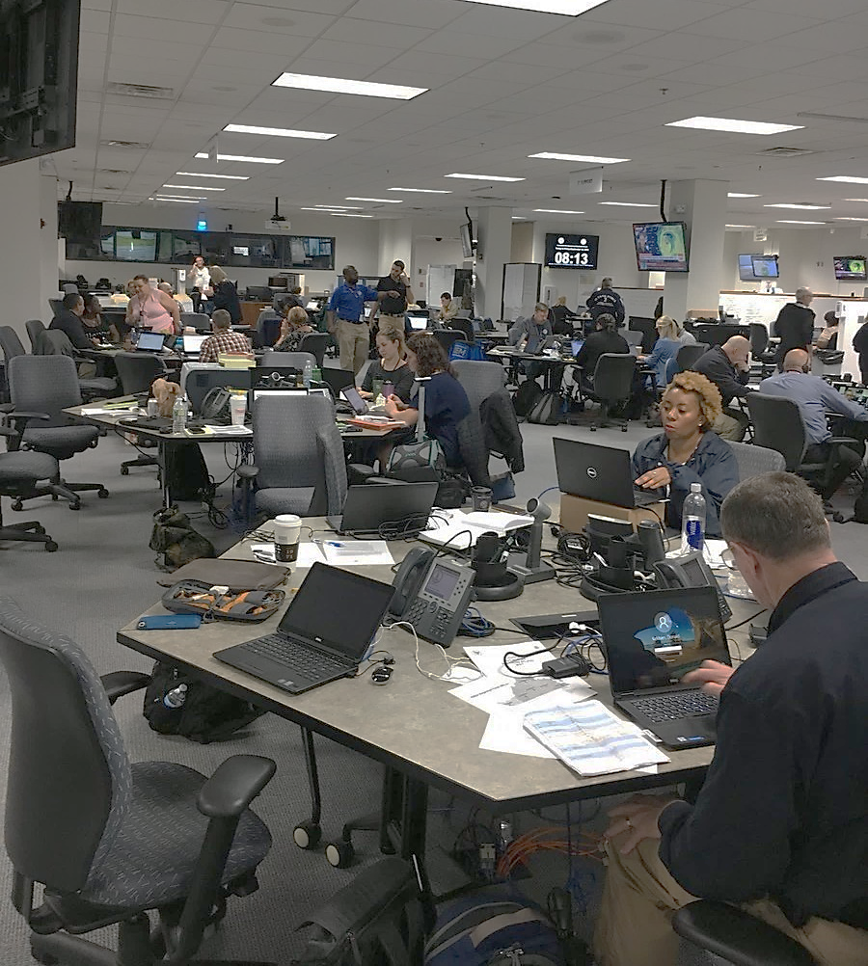
Virginia Emergency Support Team (VEST)
Comprised 300 +members drawn from all Executive Branch state agencies, NGOs, and private sector companies.
During steady-state operations, VEST training is conducted on a bimonthly basis on a variety of emergency management topics.
During VEST Activations,
VDEM fills the VEST Command & General Staff positions.
VEST members may be physically present at the VEOC while others may be virtual or may not be activated.

Slide 7
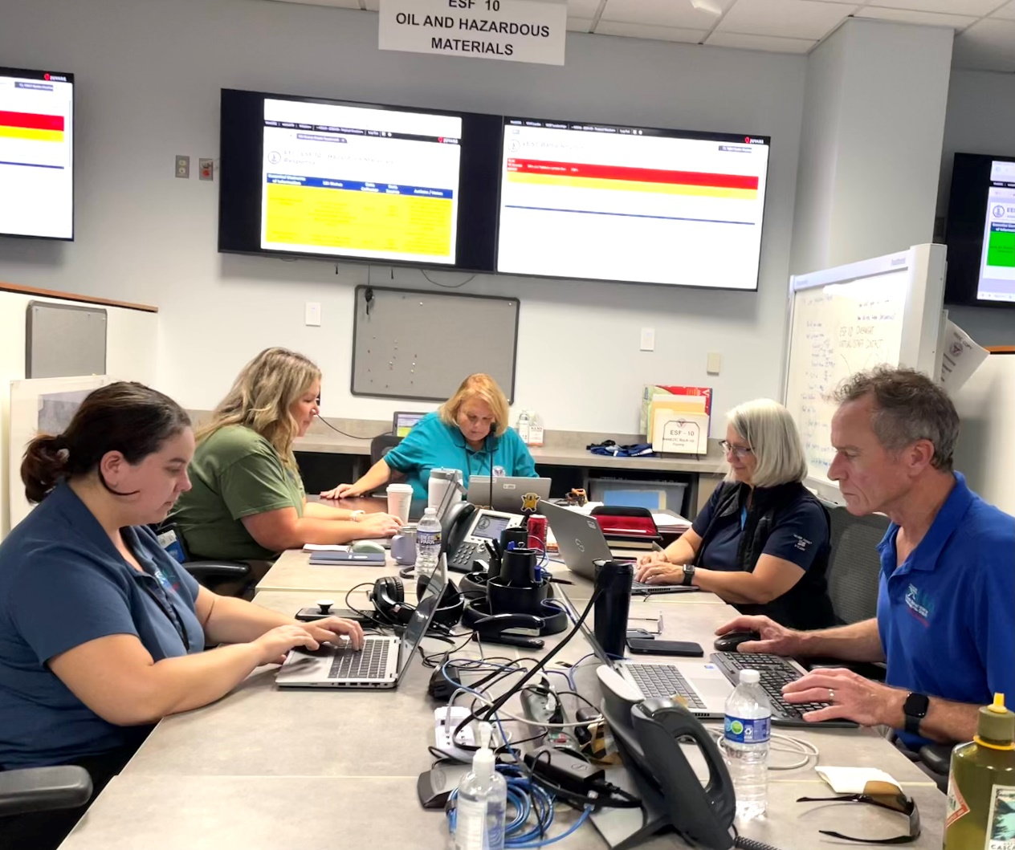
Virginia Emergency Support Team (VEST)
Under the COVEOP, DEQ supports the VEST when activated and has the following roles/responsibilities:
ESF 10 (Oil/Hazmat): Co-Lead
ESF 3 (Public Works): Support
ESF 8 (Public Health): Support
ESF 11 (Agriculture): Support
ESF 15 (Public Information): Support

Slide 8
How does DEQ support HazMat recovery efforts?

Slide 9
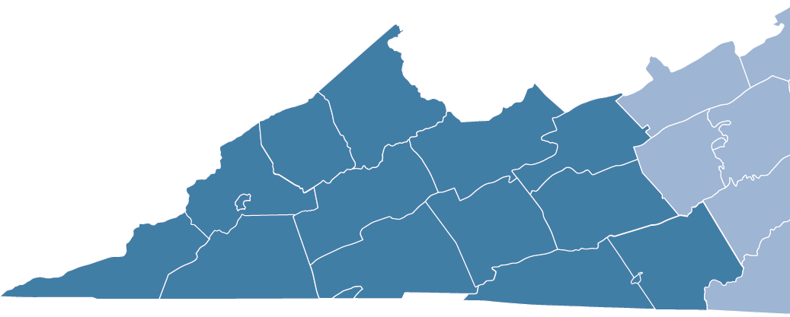

DEQ Field Assessment Teams
During historical flooding events, TS Helene and the February 2025 flooding event, the SWRO placed multiple teams in the field to collect hazmat assessment information.

Slide 10
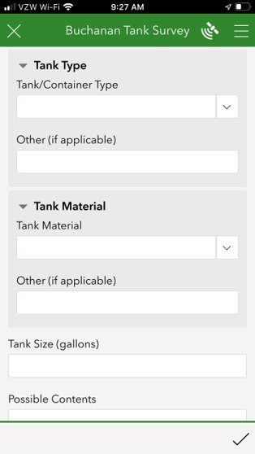
Post Disaster HazMat Field Surveys
Post-disaster, VDEM and DEQ conduct surveys of affected areas​ using GIS-based survey
Identify location of abandoned tanks and containers
Identify container type and material
Work with regional hazmat teams and state-lead and emergency contractors to retrieve and manage oil/hazmat​

Slide 11
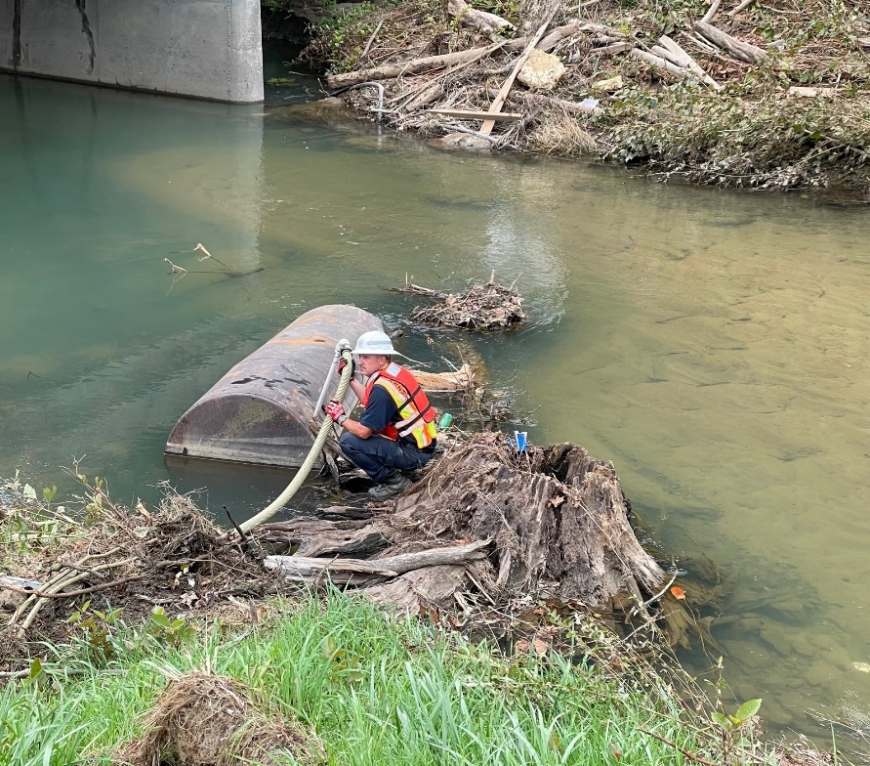
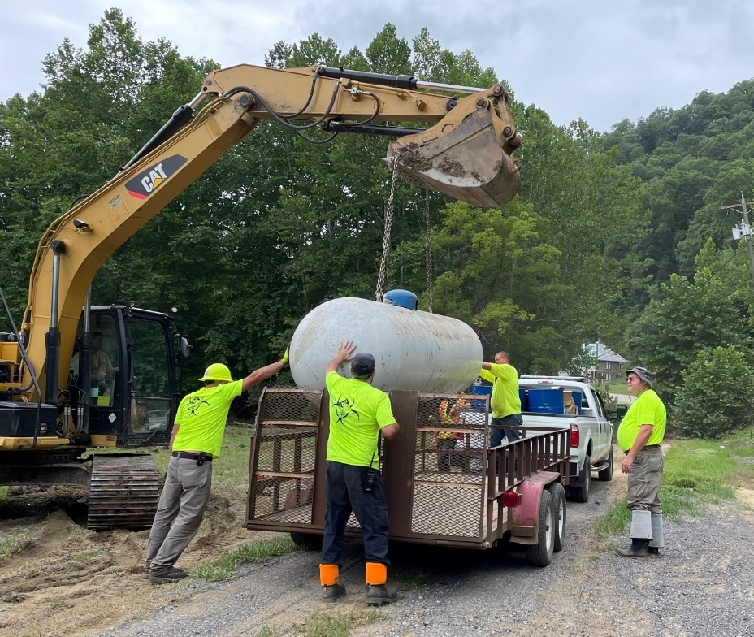
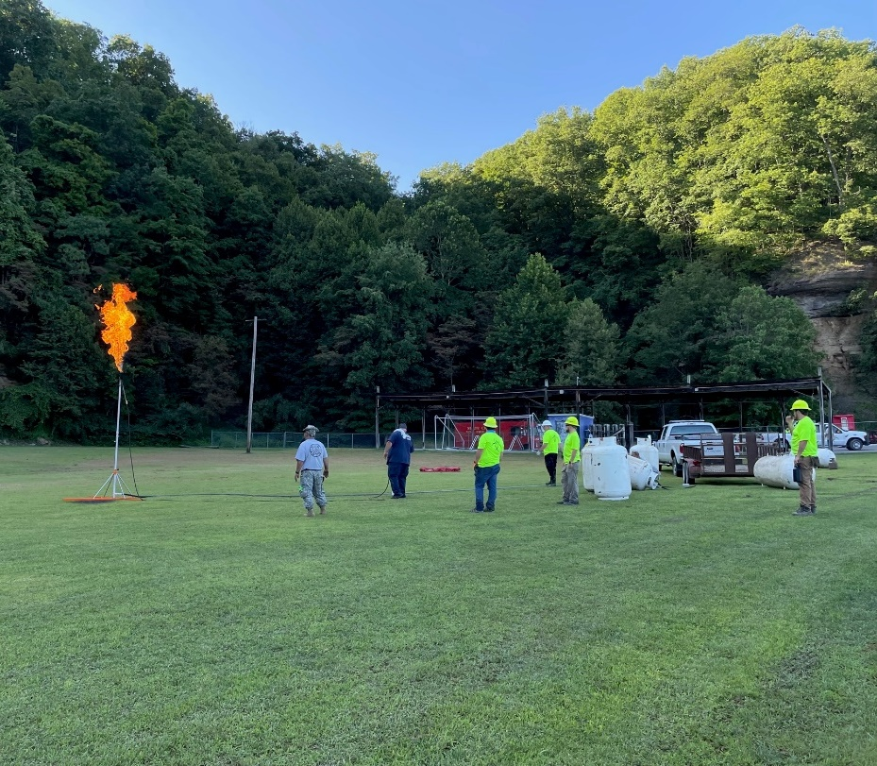
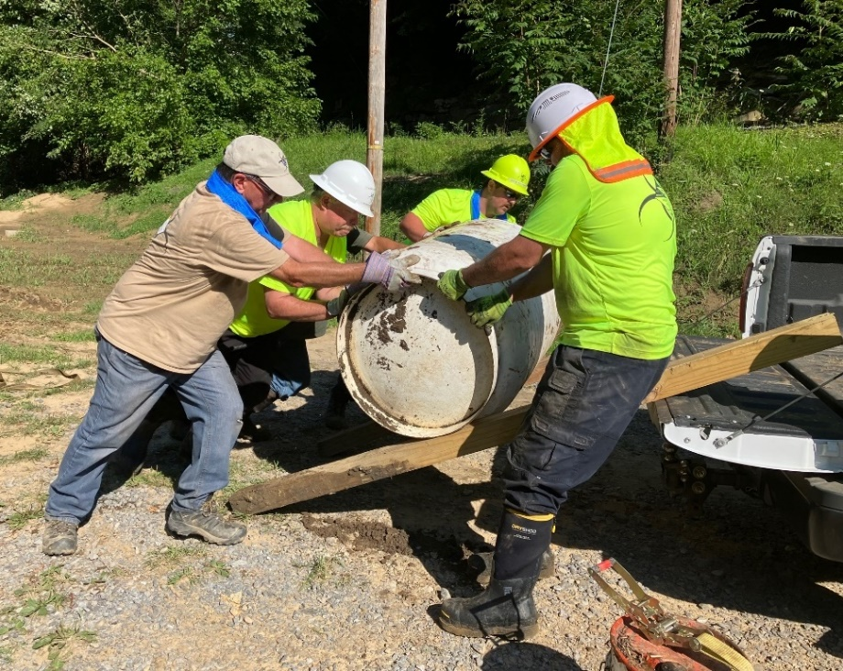
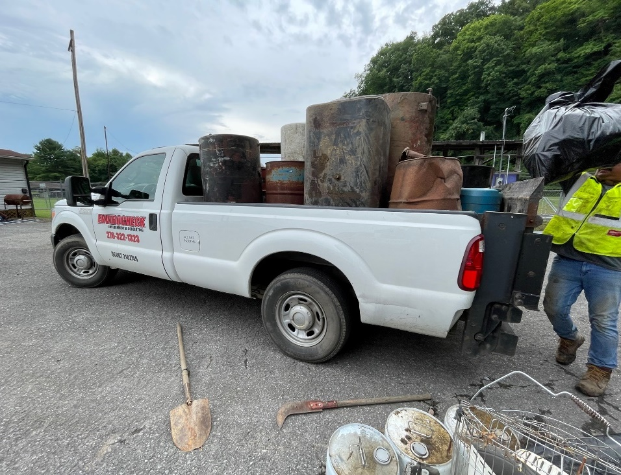
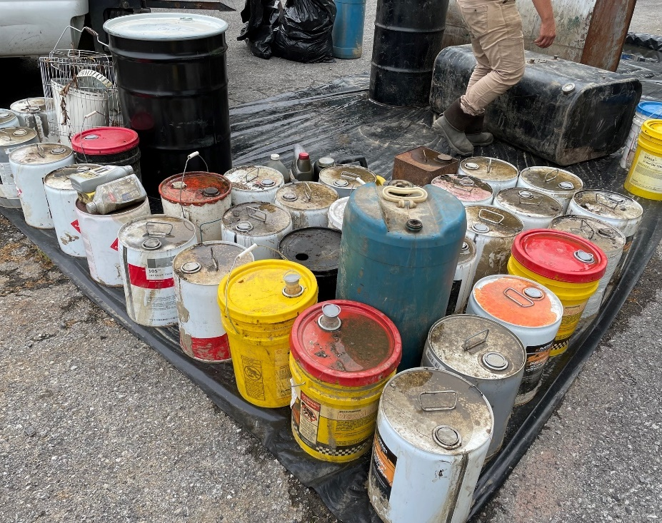

Slide 12
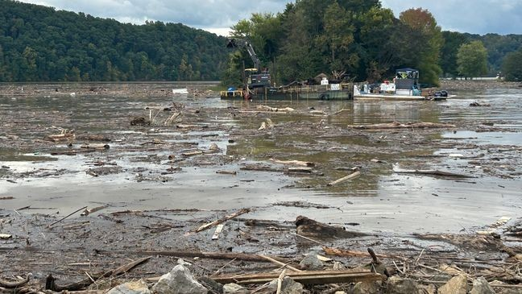
Claytor and South Holston Lakes
The lakes contained large masses of woody debris, oil and hazmat tanks and containers, propane tanks, white goods, demolition debris, and other solid waste.

Slide 13
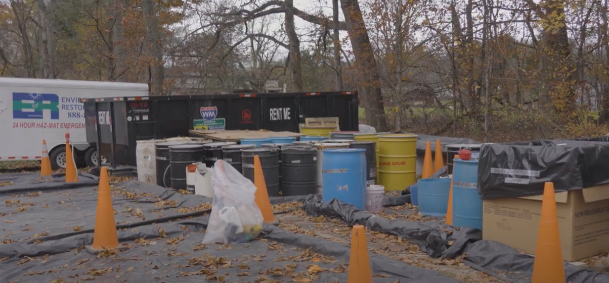
Damascus

Slide 14
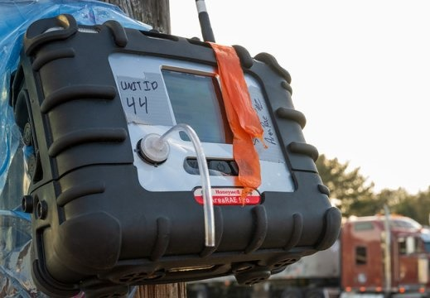
Federal Resource Requests
When state capabilities are exceeded, DEQ can submit resource request to EPA and/or USCG for additional support under their federal authorities or through FEMA Mission Assignments.
Examples:
Waste collection, staging, and disposal
Air monitoring
Water sampling and analysis
Site assessments

Slide 15
Helene Response
September 29 – January 24, 2025
RESPONSE PARTNERS
Virginia Department of Emergency Management
Virginia Department of Environmental Quality
and State-Lead Contractor
US Environmental Protection Agency
and emergency response contractors
Small Containers (<55 gallons)
3,405
Small Cylinders (<20 pounds)
1,596
Drums (55 gallons)
146
COUNTIES
Response and recovery efforts were concentrated in:
Giles
Grayson
Montgomery
Pulaski
Washington
Wythe
Large Cylinders (>20 pounds)
68
Large Containers (>55 gallons)
139
Propane Tanks (20 pounds)
133
Source: EPA and DEQ

Slide 16
What can localities and solid waste management organizations do to prepare?

Slide 17
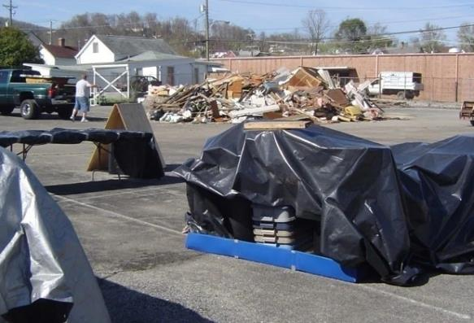
Disaster Debris Management Planning
Many localities do not have disaster debris plans
Assist with disaster debris planning
Assist with emergency debris site pre-selection and approval
Issue emergency permits for temporary debris reduction sites as needed

Slide 18
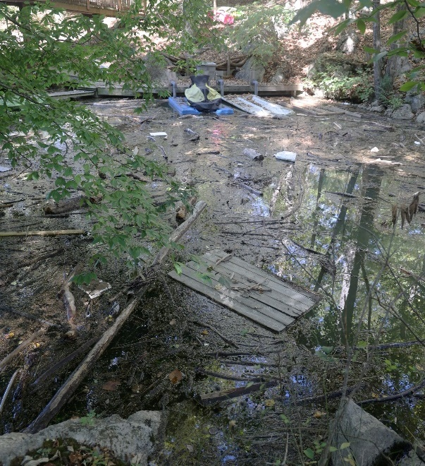
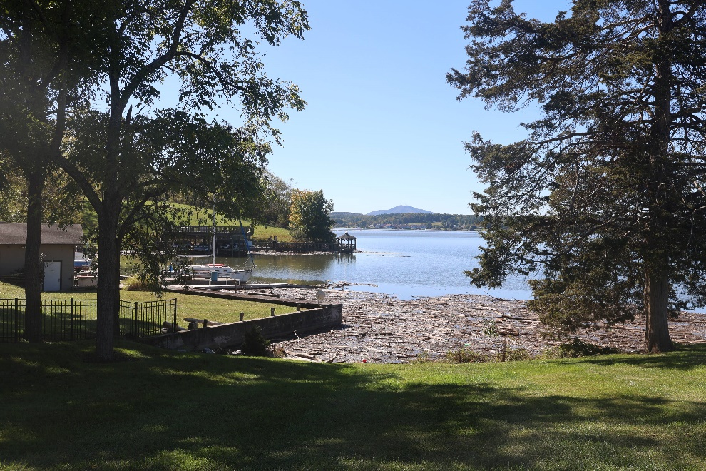
Important Lessons Learned During Helene:
Debris quantities can be hard to estimate and more than expected (Be flexible)
Good to have backup disposal plans (mutual aid agreements with other localities)
Having existing debris management contracts can speed up debris removal and management timeframes.
Need to know if any invasive species which could hinder movement of debris across county borders (Virginia Department of Agriculture and Consumer Services – Plant Industry Services)
Work with local emergency managers/localities to develop or update plans. (Build relationships now)

Slide 19
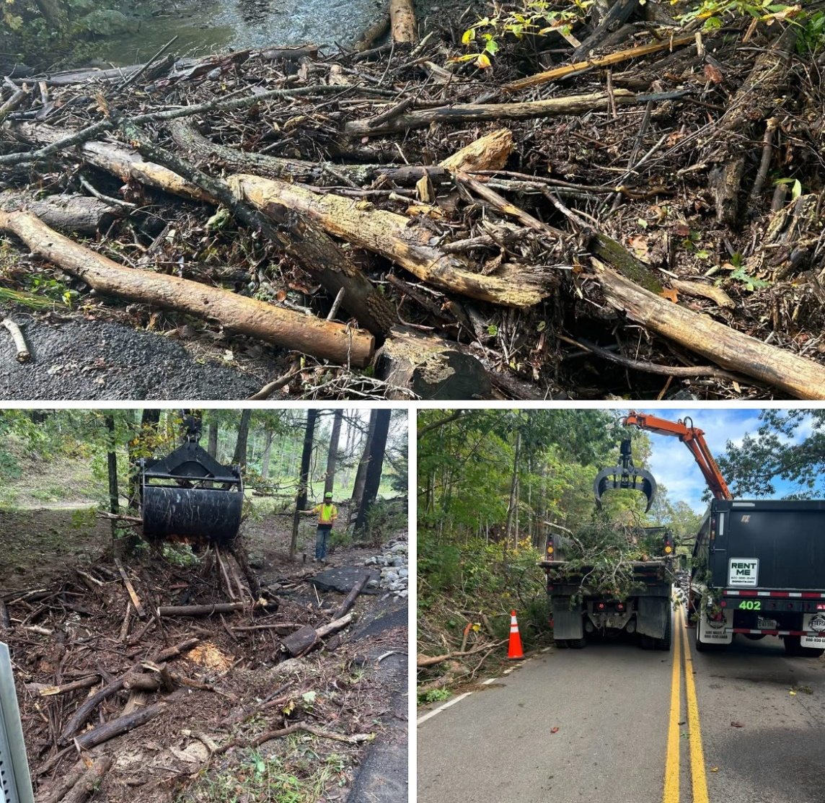
VDOT Debris Reduction Sites
Air regulations have provision for VDOT to open burn debris
Must notify DEQ when establishing site and prior to burning
Must comply with regulation and approved Best Management Practices

Slide 20
How can technology advancements support disaster debris recovery efforts?

Slide 21
Recent Collaborations with Virginia Tech

Slide 22
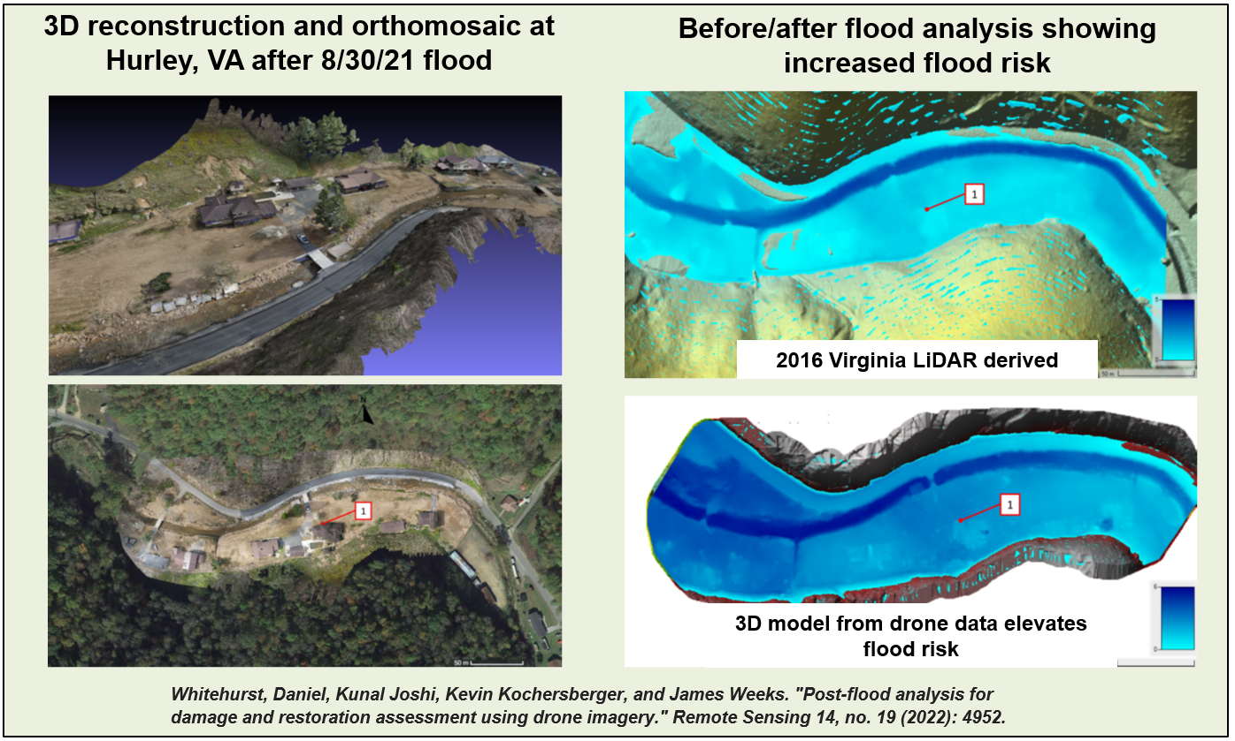
Buchanan County has been the focus of analysis and publications

Slide 23
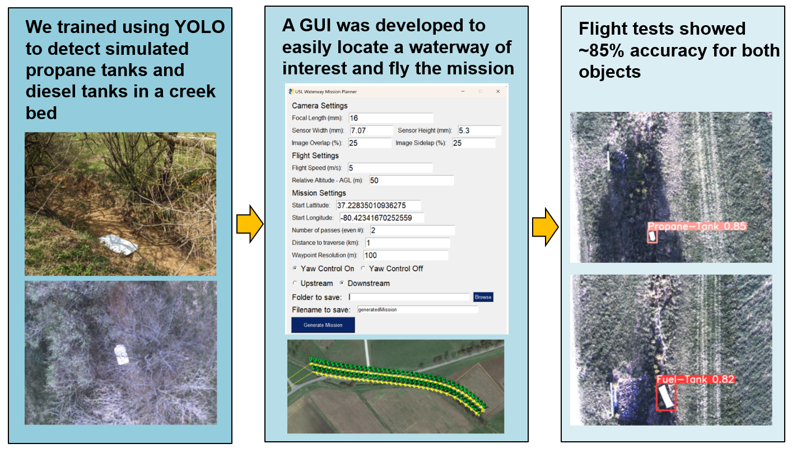
Detection of propane/fuel tanks in cluttered environments
23

Slide 24
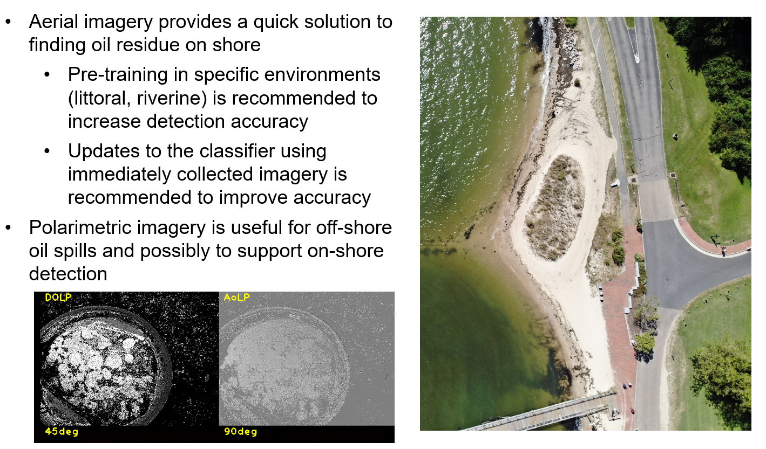
Coastal oil spill detection and classification

Slide 25
Damage assessment - Hurricane Helene
Claytor Lake, South Holston Lake, Damascus, Taylors Valley

Slide 26
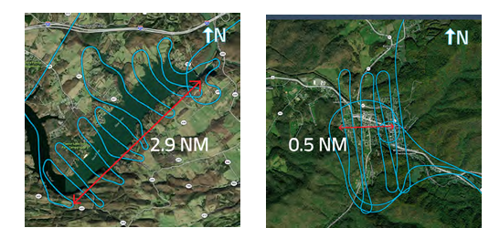
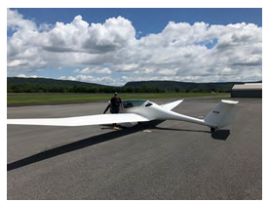
Aerial images were collected over Claytor Lake and Damascus
Flight path in Claytor Lake
Flight path in Damascus
Phoenix U-15 Motorglider

Slide 27
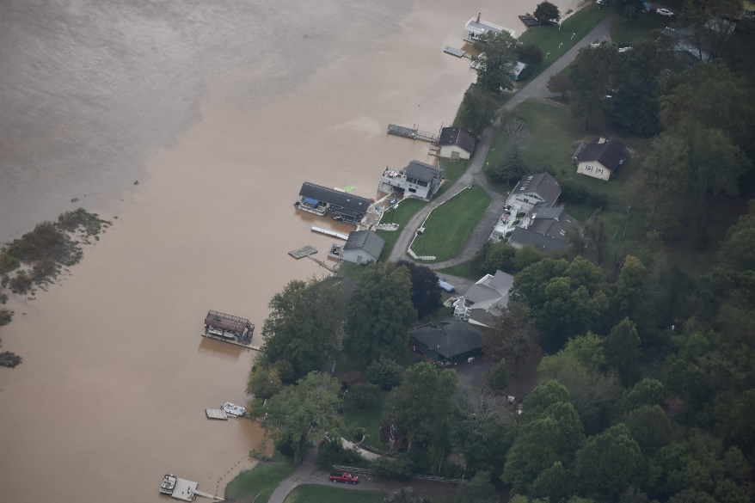
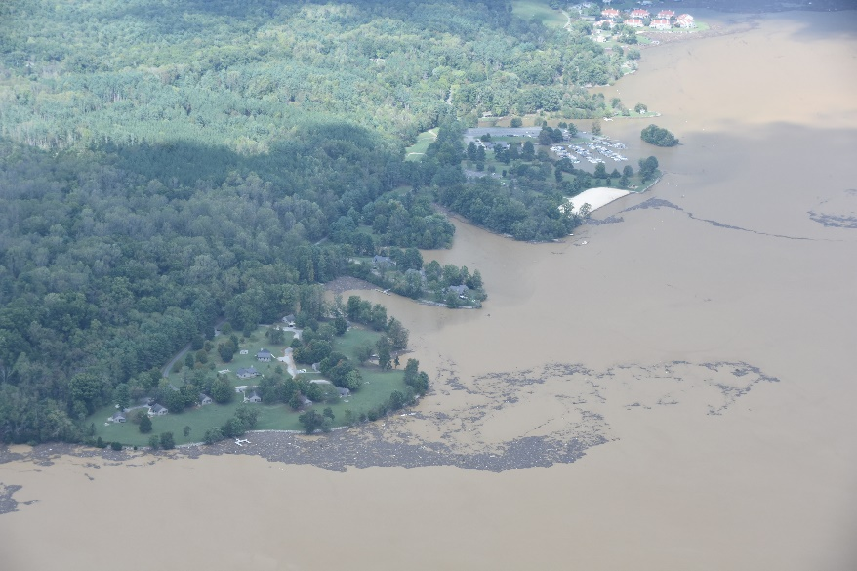
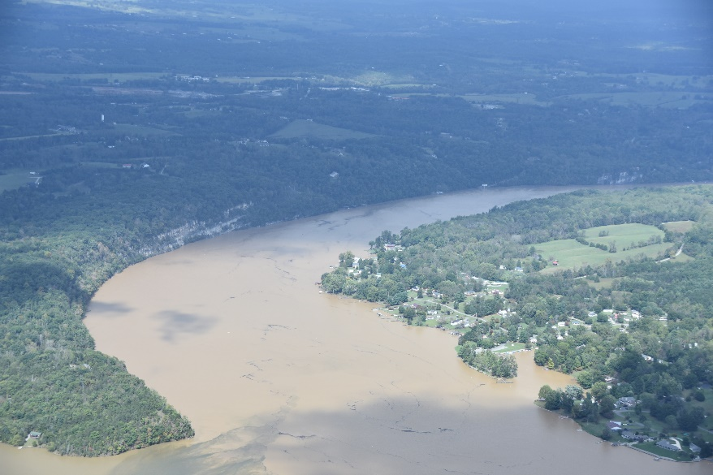
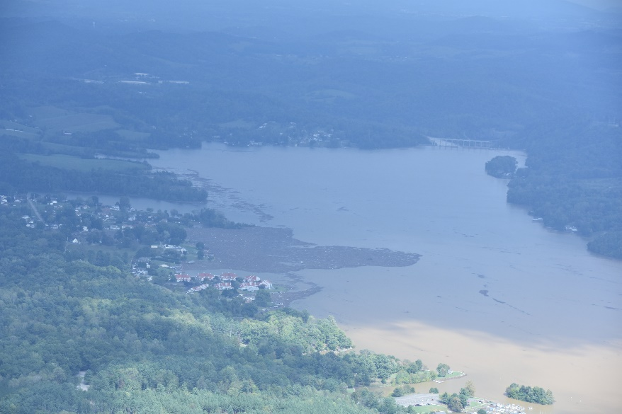
Claytor Lake imagery – good for perspective but not for analysis

Slide 28
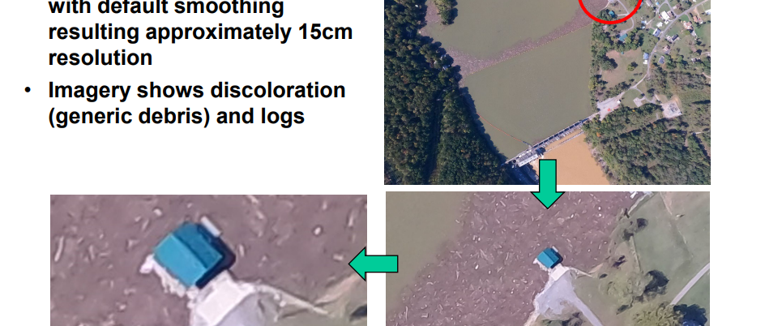
Claytor Lake imagery used for analysis

Slide 29
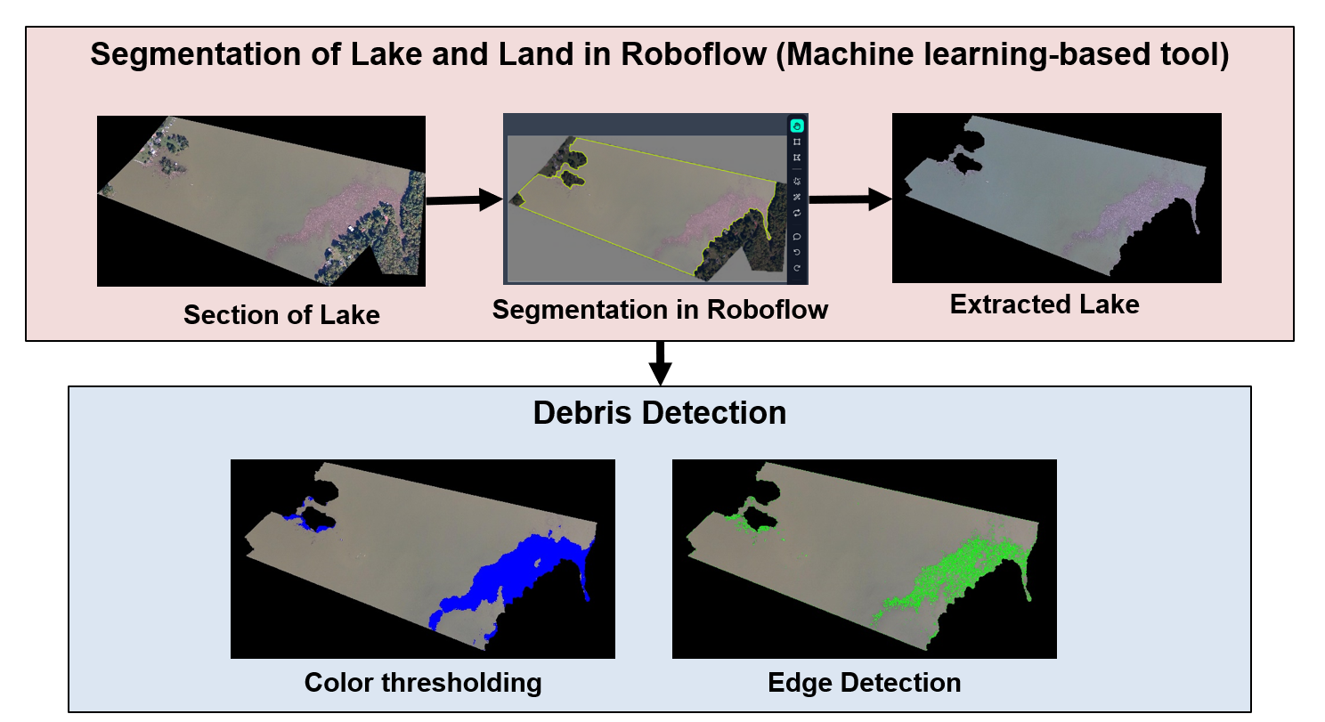
Debris Detection in Claytor Lake

Slide 30
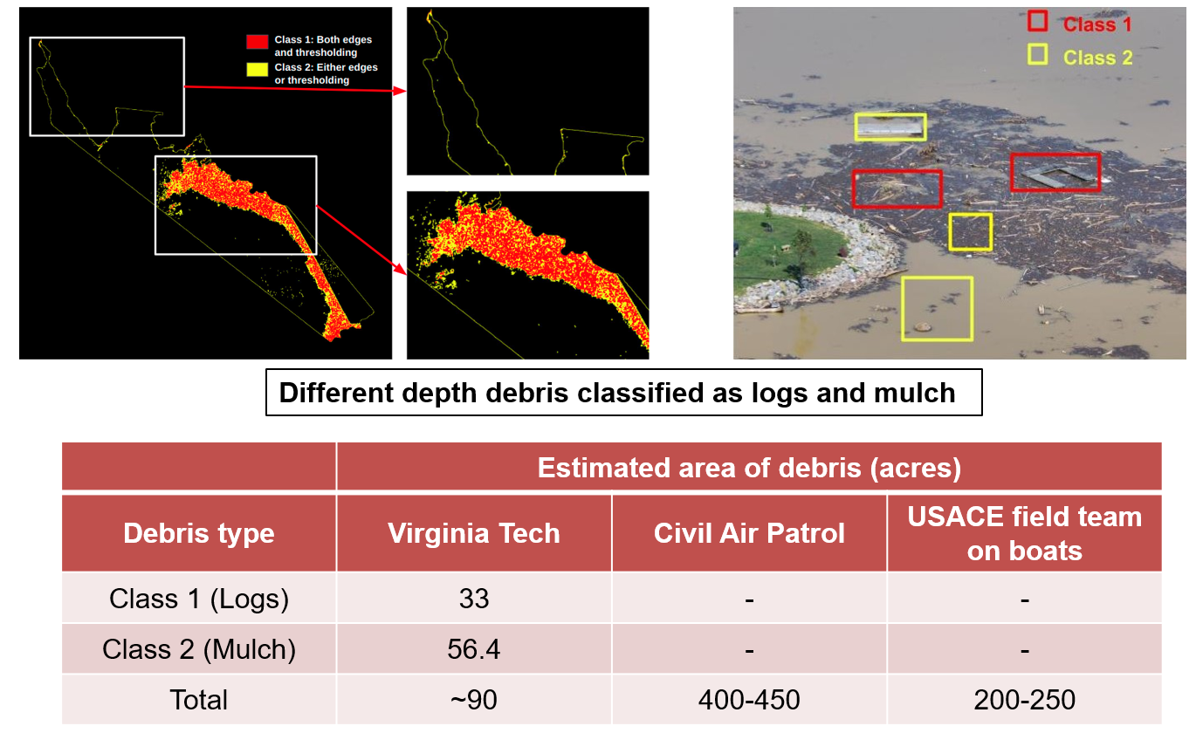
Debris Classification & Area Estimation

Slide 31
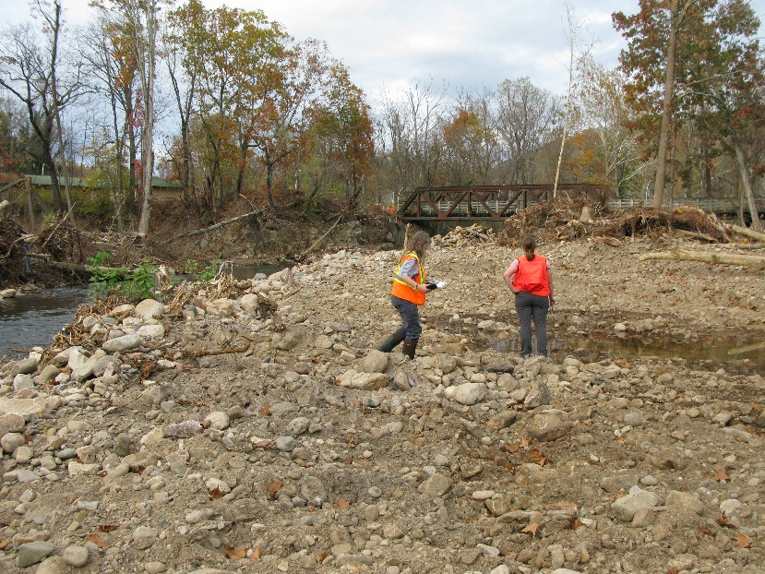
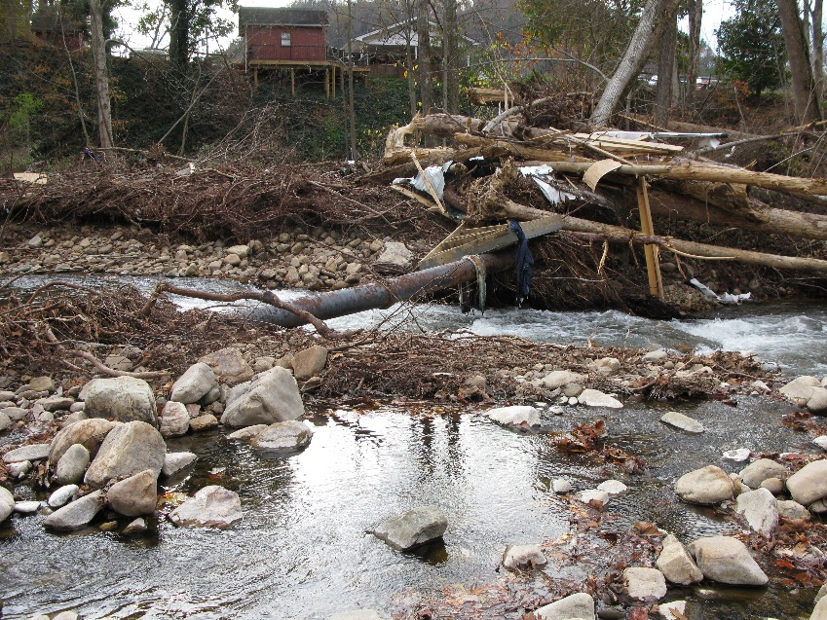
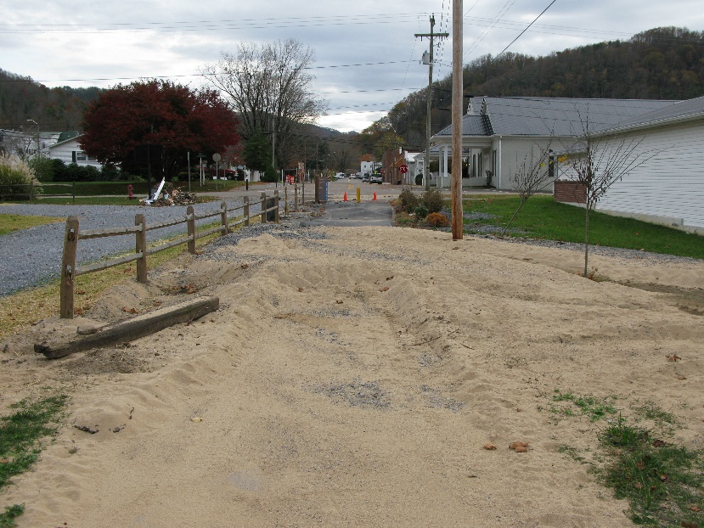
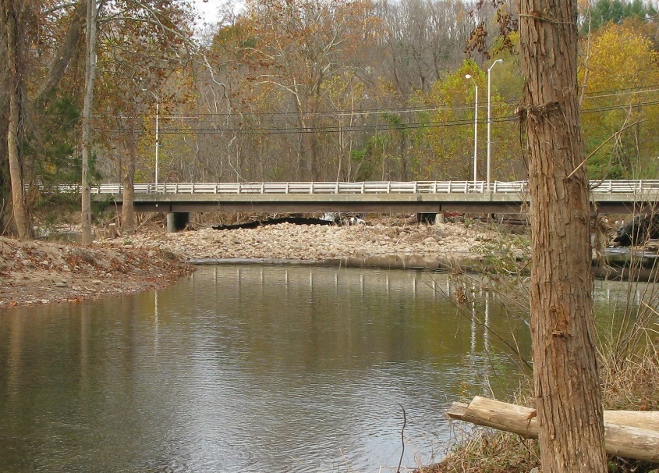
Ground images at Damascus provided perspective but were not useful for analysis

Slide 32
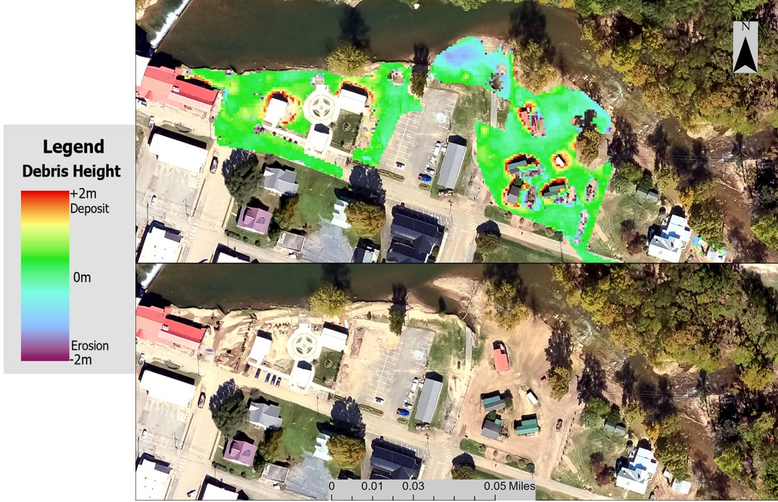
Debris Estimation in Damascus
Compared the 2016 LiDAR data with the DEM data from 3D construction and evaluated the debris height.

Slide 33
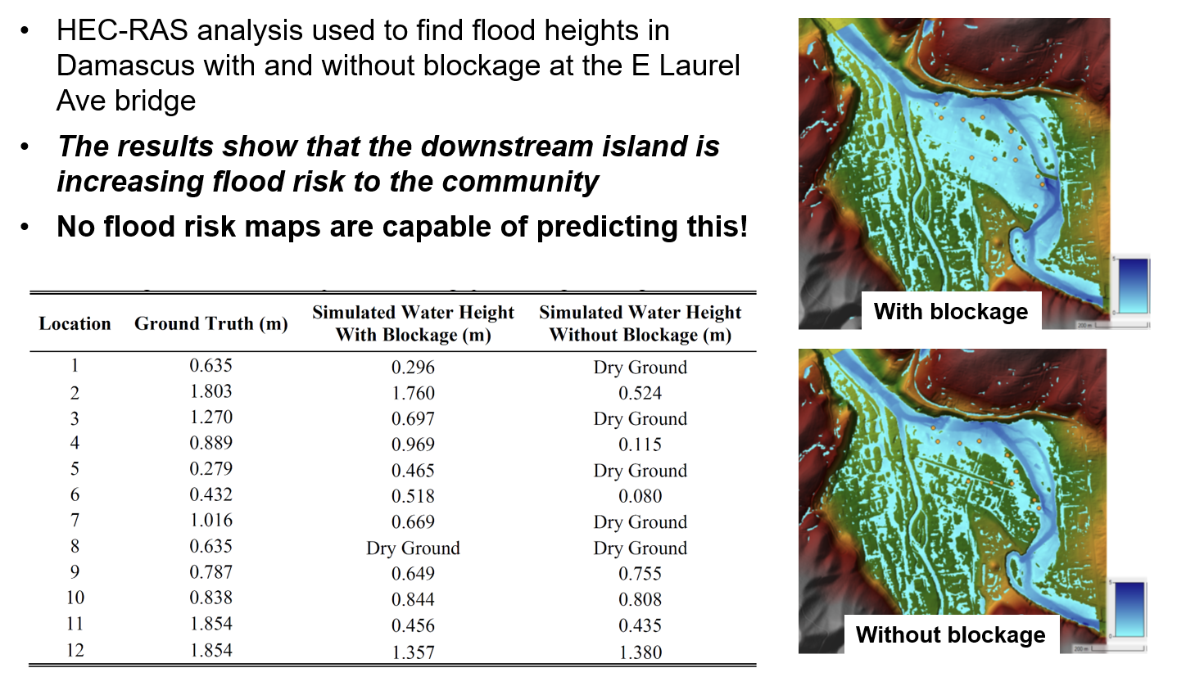
One of the significant outcomes of our analysis was quantifying the blockage in Laurel creek
33

Slide 34
Lessons learned: Benefits to using scientific approach to damage assessments
Need for high-definition aerial imagery
Data analysis to support:
Quick identification of damage to structures and quantification of debris
Assignment of risk category
Prioritization of the recovery efforts
Scoping the work appropriately
Aligning the funding source with the work
Data management and storage

Slide 35




Where to go from here:
Get to know your local emergency manager.
Get involved with local or regional disaster debris planning efforts.
Learn more about how FEMA Public Assistance funding may apply to your organization.
Think about which elements of information your organization needs to navigate disaster recovery successfully.

Slide 36
Questions:
Holly Brown, Program Specialist
Office of Pollution Response & Emergency Preparedness
Virginia Department of Environmental Quality
holly.brown@deq.virginia.gov
804-718-9464

