Slide 1
Elevated Temperature Landfills
SWANA - Old Dominion Chapter
Eric Deibel
Air Compliance Coordinator
Virginia Department of Environmental Quality
October 16, 2025

Slide 2
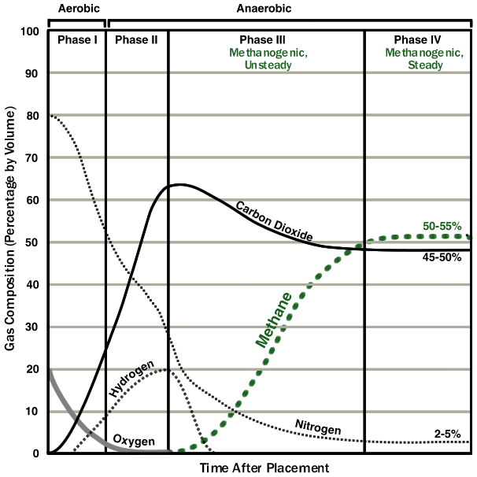
Typical LFG composition after waste placement
The subsurface reaction which causes ETLFs inhibits the normal methanogenic process.
This causes a reversion back to the end of Phase II, including high CO2, low Methane, and Hydrogen in the gas.
Other effects are increased settling of the waste, increased and changed leachate production, odors, slope instability, increased gas pressure from water turning into steam, decreased structural integrity of gas collection components.
Figure adapted from ATSDR 2008. Chapter 2: Landfill Gas Basics. In Landfill Gas Primer - An Overview for Environmental Health Professionals. Figure 2-1, pp. 5-6
Notes:
I will not be going into detail on the CAUSE of an ETLF event in this presentation, because that can be varied, debatable, or unknown. The important thing to know is that SOMETHING triggers the interruption of the normal anaerobic process in the landfill. This could be oxygen, obviously, or heat inhibiting the methanogens. This heat builds up under the surface of the landfill, and since heat dissipates into surrounding areas, it can cause the spread of the ETLF condition over time. Heat inhibits the methanogens, which causes more heat, which spreads and inhibits more methanogens.

Slide 3
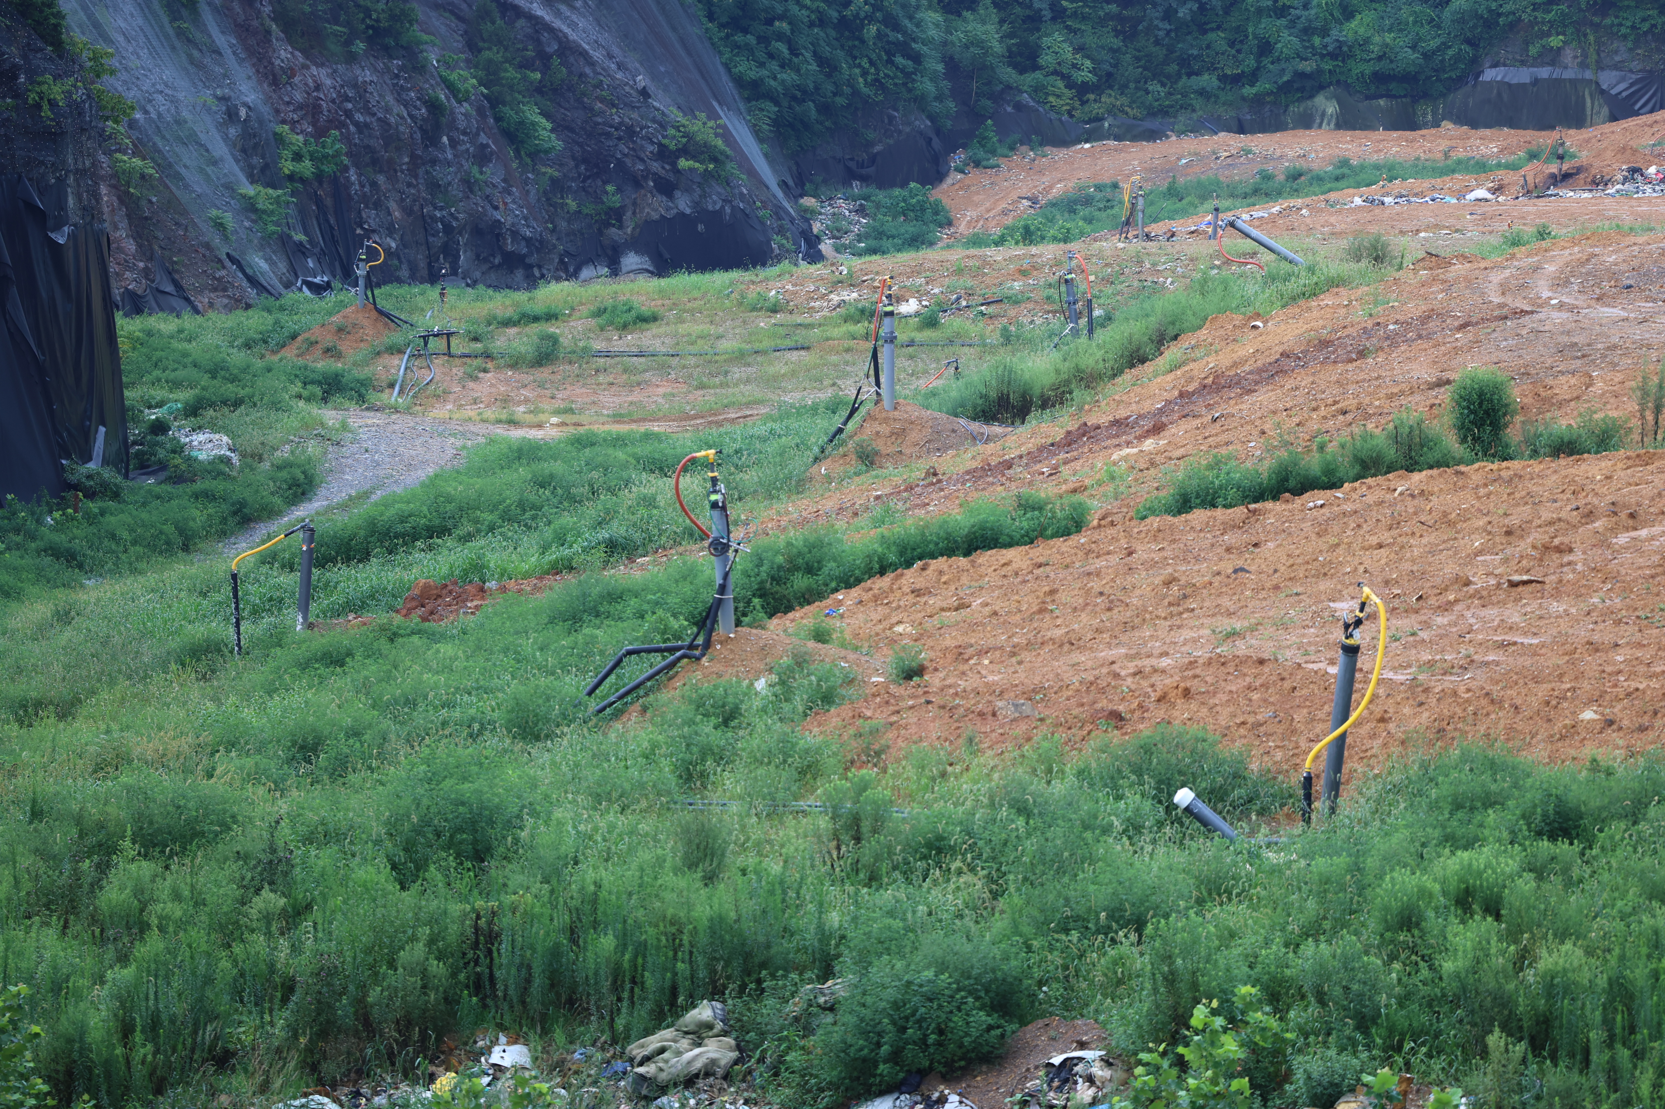
ETLF Identification and Early Indicators
First impact appears to be landfill gas composition:
  More carbon dioxide than methane - CO2>CH4
  Hydrogen – H2
  Carbon monoxide – CO
Next will be increased temperatures and increased landfill gas and leachate generation
Notes:
As outlined in the graphic on the previous slide, early indicators would be a decrease in methane in the landfill gas, and a corresponding increase in CO2. Eventually you will have Hydrogen in the gas, starting at a low percentage and eventually increasing as the condition progresses. Carbon Monoxide increases to potentially over 1,000ppm, but not to the levels that would indicate sub-surface oxidation (fire). None of these parameters are required to be monitored or reported under the federal landfill regulations (NSPS XXX, EG Cf, MACT AAAA) This can make early identification difficult.
Increased temperatures can lag 2 years behind the start of the changes to gas composition. When the temperatures do increase, you’ll request a Higher Operating Value (HOV).

Slide 4
Temperature Higher Operating Values (HOVs)
From NSPS XXX, EG Cf, and MACT AAAA:
“The owner or operator may establish a higher operating temperature value at a particular well. A higher operating value demonstration must be submitted to the Administrator for approval and must include supporting data demonstrating that the elevated parameter neither causes fires nor significantly inhibits anaerobic decomposition by killing methanogens. The demonstration must satisfy both criteria in order to be approved (i.e., neither causing fires nor killing methanogens is acceptable).”
Notes:
The federal regulations allow an HOV if the higher temperature does not cause a fire or inhibit anaerobic decomposition by killing methanogens. An approved HOV for temperature means that you’re allowed to operate a specific gas collection well at the newly established temperature without needing corrective actions.

Slide 5
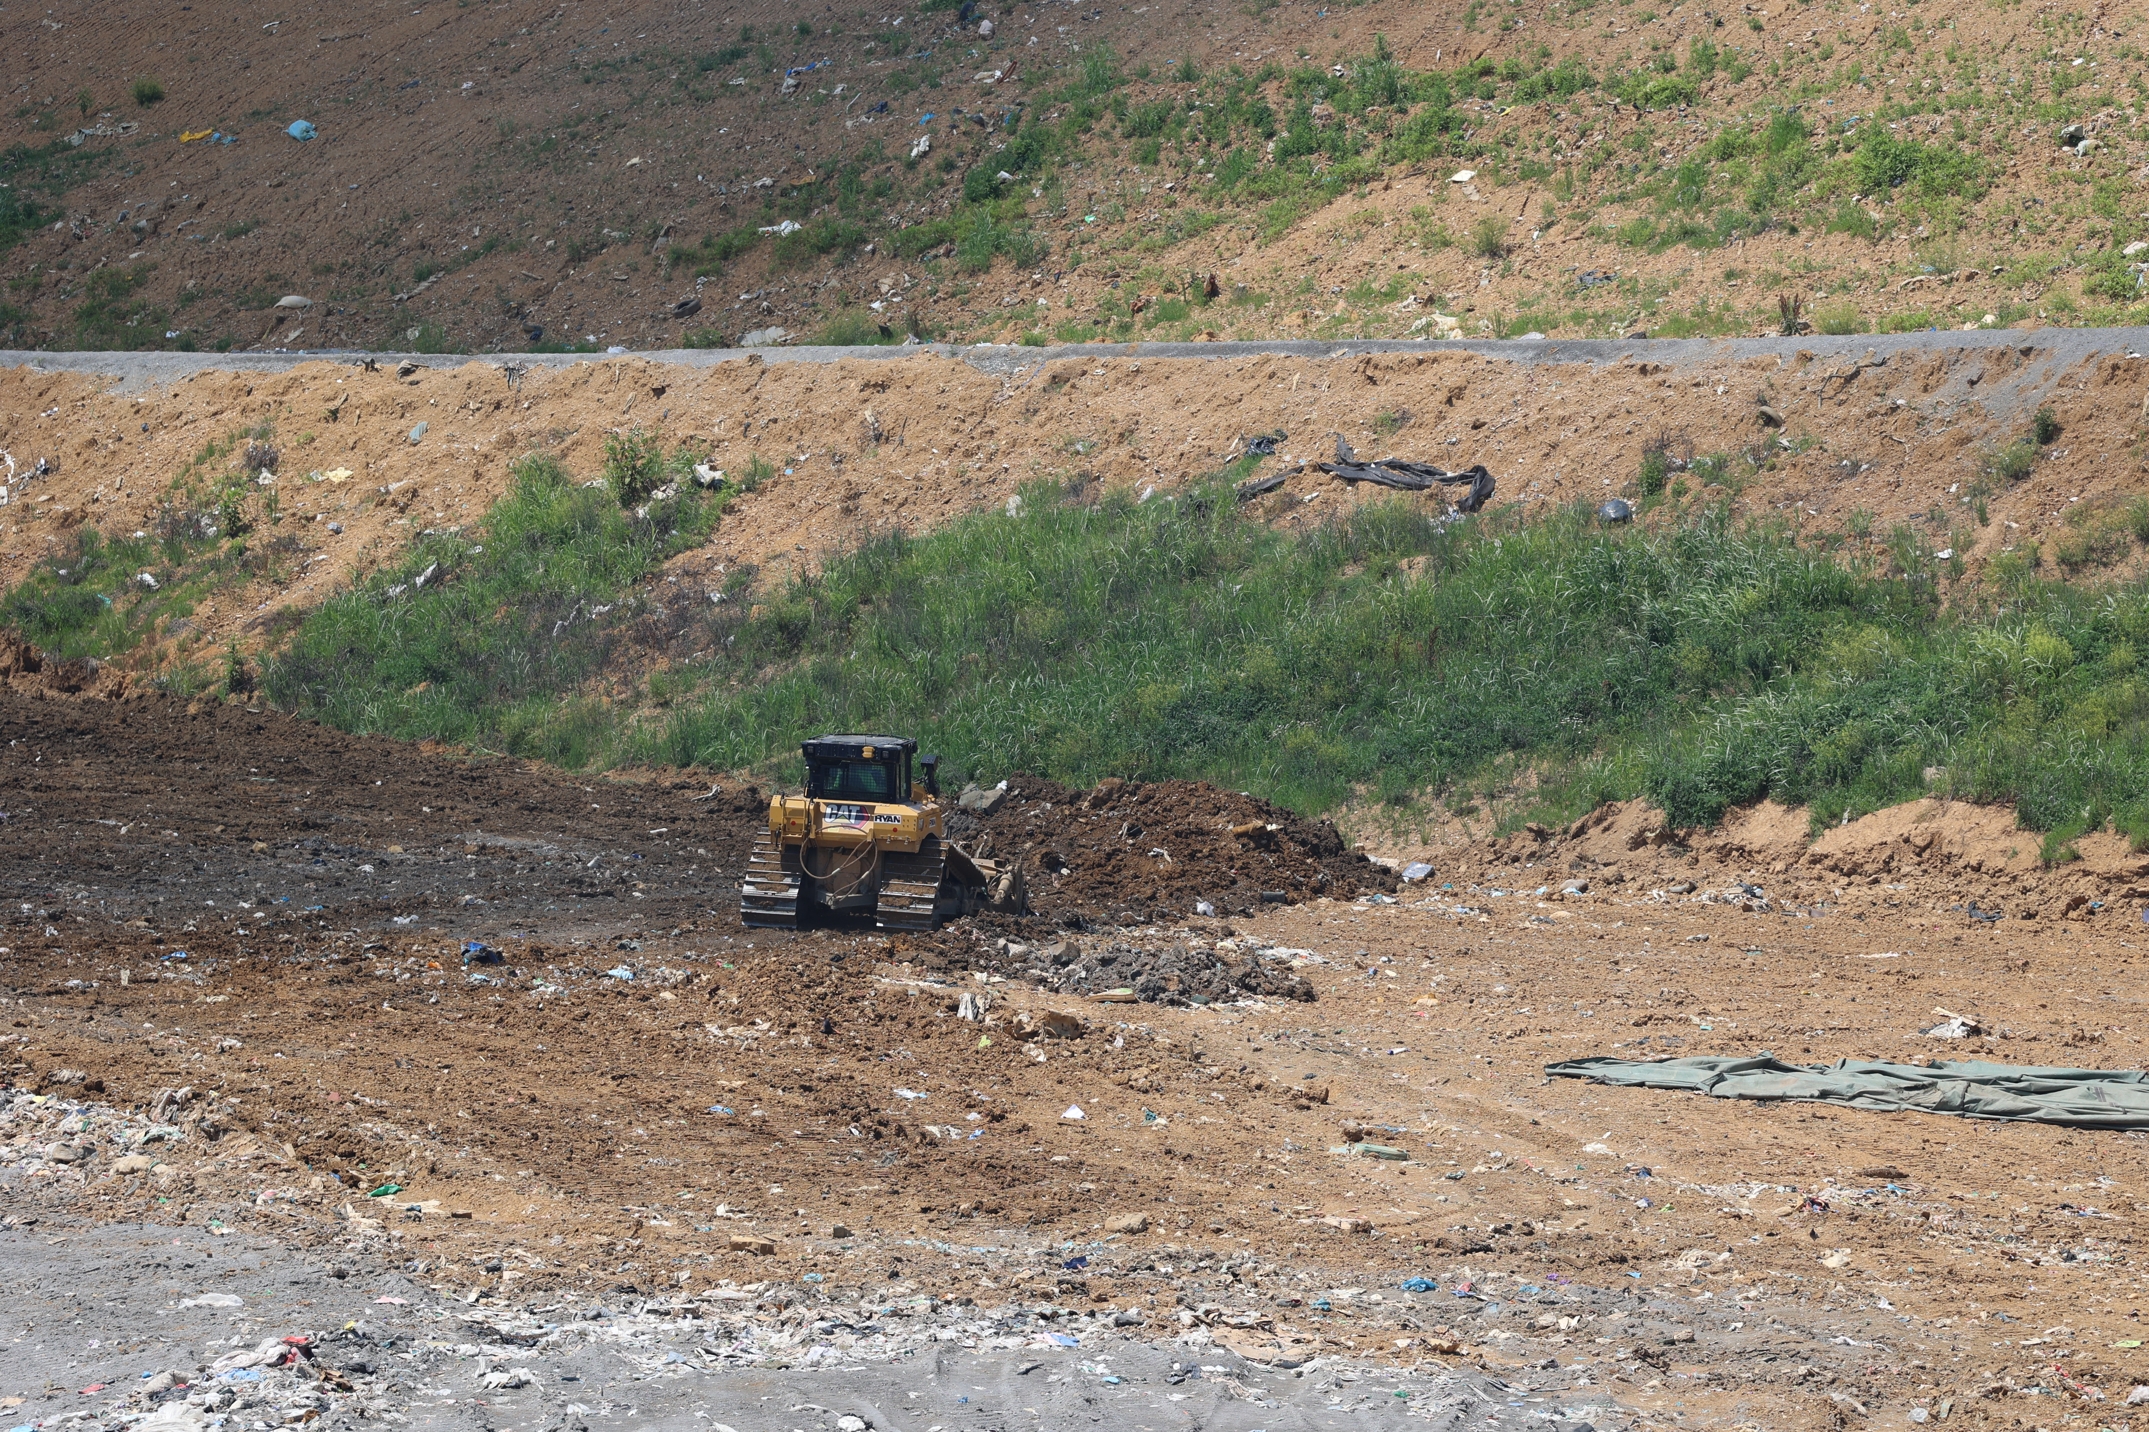
Additional monitoring for HOV Wells
Methane and CO2 monitoring
For higher temperatures:
  H2 monitoring
  CO monitoring
  Down-well temperature Monitoring
  Leachate quantity
  Wellhead gas flow
Notes:
Even with an approved HOV, it would be in your nest interest to keep an eye on those wells. Some parameters you could monitor for that may be in addition to the minimum requirements of the regulations include Methane and Carbon Dioxide. As temperatures increase, you could monitor for Hydrogen, Carbon Monoxide, and down well temperatures. The temperatures down the well can be much higher than the temperature monitored at the wellhead.
An ETLF condition causes increased quantities of leachate.
And measuring the flow of gas at the well heads can check for watered-in wells.

Slide 6
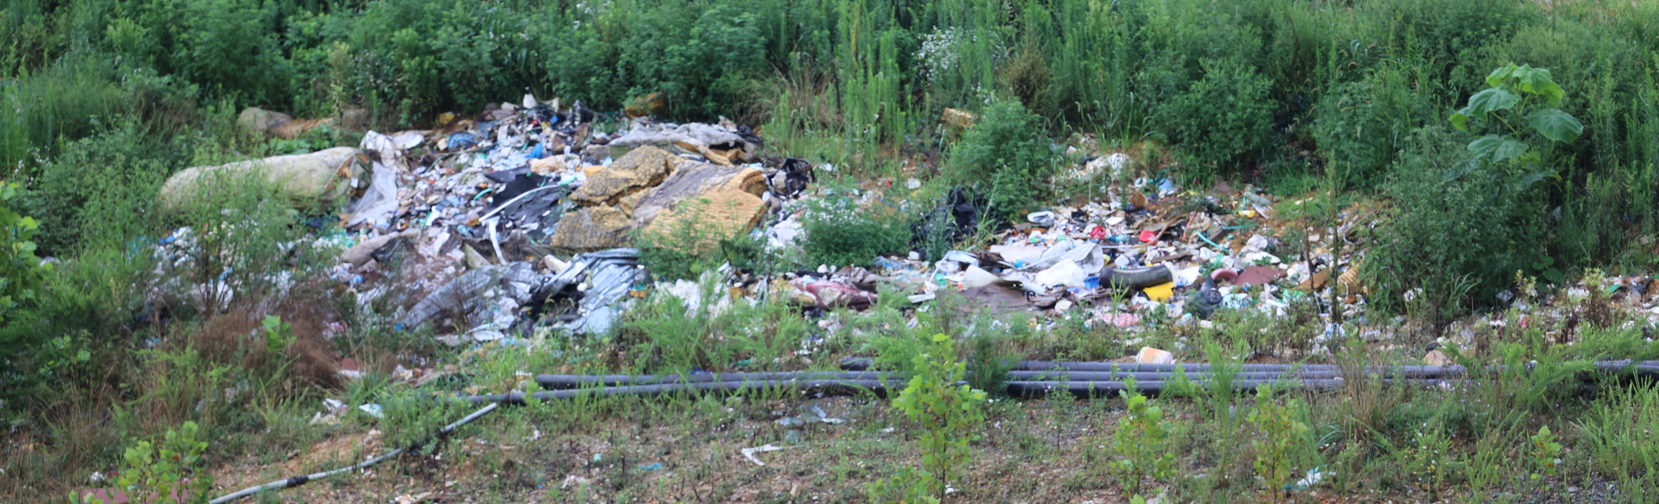
Things you may not have thought about
Notify the Solid Waste and Water divisions of DEQ
Review the details of the Gas Collection and Control System Design Plan
Review Odor Management Plan (if applicable)
Conduct thorough cover integrity checks
Watch for ‘watered-in’ wells in the monthly monitoring data
Notes:
Once a landfill begins having temperatures of 170 degrees or more, there are some things to look into that you may not have thought of. First, you should notify the other media at DEQ. The rapid settlement, odors, and leachate changes are going to be important for them to know about.
Next, you should review the GCCS Design Plan. This plan outlines the materials that you will use to build out your system. These materials likely have an upper temperature limit, so if the landfill is operating above those upper limits, you may want to update the design plan to account for the increased temperatures.
Then, if applicable, review the odor management plan. ETLFs come with increased odors.
With the potential for rapid settlement, paying closer attention to the required cover integrity checks is important. Make sure to repair the cover in a timely manner.
ETLFs generate a much greater amount of leachate. This can often lead to leachate filling a gas collection well until all of the slotted pipe is covered. When this occurs, the well isn’t actually pulling any gas from the landfill. If this happens repeatedly, you can send a pump down the well to remove the leachate, so it can begin collecting landfill gas again. You can also consider if you replace that well, you can replace it with a wider diameter well and install a permanent pump. A few of these spread around the ETLF area can really help manage the leachate levels.

Slide 7
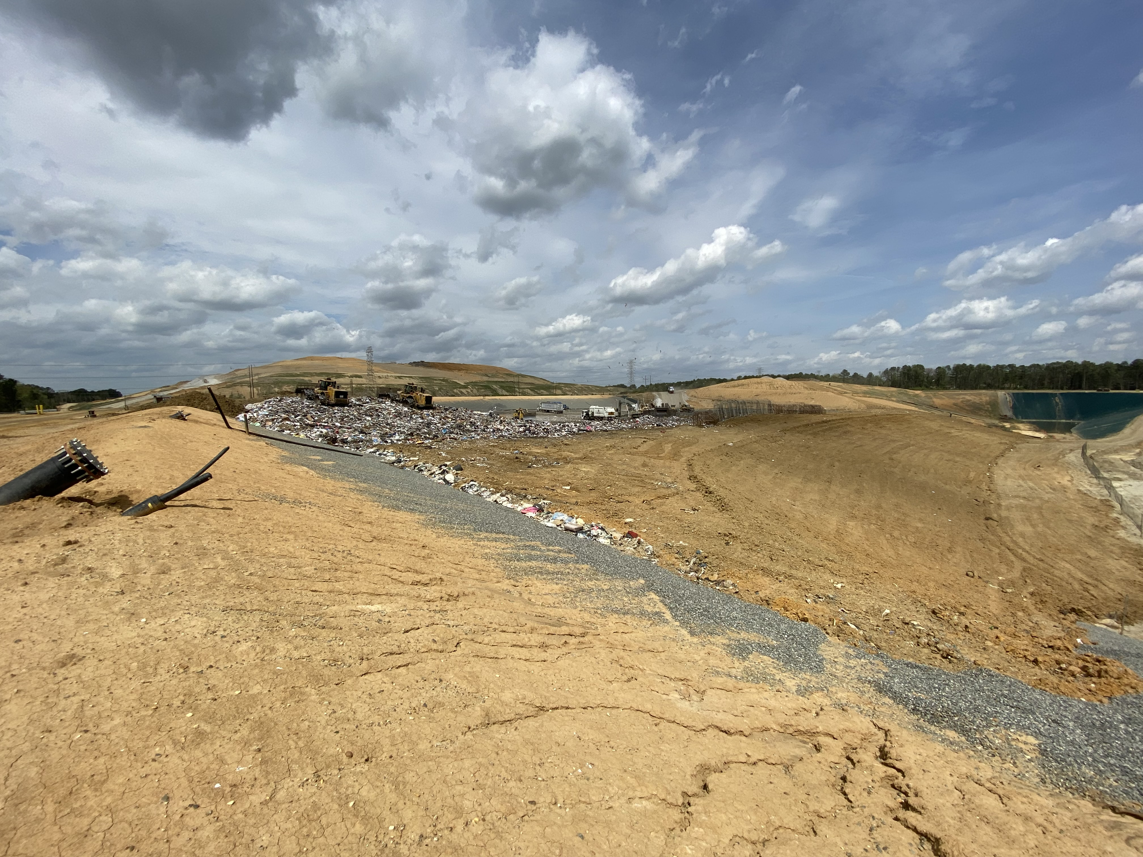
“Late stage ETLF”
Proper gas collection is important to:
  Prevent steam from escaping the surface
  Control odors
  Remove some of the heat
Wells may need to be replaced with materials intended to be used in such extreme heat, like stainless steel.
A geosynthetic membrane will likely need to be applied to control gas leaks and odors. It also prevents additional water intrusion into an already wet part of the landfill.
The landfill will need to stop adding additional waste to any area that could have the ETLF reaction spread to it.
Notes:
I’ve made up this term “Late Stage ETLF”, but what it means to me is a site with multiple gas collection wells over 190 degrees. There is likely an area of significant settlement that has been deemed as unsafe for surface emissions monitoring.
At this point, adequate gas collection is important. Water in the landfill is likely turning into steam. If there is not enough collection, the steam will actually work its way to the surface.
ETLFs have a horrible smell that is nothing like the typical odors you would experience at a landfill. Without adequate collection, these odors can stretch for tens of miles from the landfill.
Also, any removal of heat is good.
The heat of the landfill may melt collection components, which will need to be replaced with something more suitable to the conditions.
While a geosynthetic membrane makes it difficult to keep an eye on the settlement below, it is really the best way to make sure all of the landfill gas is being collected.
Once an ETLF condition gets this bad, it will keep spreading to any surrounding actively decomposing waste. If you continue to add waste to areas where the reaction could spread, you’re just going to prolong the time it will take for the reaction to run its course. If you have space, they can redesign the landfill to add an air break between the impacted area and a new area.

Slide 8
Questions?

