Slide 1


Ag Container Recycling Council (ACRC)
Virginia Dept of Ag and Consumer Services
Training Session

Slide 2
Agenda
ACRC Program Overview
VA Collection
Inspection and Rinsing 101
Related Collection Challenges
Resources
ACRC Website

Slide 3
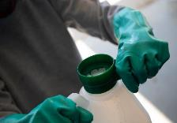
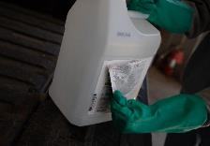
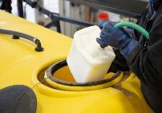
About Us
Ag Container Recycling Council (ACRC)
Ag chemicals industry initiated
Not for profit corporation, formed in 1992
Oldest stewardship program in US
Provides research and funding for Ag container collection and recycling into acceptable end uses
Promotion and education of triple and pressure rinsing
Collaboration with EPA
Developed ANSI / ASABE S596 Standard
Containers Contained. Agriculture Sustained.

Slide 4
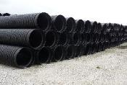
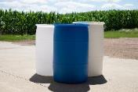
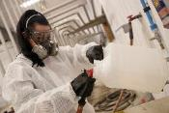

Our Mission
Research
Support
Promote
Potentially acceptable end uses of recycled HDPE plastic ag containers.
Collection and recycling of HDPE plastic agricultural containers through cost-effective programs
Public health & safety
Environmental protection
Resource conservation
End user convenience
We Collect…
55 gallons or smaller,
HDPE plastic agricultural containers:
Pesticides
Fertilizer
Animal health
Specialty pest control
Biologicals
Adjuvants
Industry Funded
free service to
Farmers
Commercial applicators

Slide 5
Program Scope
7 Contractors (6 private, 1 state - MT)
1 independent state sponsored programs (PA)
47 states covered (excl. AK, state sponsored programs)
Collection site scenarios:
On farm, retail outlets, aerial and ground applicator locations, pest control applicators, state ag extension locations, solid waste landfills, golf courses, nurseries
Product scope: HDPE plastic 55 gal drums and smaller:
Pesticides, animal health, micronutrient, biologicals, biostimulants, fertilizer, and/or adjuvant product containers.
Market scope: Professional ag and non-ag markets:
Crop protection, aquatics, forestry, nursery & greenhouse, public health, structural pest control, turf & ornamental, vegetation management.

Slide 6
Our Members

Slide 7
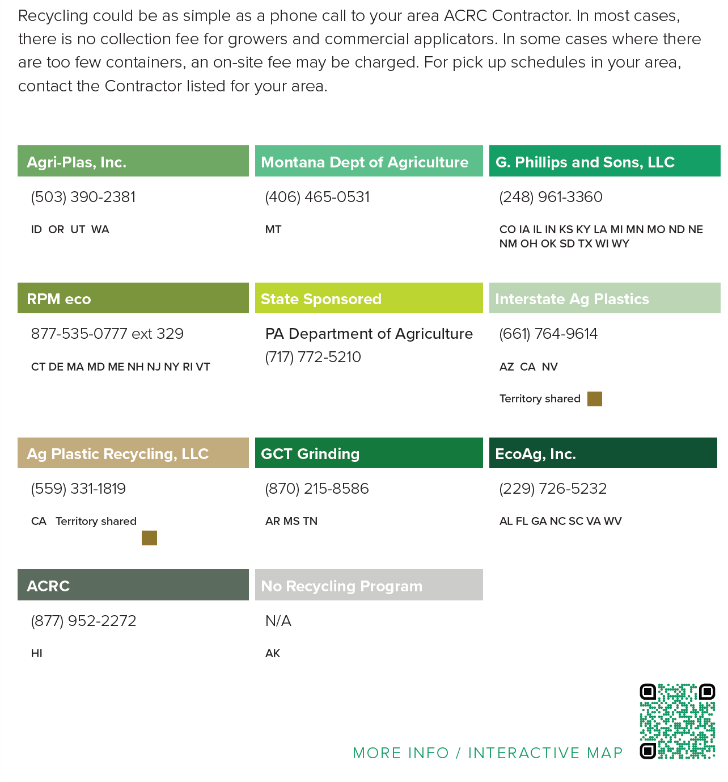
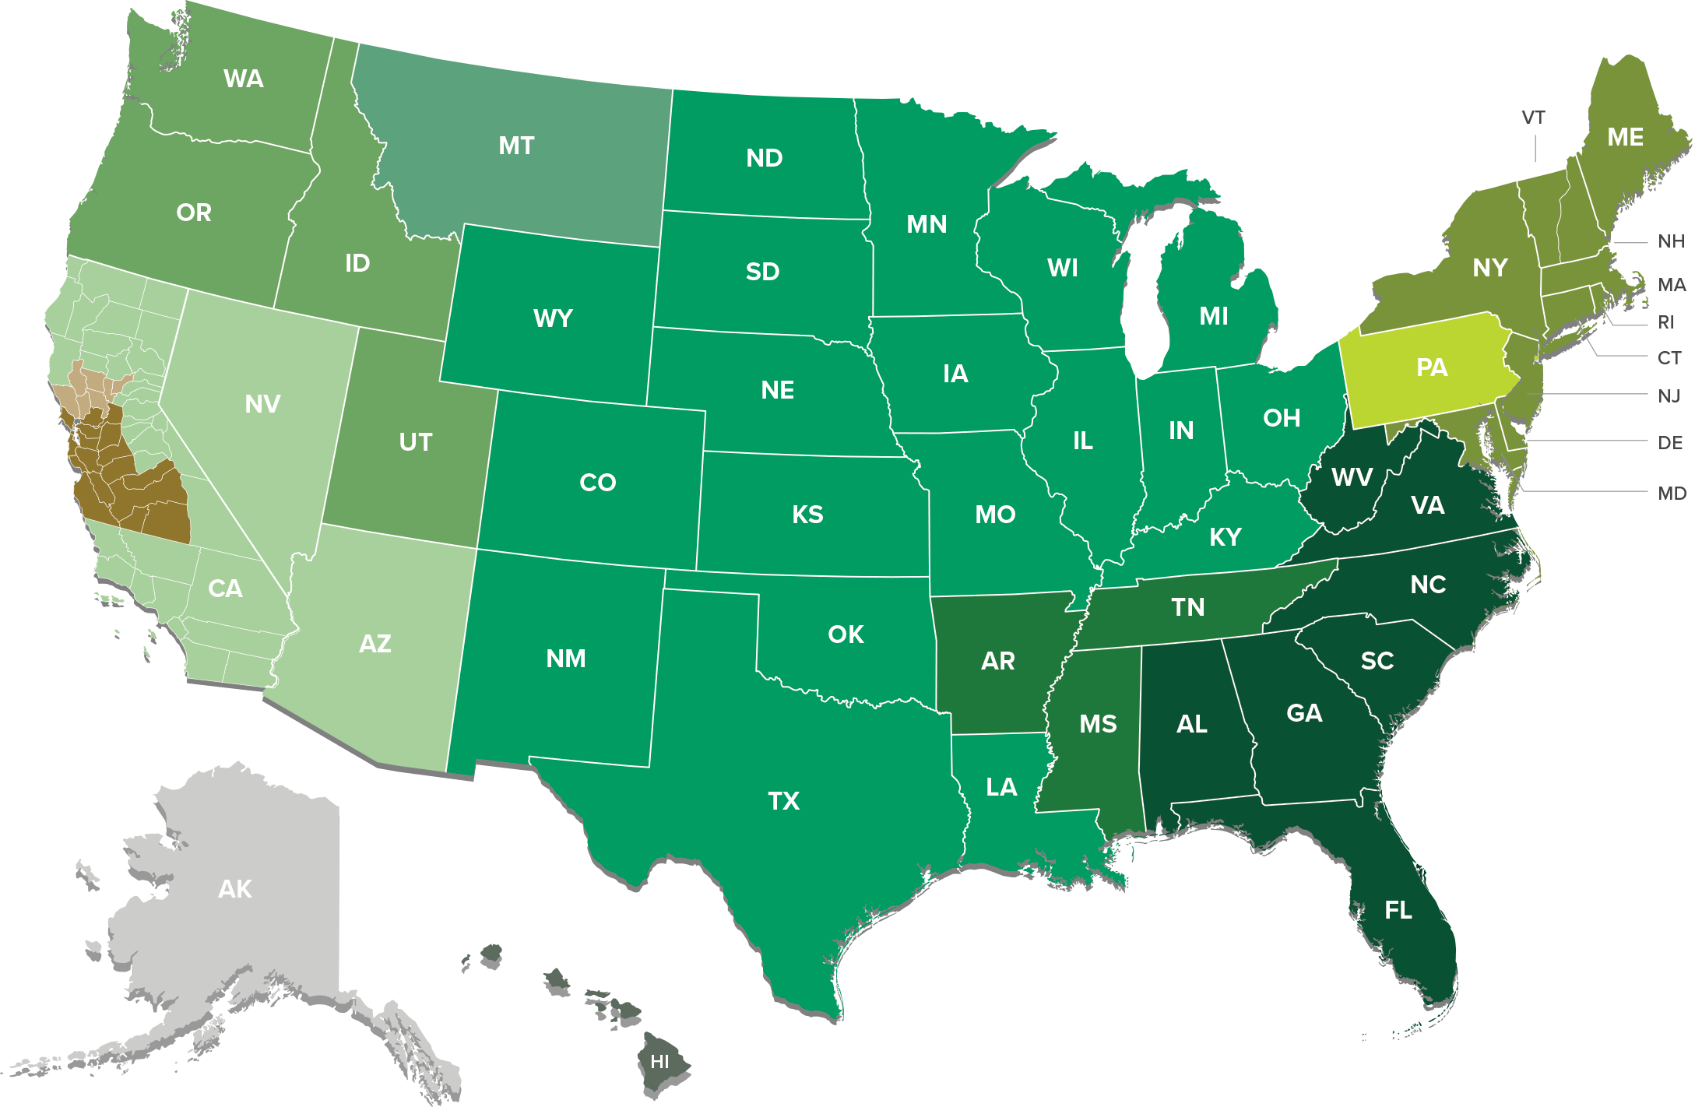
Contractor Territories
Contractors
Regional Container Recycling Map

Slide 8



Northeast Territory Contractor
ACRC Territory Contractor
EcoAg, Inc.

Slide 9

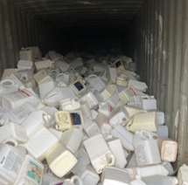
Access to Containers
Driving access for truck
Location of containers clearly communicated
Crew access to containers
Safe access and environment
Storage unlocked or accessible

Slide 10
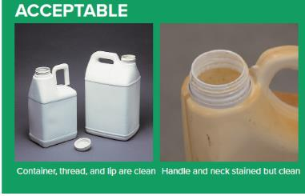
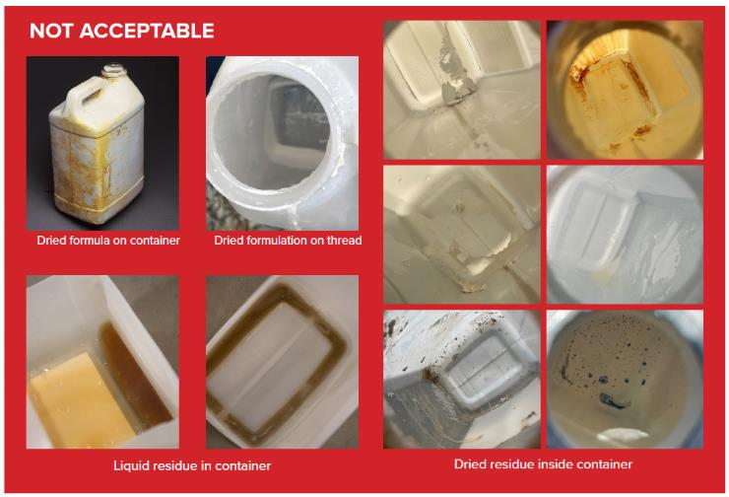
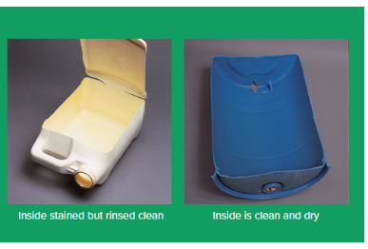
Inspection Criteria

Slide 11



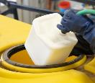
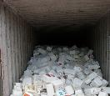
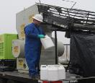

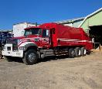
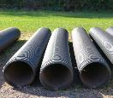
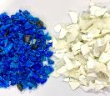


Collection Journey
1
Rinse
2
Store
3
4
Inspect
Collect
5
Recycle
Grind
6

Slide 12
General Funding Model
Voluntary membership funded by producers & registrants of chemicals sold in HDPE containers.
Annual survey of members provides pounds HDPE sold.
Annual budget / annual pounds = annual dues ($ / Lb.)
Each member pays “fair share” of budget based on their HDPE pounds sold.
Over $134M funded by ag industry since inception.
Cost to grower / applicator is zero!

Slide 13
Program Achievements – 1993 - 2023
Notes:
have 3.22 million lbs. at the end of 2024!
Equivalent to 893 miles of 6” ag drain tile
Equivalent to almost 12,000 cubic yards of landfill space saved
Equivalent to reducing 273 vehicles off the road
Equivalent to almost 420,000 gallons of gasoline
Equivalent to 943 household’s annual energy used
Leigh O’Neill
Recycling End Use Manager
Ag Container Recycling Council
952-334-1855

Slide 14

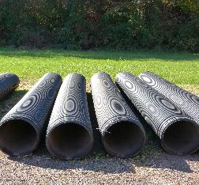
Existing Approved End Uses
Agricultural Drainpipe
Ag Chem Composite IBC Base Plates
Cinder Blocks
Ground Protection/Construction Mats
Highway and Agricultural Fence Posts
Highway Signposts
Industrial Pallets for Ag Chemical and Seed Packaging
Landscape Edging
Pallets for a Variety of Industrial B2B Applications (Contact ACRC)
Nursery Pots
Plastic Lumber – Must meet design specs (Contact ACRC)
Rebar Chairs
Spool Flanges for Wire Cable
Underground Utility Conduit

Slide 15
Inspection & Rinsing 101

Slide 16
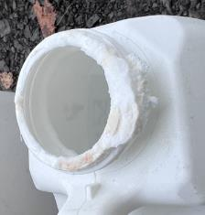
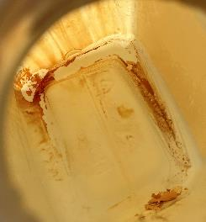
#1 Threat to Container Recycling
Inadequate rinsing of containers
Liquid inside
Wet / dry residue inside
Wet / dry reside outside
Mouth / threads of container
What are the risks and impacts?
EHS hazards at collection areas (trailers, staff, soil, etc.)
EHS hazards to downstream parties
Non-grower collection site owners (retailers, landfills, extension, etc.)
Transportation
Grinding operations
Financial – Inability to recycle / sell plastic
Waste – inevitably ends up in landfill

Slide 17
Container Acceptance Standards
Definition of CLEAN:
Triple Rinsed or Pressure Rinsed, according to product label
99.99% clean - Required by law - EPA 40 CFR 156.146; 165.25; 2006 Container and Containment Rule
No residue inside or outside container, including container mouth or threads
Staining is OK, Residue is NOT
Residue means if you wipe with the finger of a glove, material comes off (“black glove” test)
No rinsate or water in container
Puncture bottom of container to drain/dry properly after rinsing
Other ACRC Requirements:
Rigid HDPE container, 55 gallons or smaller
Professional-use product containers only (non-household)
Remove, rinse and dispose of cap in the trash
Remove label booklet; base label may remain
Remove bungs and all other fittings from drums or other types of containers
CLEAN MEANS CLEAN, WITH NO RESIDUE SEEN!!

Slide 18
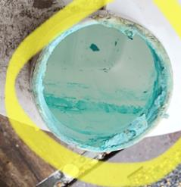
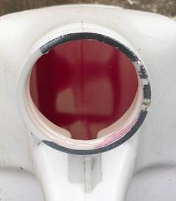
Action Plan – How to Improve
Educational Tools
Inspection Checklist
Rinsing Best Practices
Written Procedures
Video Procedures
Spanish Translations
Physical Rinsing Tools
Promote on ACRC website and brochures
Discussions with AquaTools about product suggestions
Training Support & Promotion
Video conference / Zoom
Grower meetings
Pesticide applicator training
State agency program meetings
Retail member collaboration and training

Slide 19

Training Resources
All available from ACRC !!
Inspection Checklist
Rinsing Best Practices
CLEAN means CLEAN poster
Not Acceptable Photos
Rinsing Tools
Rinsing Procedures:
Jugs
Drums
IBCs
All Available in English and Spanish !!

Slide 20
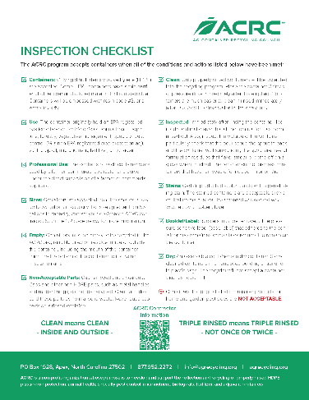
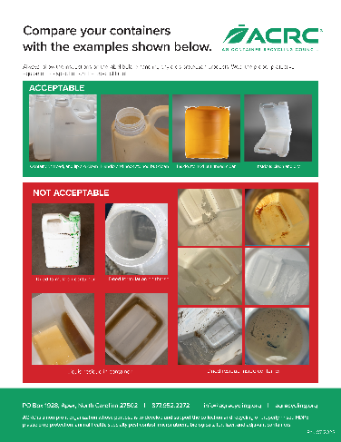

Inspection Checklist
Updated with more “NOT ACCEPTABLE” photos and new taglines
Spanish Translation
available!

Slide 21
Inspection Checklist
KEY POINTS OF EMPHASIS:
HDPE, 55 gal or smaller
Professional use products ONLY
Empty of all product
CLEAN means CLEAN!
Inside / outside
Triple rinsed – more if still not clean!
Not once or twice!
Also can pressure rinse
Stains are OK, residue is NOT
Throw away caps, bungs, or fittings
Remove label booklet
Drained of ALL rinsate
“NOT ACCEPTABLE” PHOTOS SAY 1000 WORDS !!

Slide 22
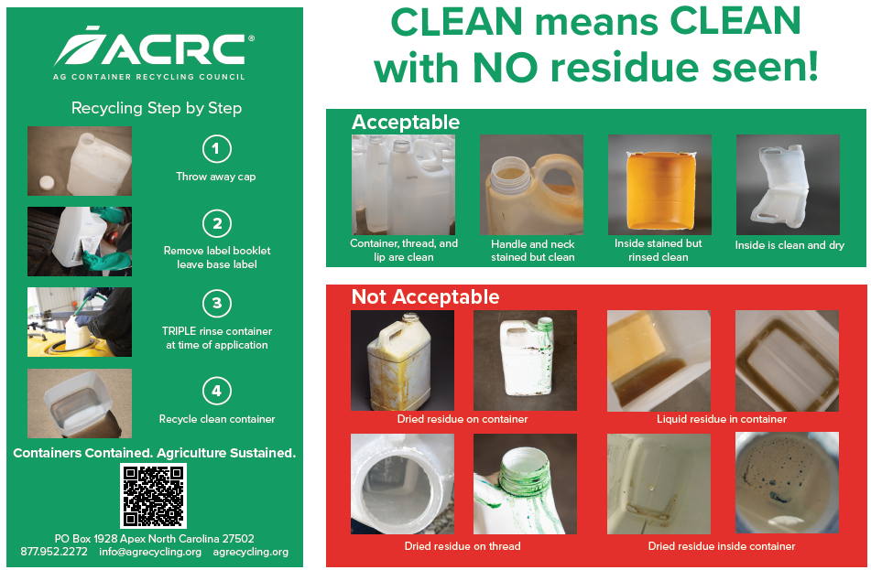

CLEAN means CLEAN Poster
SCAN TO ORDER A POSTER
Clear instructions, designed for posting at collection sites, including at Ag retail locations!
Water-proof material; 2 Sizes available
Spanish Translation available!

Slide 23
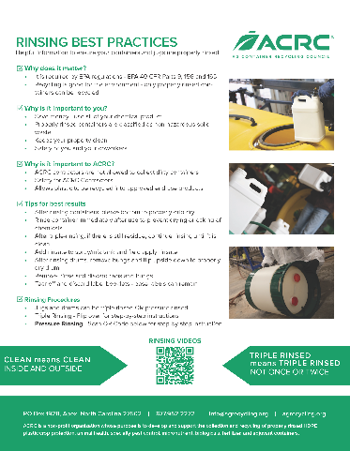
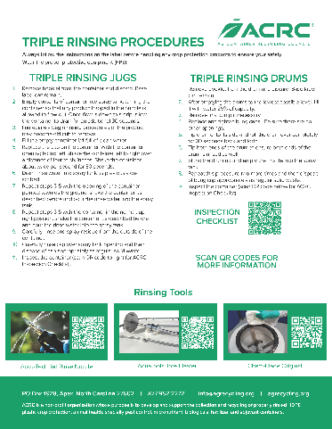

Rinsing Best Practices
Improved communication of expectations and instructions
Includes rinsing tools
Spanish Translation available!

Slide 24
Rinsing Best Practices
KEY POINTS OF EMPHASIS:
Required by law per EPA 2006 Container and Containment Rule
Required by law per EPA 40 CFR 156.146; 165.25
ACRC contractors are not allowed to collect dirty containers!
Improves your return on your chemical investment
Properly rinsed containers are classified as clean, solid waste (non-haz)
USE ALL OF THE PRODUCT – good financial sense!
Rinse container immediately…don’t allow drying and caking!
Rinsate should be clean and WATER CLEAR
Add rinsate to the mix tank and field apply all rinsate!
Use proper rinsing tools and procedures
After rinsing jugs – pierce bottom of the jug to drip dry
After rinsing drums - remove drum bungs and flip upside down
After rinsing IBCs – keep IBC valves open
Remove / rinse caps, bungs and label booklets – discard in trash
Base labels can remain
Inspect the container per ACRC inspection checklist
CONTINUE RINSING UNTIL CLEAN !!

Slide 25



Rinsing Tools
Pressure Rinsing: Jugs
Axiom Products
Accu-Tech Jet Rinse Triple-Rinse Nozzle
https://axiomproductsusa.com/accu-tech/jet-rinse/
Connects to a conventional garden hose!

Slide 26
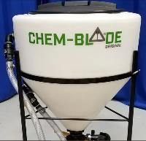
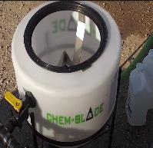
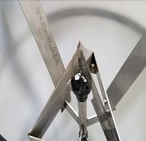
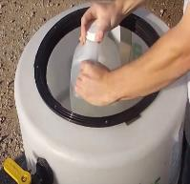
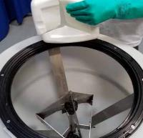

Rinsing Tools
Pressure Rinsing: Jugs
Chem-Blade Original
https://chemblade.com/chem-blade-original

Slide 27
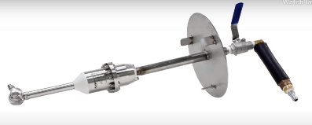
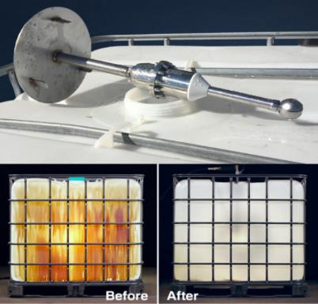

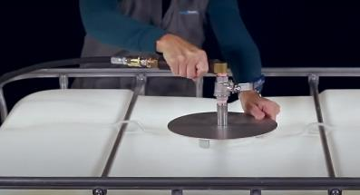
Rinsing Tools
Pressure Rinsing: Drums & IBCs
AaquaTools ToteBlaster LT
https://aaquatools.com/products/rotary-spray-jet-heads/toteblaster-lt/

Slide 28
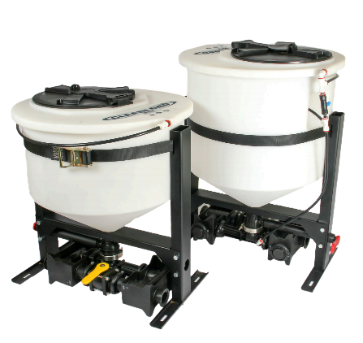
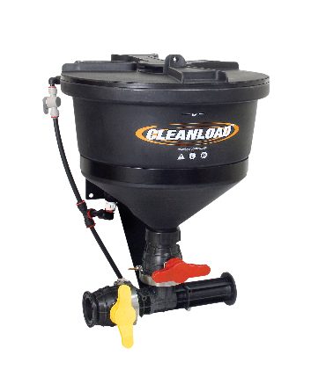

Rinsing Tools
Pressure Rinsing: Jugs
Pentair Cleanload
https://www.pentair.com/cleanload

Slide 29

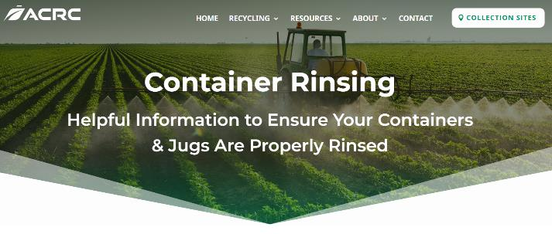
Rinsing Procedures
Procedure Resources:
https://www.agrecycling.org/recycling/container-rinsing/
Pressure Rinsing
Small containers
Drums
Triple Rinsing
Small containers
Drums

Slide 30
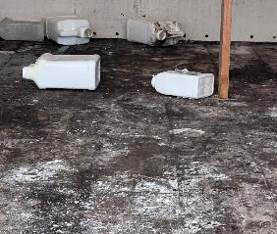
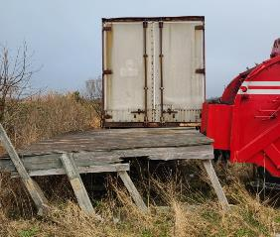
Related Collection Challenges
Unmonitored / unsecured collection sites
Contaminated storage areas
Slippery floors
Unsafe access for contractor crews
Fumes / Odors
Dirty containers in bags contaminate other containers
Can’t have these issues at collection sites !!

Slide 31

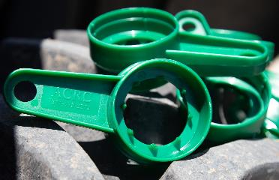
Resources Available
Informational brochures
Training brochures – English / Spanish
Posters – English / Spanish
Cap Seal Removers

Slide 32
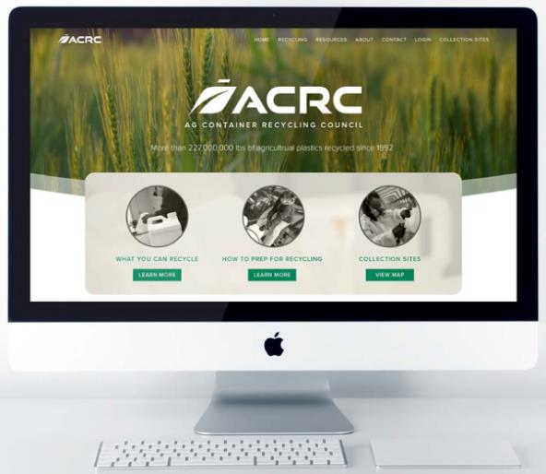

Learn More at Our Website
www.agrecycling.org

Slide 33
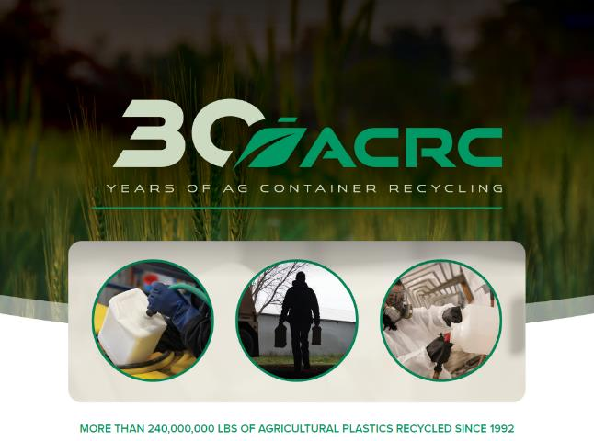
Thank You
Q & A ??

