Slide 1
SWANA Regulatory Training
SWIFR, SWIA, Litter & Recycling Updates
Sanjay Thirunagari
Programs Manager – Waste Planning, Data & Reporting
October 16, 2025

Slide 2



Background: Solid Waste Infrastructure for Recycling (SWIFR) Grant
EPA Funding
DEQ SWIFR Projects
State Recycling Rate
EPA funding for states to improve post-consumer materials management programs
Statewide solid waste management plan
Recycling data collection and analysis application
Virginia’s statewide recycling rate for CY2024 is 39.5%
Notes:
- EPA announced funding for solid waste infrastructure for recycling grants, also known as SWIFR
- The funding was for states to improve post-consumer materials management programs
- DEQ applied for and received the SWIFR grant and intends to use it for the development of a new statewide solid waste management plan and for the development of a recycling data collection and analysis online application
- EPA has a goal of getting to 50% recycling goal by 2030 so in context, Virginia’s statewide recycling rate currently stands at 39.5%

Slide 3
Statewide Solid Waste Management Plan (SWMP) Development

Slide 4




Background: Current Statewide SWMP + Future
Developed in 1979 in accordance with the 40 CFR 256 Final Rule, Guidelines for Development and Implementation of State Solid Waste Management Plans
1979 Plan defined the policies, goals, and objectives of the State with regard to resource recovery and solid waste disposal practices
Several regulations have been promulgated to implement waste management hierarchy, increase recycling and permit solid and hazardous waste facilities
DEQ aspires to produce a statewide SWMP that reflects the current needs of the industry and serves as a road map for the future
Notes:
The 1979 Plan included two key elements: Develop list of Open Dumps in Virginia (meeting the federal criteria) and require groundwater monitoring at selected landfills

Slide 5
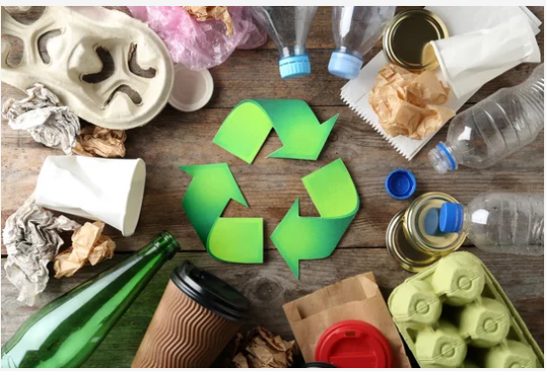
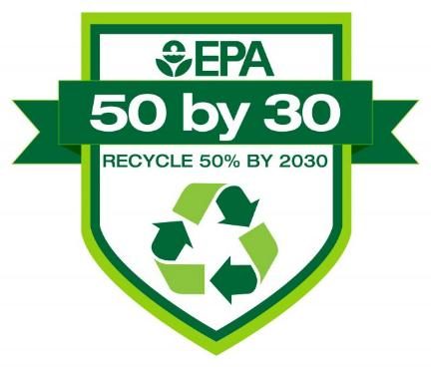
Virginia SWMP Goals
Solid Waste Proposed Plan Period: 2026 - 2046
Develop or update plans to advance post-consumer materials management
Develop, strengthen, and/or implement comprehensive data collection efforts that demonstrate progress towards: National Recycling Goal (50% by 2023) National Food Loss & Waste Reduction Goals (50% by 2030)
Reflect the current needs of the industry and serves as a road map for the future

Slide 6
Key Contracted Activities to Support Statewide SWMP Development
Identify current applicable Virginia statutes, regulations, and existing plans
Research statewide solid waste management plans for other states
Current strategy and/or activities associated with post-consumer materials management in the state, including all materials in the municipal solid waste stream
Current measurement and tracking capability and authority and identification of additional needs
Identify stakeholders who will play a role in meeting the objectives of the plan
Plan for addressing the needs of disadvantaged communities in the state
Plan for making progress toward goals and/or targets

Slide 7
Key Contracted Activities to Support Statewide SWMP Development
Clearly defining the waste streams being measured
Identifying specific materials being measured and appropriate units
Detailed data and methodology citations
Developing information to understand the contamination of recyclable material streams
Identify clear connections to circular economy, climate goals, and action plans
Identify administration, legal and/or financial needs or gaps to be addressed in order to meet goals or milestones
Strategy for including resiliency & natural disaster debris into plans by utilizing available guidance to manage disaster debris

Slide 8

SWMP Development – Tasks & Timeline
Task 3
Facilitation & SWMP Outline
1st & 2nd Quarters 2025
Task 5
Public Comment Period & SWMP Revisions
4th Quarter 2025
Task 1
Project Kick-Off
December 2024
Task 2
Baseline Assessment
1st & 2nd Quarters 2025
Task 4
Content & Draft SWMP
2nd & 3rd Quarters 2025
Task 6
Final SWMP
4th Quarter 2025

Slide 9
Recycling Rate Report (RRR) Online Application Development

Slide 10
Recycling Rate Reporting Online Application Development
Code of Virginia Statute: § 10.1-1411
Recycling Requirements Regulations: 9VAC20-130-125 – Mandatory required rates and recycling rate calculation
Recycling Data Reporting Regulations: 9VAC20-130-165 – Frequency of reporting and deadline to report
Currently, all recycling rate reports are submitted to DEQ in an Excel spreadsheet format
Tracking, data analysis, and statewide rate calculations are performed manually using spreadsheets
Intent is to make the reporting and review process easy on both the reporting entities and DEQ

Slide 11
RRR Application Project Roles
EPA
DEQ
Windsor
SWIFR funding
Workplan compliance
Guidance and scope
Review and testing
Project management
Other responsibilities per workplan
Form development and database integration
Project deliverables
Technical support

Slide 12
RRR Application Development – Tasks & Timeline
Task 3
Integration Development
June 2025
Task 5
System & Acceptance Testing
September – October 2025
Task 1
Project Kick-Off
May 2025
Task 2
Implementation Design
May - June 2025
Task 4
Internal Forms Architecture
June - August 2025
Task 6
Final Product Implementation
October 2025

Slide 13
Solid Waste Information & Assessment (SWIA)

Slide 14
SWIA Reporting for CY2024
Who should report - All permitted solid waste management facilities that received and managed solid waste during the previous calendar year
All solid waste management facilities with remaining disposal capacity should report (excluding those in post closure)
CY2024: 199 permitted facilities reported
CY2024 annual report currently under review with OSHNR
DEQ statewide report due by October 30th
Report is available on DEQ website: https://www.deq.virginia.gov/home/showpublisheddocument/24299/638551795838170000

Slide 15
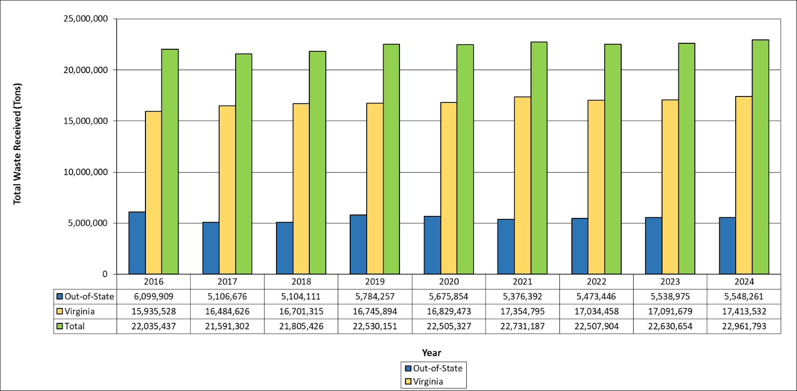
Solid Waste Received by Virginia Facilities (2016-2024)

Slide 16
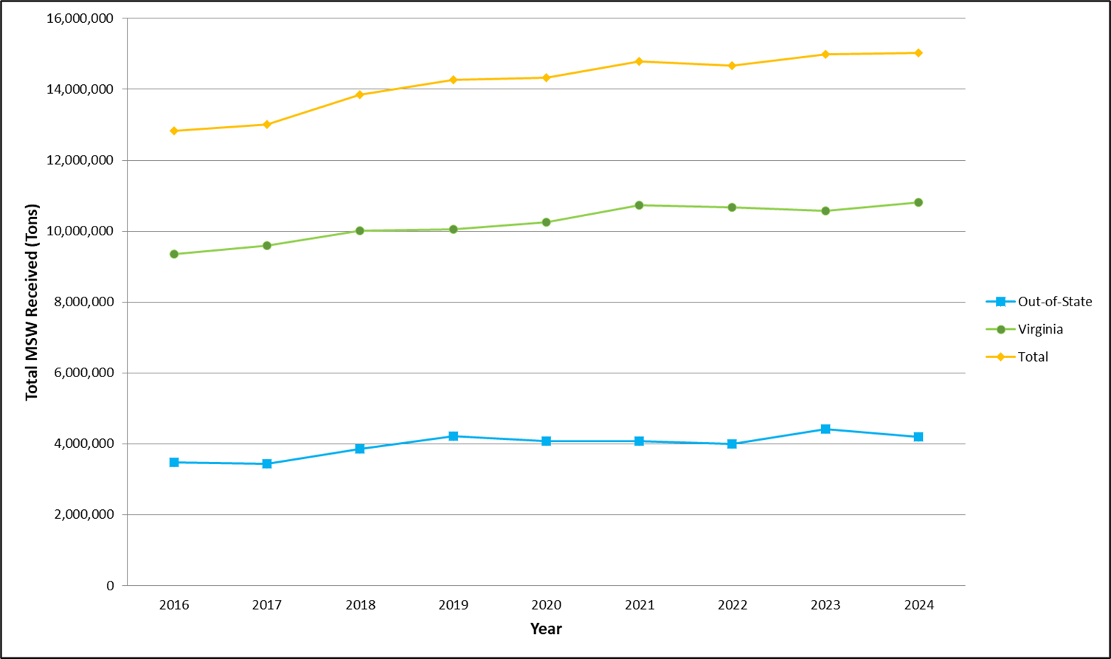
Total MSW Received from 2016 through 2024

Slide 17
Disposal Method Comparison: 2016 vs 2024
Notes:
“Other” methods of management may include steam sterilization or medical waste, approved use of shredded tires, and thermal treatment of petroleum contaminated soils, among others.

Slide 18
Recycling Rate Reports (RRR)

Slide 19
Recycling Rate Requirements
SWPUs shall maintain a minimum recycling rate for municipal solid waste generated annually
Two-tiered recycling mandate:
Planning units must meet and maintain their recycling rate annually (even if not required to report annually)
Can voluntarily report annually
15%
population density < 100 people/sq. mile, or unemployment rate 50% higher than the state average
25%
All Others

Slide 20
Recycling Rate Reporting
Population > 100,000
(19 SWPUs)
Population ≤ 100,000
(52 SWPUs)
Submit Annual Report (Due April 30)
Submit Report Every 4 Years

Slide 21
Recycling in Virginia in CY2024
For CY2024, all 71 SWPUs were required to report
67 have reported
4 have still not reported
CY2024 data reviewed and finalized in Sep 2025
CY2024 annual draft report currently under internal review
State recycling rate for CY2024 = 39.5%

Slide 22
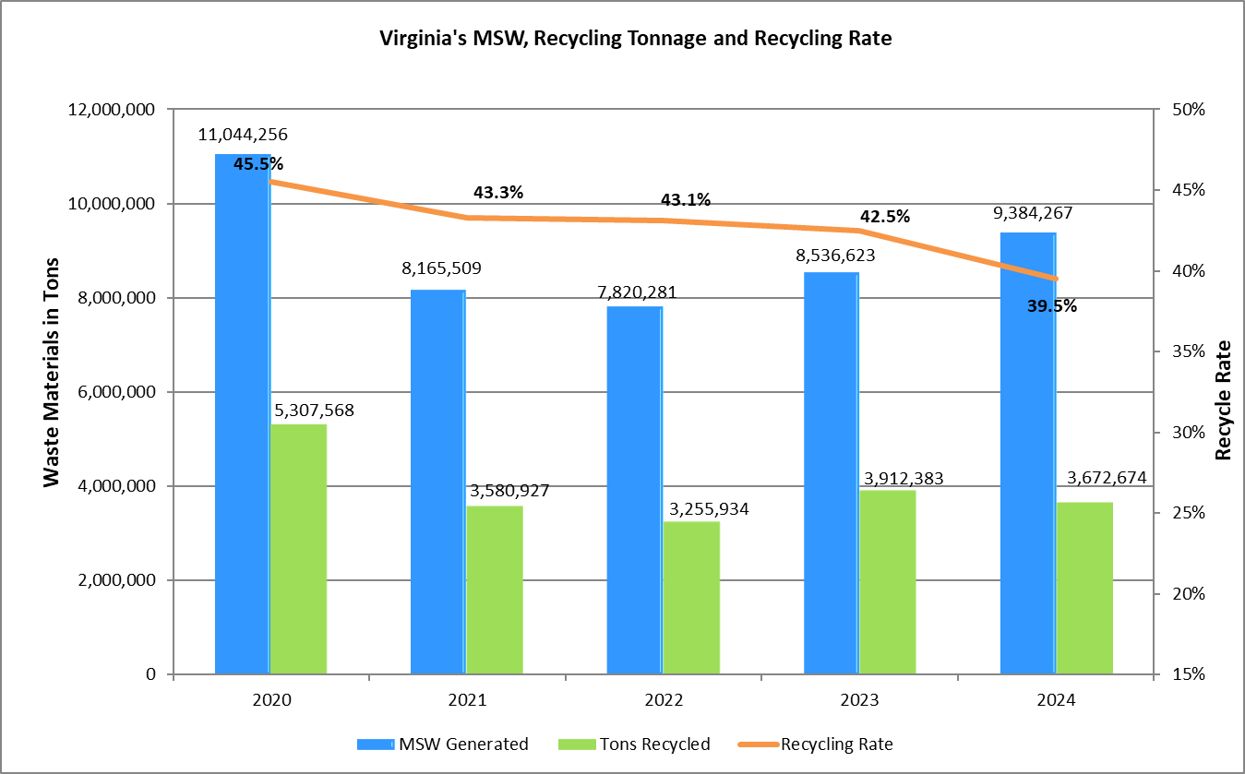
Virginia’s MSW, Recycling Tonnage and Recycling Rates

Slide 23
Litter Prevention & Recycling Grants

Slide 24
Types of Litter & Recycling Grants
Non-Competitive Grants
Competitive Grants
All VA localities are eligible to apply
Grant amount cannot be requested and is calculated based on population and road miles.
Used for local litter prevention and recycling program implementation, continuation, and/or expansion
All localities currently receiving the non-competitive grant are eligible to apply
Grant amount is requested on the application
Used for implementing statewide and regional litter prevention and recycling educational programs and pilot projects

Slide 25
Litter & Recycling Grants – Grant Year 2026
Non-Competitive Grants
168 applications received so far (single and coop)
Grants will be tentatively awarded and disbursed by end of October
Applications and reports currently under review
Competitive Grants
23 applications received – single and joint applications
Will be reviewed and awarded by Litter Fund Board at the Fall meeting
Grants will be tentatively disbursed by end of October
25
Notes:
EPS – Up to 5%
Competitive & Non-Competitive Grants

Slide 26
Expanded Polystyrene (EPS) Ban & Campaign
Notes:
Bill passed in 2021 GA Session – The operation of public information campaigns to discourage the sale and use of expanded
polystyrene products and to promote alternatives to expanded polystyrene.

Slide 27
Expanded Polystyrene (EPS) Campaign & Ban
§ 10.1-1424.3. Expanded polystyrene food service containers prohibited; civil penalty
Beginning July 1, 2023, no food vendor that is a restaurant or similar retail food establishment and is part of a chain with 20 or more locations offering for sale substantially the same menu items and doing business under the same name, regardless of the form of ownership of such locations, shall dispense prepared food to a customer in an expanded polystyrene food service container.
Beginning July 1, 2025, no food vendor of any type shall dispense prepared food to a customer in an expanded polystyrene food service container.
Prohibition of use by food vendors {§10.1-1424.3}
July 1, 2023 2028 2025 for chain restaurants
July 1, 2025 2030 2026 for all other vendors
Localities responsible for enforcement & can grant exemptions
Updated DEQ webpages with resources and information on the ban
Reached out to VA localities and requested for the designated locality contact for implementing the EPS ban - Information will be posted on our website in the next few weeks.
27
Notes:
2021 GA enacted a bill to prohibit the use of expanded polystyrene food service containers. The bill outlined a phased ban, establishing July 1, 2023 for chain restaurants and July 1, 2025 for all other food vendors.
2022 & 2023 Budget Bills delayed the phased prohibition on the use of polystyrene containers until July 1, 2028 and July 1, 2030 respectively and added a requirement for DEQ to conduct a recycling economic & environmental impact assessment (talk about on NEXT slide)
In 2024, the budget again affected the prohibition dates and moved them to July 1, 2025 and July 1, 2026 respectively.
The locality may grant the exemption if the food vendor demonstrates to the satisfaction of the locality that compliance with subsection A would impose an undue economic hardship on the food vendor. For the purposes of this subsection, "undue economic hardship" means a situation in which (i) a food vendor has no reasonable alternative to the expanded polystyrene food service containers in use by that food vendor and (ii) compliance with subsection A would cause significant economic hardship to that food vendor. A locality may so exempt a food vendor for a period of not more than one year from the date of the exemption. A food vendor granted such an exemption may reapply to the locality before the expiration of the exemption, and the locality may grant an additional exemption from the provisions of subsection A not to exceed one year for each such reapplication if the food vendor demonstrates a continuing undue economic hardship at the time of reapplication to the satisfaction of the locality.
Litter Grant Guidelines
The 2021 General Assembly allocated up to 5% of the net resources allocated for the Litter Control and Recycling Fund (Fund) for the operation of public information campaigns to discourage the sale and use of expanded polystyrene products and to promote alternatives to expanded polystyrene in the Commonwealth. Localities applying for the non-competitive litter grant and opting to implement this campaign will receive additional funds for this purpose. The campaign should be targeted to achieve the goals and work with the food vendors in accordance with Section 10.1-1424.3 of code of Virginia.

Slide 28
EPS Campaign
HB1902 (2021 GA) – Changes to allocation of Litter Grant funds. Up to 5% allocation for EPS campaign
The operation of public information campaigns to discourage the sale and use of expanded polystyrene products and to promote alternatives to expanded polystyrene.
Localities can currently opt into receiving additional funds for the EPS campaign as part of their non-competitive litter grant

Slide 29
Solid Waste Management Plans (SWMPs)

Slide 30
SWMPs – 5-Year Updates
Submit a 5-year update certification letter stating that the 3 elements covered under 9VAC20-130-173 have been maintained and updated
Copy of the updated SWMP reflecting updates certified in the certification letter
Does not require public participation unless the SWPU’s internal process requires it

Slide 31
SWMPs – Minor Amendments
Submit a minor amendment letter identifying the amendment per 9VAC20-130-175.C and stating the purpose of the amendment
Copy of the updated pages/SWMP reflecting the minor amendment
Does not require public participation except if the SWPU’s internal process requires it

Slide 32
SWMPs – Major Amendments
Submit a major amendment letter identifying the amendment per 9VAC20-130-175.B and stating the purpose of the amendment
Copy of the updated SWMP reflecting the major amendment
Requires public participation per 9VAC20-130-130
Public notice copy, which should explicitly state the major amendment being conducted (for example: a major amendment is being done for an increase in landfill capacity from XX cubic yards to YY cubic yards)
Public hearing/meeting documentation
Copy of written and/or oral comments received and the SWPUs response to the comments

Slide 33
SWMPs – Plan Amendments
Submit a plan amendment letter identifying the amendment per 9VAC20-130-110 and stating the purpose of the amendment (usually occurs if you have a new plan or it is rewritten)
Copy of the updated/revised SWMP reflecting the plan amendment
Requires public participation per 9VAC20-130-130
Note: 5-year updates will still be due from the original plan approval date, even though the plan has been amended/revised in full

Slide 34
Contact Information
Sanjay Thirunagari
sanjay.thirunagari@deq.virginia.gov
(804)659-1532
Prina Chudasama
prina.chudasama@deq.virginia.gov
(804)659-1530

Slide 35
Questions?

