Slide 1
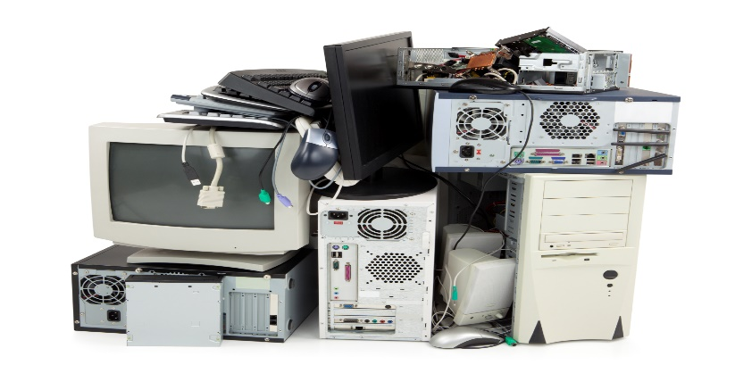
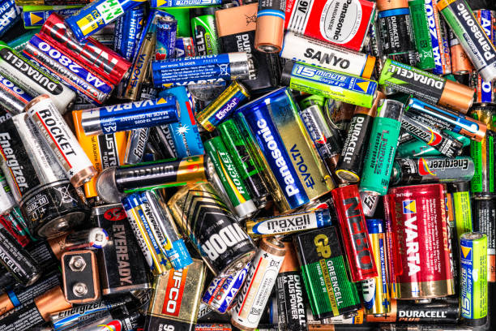

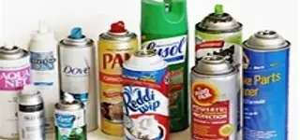
Household Waste and Unauthorized Waste
Lisa Ellis, Hazardous Waste Compliance Coordinator
Jenny Poland, Solid Waste Permit Coordinator
10/16/2025

Slide 2
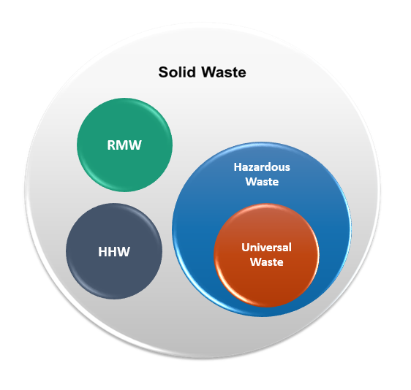
Generally Speaking…
Virginia Solid Waste Management Regulations (VSWMR) specify what is and isn’t a solid waste
Virginia Hazardous Waste Management Regulations (VHWMR) specify which solid wastes are or may be hazardous wastes
In order to be a Hazardous Waste (HW), something must first be a Solid Waste (SW)
Notes:
(incorporates RCRA by reference + adds state-specific items)

Slide 3

Household Waste (9VAC20-81-10 of VSWMR)
“any waste material, including garbage, trash, and refuse, derived from households. Households include single and multiple residences, hotels and motels, bunkhouses, ranger stations, crew quarters, campgrounds, picnic grounds, and day-use recreation areas.

Slide 4
Household Wastes
More at VSWMR at 9VAC20-81-10:
Households include single and multiple residences, hotels and motels, bunkhouses, ranger stations, crew quarters, campgrounds, picnic grounds, and day-use recreation areas. Household wastes do not include sanitary waste in septic tanks (septage) that is regulated by other state agencies.

Slide 5
Household Wastes
What is household waste under the HW regulations?
VHWMR at 9VAC20-60-261.4(b)
“Household waste” means any material (including garbage, trash and sanitary wastes in septic tanks) derived from households (including single and multiple residences, hotels and motels, bunkhouses, ranger stations, crew quarters, campgrounds, picnic grounds and day-use recreation areas).

Slide 6
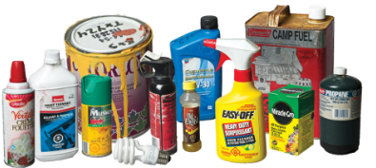
Household Hazardous Waste
Wastes commonly generated by households which, if not excluded, would meet the definition of hazardous waste
Includes things like cleaning products, herbicides and pesticides, paints and solvents
Note, certain hobby-generated wastes would not be commonly generated by households and should not be managed with routine household hazardous wastes

Slide 7

How Should Households Manage HW?
Use the hazardous material for its intended purpose
Give the material to someone who can use it
Follow recommendations on containers
Hold wastes for household hazardous waste collection events
Check recommendations at Earth911.com

Slide 8
Remember!
Although household wastes are exempt from management under the Virginia Solid Waste Management Regulations and exempt from management as hazardous wastes,
The same items from a business, industry, or institution ARE NOT EXEMPT and MUST be managed in accordance with the regulations.

Slide 9


What is an Unauthorized Waste?
Waste prohibited by regulations- (9VAC20-81-40 & 140)
Lead acid batteries
Free liquids*(some exceptions)
Regulated medical waste
Hazardous waste
Solid waste, residue or soils with 1.0 ppb TEF (dioxins)
Solid waste, residue or soils with 50 ppm PCB’s *(exception 9VAC20-81-630)
Contaminated soils (unless approved by DEQ)
Notes:
a. Free liquids.
(1) Bulk or noncontainerized liquid waste, unless:
(a) The waste is household waste; or
(b) The waste is gas condensate derived from that landfill;
(c) The waste is leachate derived from that landfill and the landfill is designed with a composite liner and leachate collection system as described in 9VAC20-81-130 J 1 a and 9VAC20-81-130 L; or
(2) Containers holding liquid waste, unless:
(a) The container is a small container similar in size to that normally found in household waste;
(b) The container is designed to hold liquids for use other than storage; or
(c) The waste is household waste.

Slide 10
What is an Unauthorized Waste? (cont.)
Wastes prohibited by a locality:
Cathode ray tubes (CRT) (if CRT Recycling program is available meeting requirements of §)10.1-1425.26
Waste prohibited in the solid waste permit:
Friable asbestos
Radioactive material
Wastes which need a Special Waste Disposal Request approved by DEQ before they can be disposed in a specific landfill
Contaminated soils
Animal carcasses

Slide 11
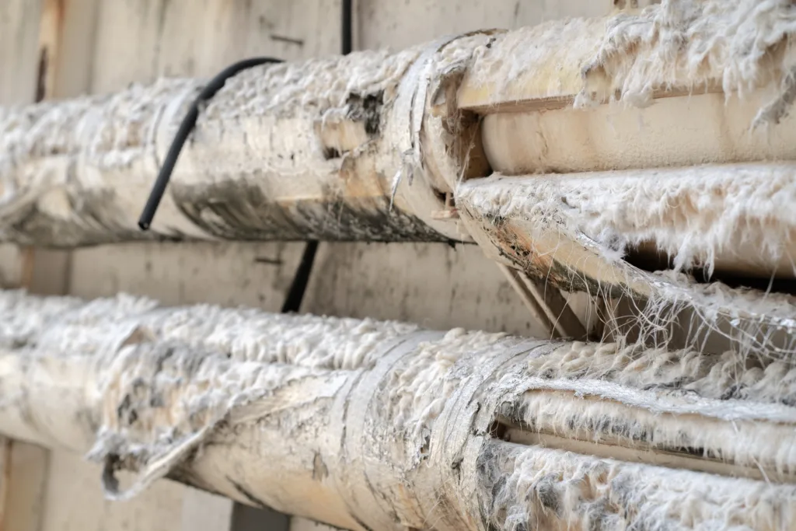
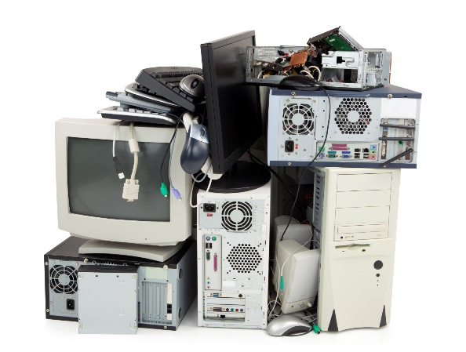
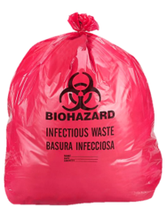
Common Unauthorized Waste
Asbestos (depending on the landfill permit)
Aerosol cans (HW)
Batteries (HW)
Electronic equipment (HW)
“Empty” intact drums
Fluorescent or other lamps (HW)
Free liquids
Hot loads
Regulated medical wastes (untreated, red bags or sharps)
PCBs
Pharmaceutical waste
Potentially-contaminated soil

Slide 12

Special Wastes (9VAC20-81- 610 thru 660)
“means solid wastes that are difficult to handle, require special precautions because of hazardous properties, or the nature of the waste creates waste management problems in normal operations. (See Part VI (9VAC20-81-610 et seq.) of VSWMR)
Asbestos-containing waste materials
Waste containing polychlorinated biphenyls (PCBs)
Waste tires
White goods
Soil contaminated with petroleum products

Slide 13
Special Wastes (cont.)
Some special wastes require analysis – contaminated soil, PCB
Not all special wastes require analysis – white goods and tires are special wastes
If a landfill is not permitted to accept a waste, they can request to accept it by completing a special waste disposal request form and submitting it to DEQ for review and approval.
DEQ must approve the Special Waste Request before the landfill can accept the waste.

Slide 14
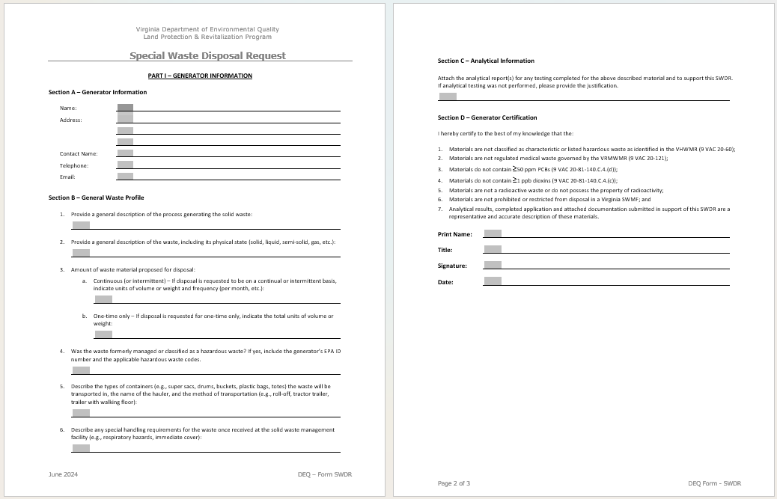
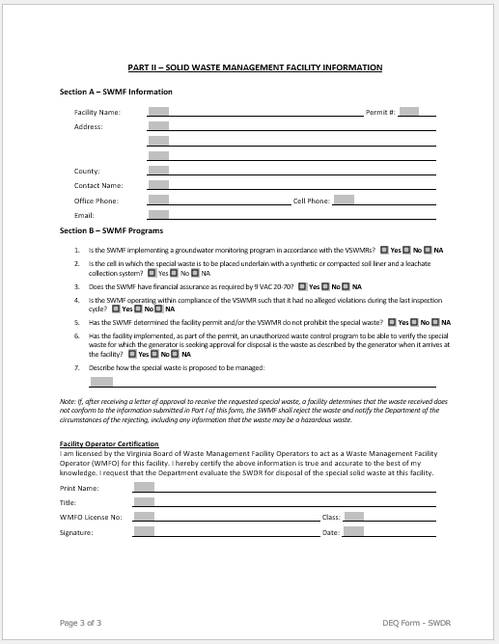
Special Waste Disposal Request
2-part form submitted by the solid waste facility to DEQ
1st part – completed & signed by generator
2nd part – completed & signed by solid waste facility
DEQ reviews and responds to the solid waste facility with any special handling requirements

Slide 15




Unauthorized Hazardous Wastes
It is required by the VHWMR that a “person” (including business entity, government, school, etc.) that generates a solid waste must determine if that waste is hazardous waste – THIS DOES NOT INCLUDE HOUSEHOLDS
It can either be a characteristic HW (ignitable, corrosive, reactive or toxic) or listed HW (appears on one of 4 hazardous waste lists in the regulations)

Slide 16
What is Universal Waste?
Universal waste is a subset of hazardous waste with lesser management requirements
Universal wastes are so prevalent that EPA created a special category for them in order to facilitate recycling of these wastes instead of disposal
Most businesses, schools, government building, etc., generate some form of Universal Waste that requires proper management

Slide 17
Universal Wastes
Universal wastes cannot go to a landfill
Universal wastes must be recycled or otherwise managed as hazardous waste
Can be managed onsite for up to one year in closed containers
Containers must be properly labeled with description and date of first waste in

Slide 18
Management Options for Universal Waste
A business can choose to manage Universal Waste as Hazardous Waste but it must be from the point of generation
Management (Recycling) by a Universal Waste management company
Management as Hazardous Waste by a hazardous waste management company
In the case of aerosol cans, the cans may be punctured and drained using a commercial puncturing unit and in accordance with the VHWMR
Anything drained must be properly containerized and characterized
Cans can be recycled as metal

Slide 19

What is Universal Waste?
Batteries
Mercury-containing equipment
Certain pesticides
Lamps (aka bulbs)
Aerosol Cans
EPA is also currently exploring the possibility of adding solar panels to the list of UW

Slide 20
Pharmaceutical Wastes
Household pharmaceutical waste should be placed into a pharmaceutical drop box at your local pharmacy or other location for disposal
Pharmaceutical waste needs to be properly characterized and managed under Part 266 Subpart P of the VHWMR
Pharmaceutical waste cannot be managed as a Regulated Medical Waste

Slide 21

Control Program for Unauthorized Waste (9VAC20-81-100.E (landfills) & 300.F (other SWMF))
Requirement for all solid waste management and disposal facilities
Program includes signage, monitoring, training
Waste load inspections:
1% of waste loads from Virginia
10% of waste loads from outside Virginia (per jurisdiction)
Notes:
Clarify with Priscilla if hold PBR Facilities to same inspection frequencies.

Slide 22
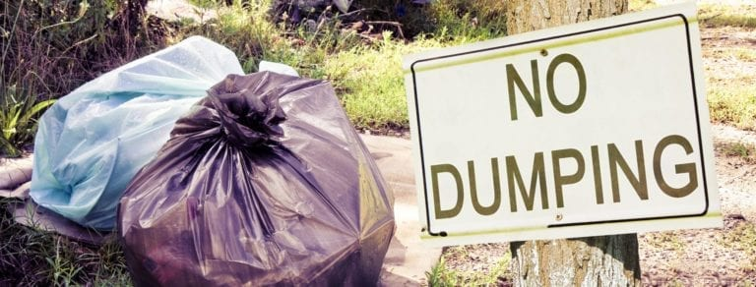
What to do when you find unauthorized waste:
Notify DEQ within 24 hours via phone or email and follow up with 5-day written report
Segregate, contain, and secure unauthorized waste
Remove or properly manage as soon as practical, but no longer than 90 days after discovery.

Slide 23
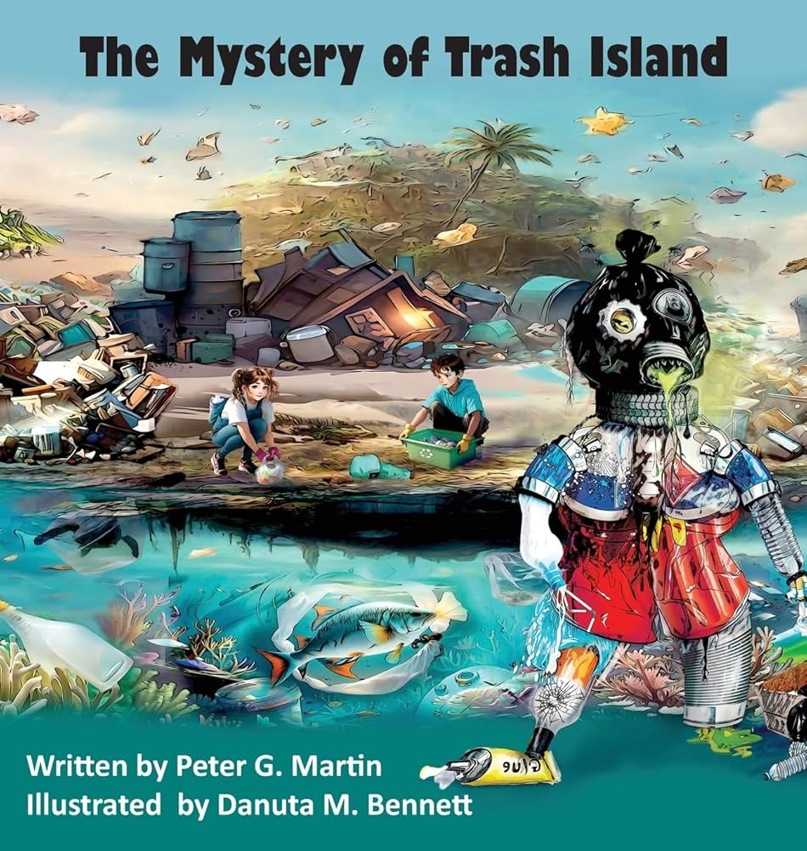
Problem!
Hazardous wastes can be generated by both businesses and households. How can a landfill tell who has generated what, and whether it is unauthorized?

Slide 24

Recommendations
Transporters and scale house operators should be trained on unauthorized wastes
Annual training on unauthorized wastes is required for transfer station and landfill staff
Spotters at transfer stations and at landfills
Follow-ups with businesses found to not comply
Review TCLP data!

Slide 25
Where should unauthorized wastes go?
Fluorescent and other lamps are typically hazardous waste even if they are “green”
Lamps must be managed onsite properly and disposed by all businesses, schools, government etc. as either hazardous waste or universal waste
Lead acid and other batteries must be managed under the HW regulations as recyclable or universal waste
Aerosol cans must be managed as either HW or UW

Slide 26

Questions?
Lisa Ellis, Hazardous Waste Compliance, 804-912-7366
Jenny Poland, Solid Waste Permitting, 540-759-9840

