Slide 1
DEQ Solid Waste Regulatory Update
2025 SWANA Regulatory Training
Priscilla Rohrer
Solid Waste Compliance Coordinator
Virginia Department of Environmental Quality
October 16, 2025

Slide 2
Outline
DEQ Solid Waste Staff Changes
Waste Regulatory Actions
Permitting & Compliance Activities

Slide 3
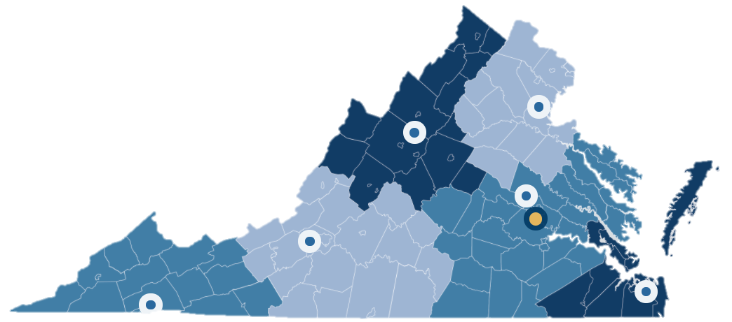






DEQ Solid Waste Program Staff
Regional Office
Land Protection Managers
Jim Datko
Northern
Laura Stuart
Valley
Jeremy Kazio
Piedmont
Melinda Woodruff
Tidewater
Stacy Bowers
Southwest
Nikki Herschler
Blue Ridge

Slide 4










DEQ Solid Waste Program Staff
Regional Office
Solid Waste
Permit Writers
Justina Kim
Northern
Autumn Sands
Northern
JengHwa Lyang
Valley
Shawn McCaffrey
Piedmont
Allen Patton
Blue Ridge
Dan Scott
Southwest
Jeffery Greer
Tidewater
Jennifer Hoeffner
Blue Ridge
Doug Masini
Piedmont

Slide 5








DEQ Solid Waste Program Staff
Regional Office
Solid Waste Groundwater Staff
Autumn Sands
Northern
Justina Kim
Northern
Shannon George
Valley
Shawn McCaffrey
Piedmont
Dean Starook
Piedmont
Jacob Gonzales-Black
Tidewater
Nathan Amick
Blue Ridge
Tyler Rhea
Southwest
Michael Sexton
Blue Ridge
Doug Masini
Piedmont
Karlie Casper
Tidewater
Chris Kampfmueller
Tidewater

Slide 6
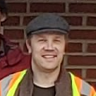















DEQ Solid Waste Program Staff
Regional Office
Solid Waste
Compliance Staff
Jeff Modliszewski
Northern
Greg Baker
Valley
Lisa Silvia
Tidewater
Zak Rabei
Northern
Paul Hansohn
Valley
Becky Wright
Blue Ridge
Katy Dacey
Piedmont
Jeff Deibler
Tidewater
Sean Priest
Tidewater
Brad Ricks
Piedmont
Zachary Mitchell
Southwest
Nicole Tilley
Blue Ridge
Todd Fowler
Blue Ridge
Andrew Peal
Piedmont
Julie Searcy
Tidewater
Chapin Piper
Tidewater

Slide 7
DEQ Waste Regulatory Actions
Notice of Intended Regulatory Action (NOIRA)
Proposed Regulation
Final Regulation
Approved & Effective
Regulation | Amendment | Status
Solid Waste | CCR Rule Incorporation | Approved (Effective 1/15/25)
Coal Combustion Byproducts | Stormwater Citation Correction | Approved (Effective 1/15/25)
Hazardous Materials Transport | 2024 Annual Update | Approved (Effective 1/15/25)
Regulated Medical Waste | Category A Waste | Approved (Effective 5/22/25)
Hazardous Waste | 2023 Annual Update | Approved (Effective 8/27/25)
Hazardous Waste | 2024 Annual Update | Final Regulation (Pending)
Solid Waste | Amendment 9 | Final Regulation (Pending)
Solid Waste | Open Burning of Vegetative Waste | Proposed Regulation (Public Comment)
Solid Waste & Hazardous Waste | Fee Increase | NOIRA (Pending)

Slide 8
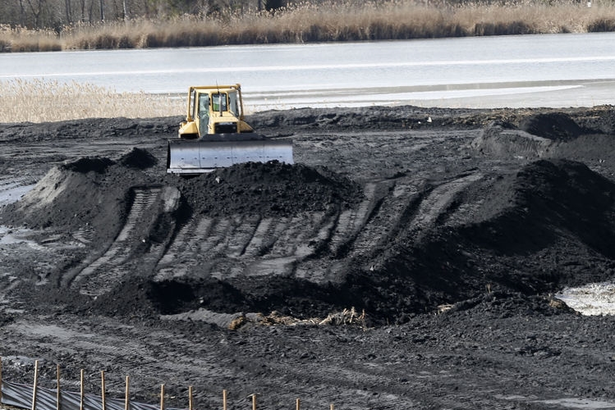
Coal Combustion Residuals (CCR) Rule Incorporation
Incorporates 2020 version of EPA CCR Rule by reference
Only impacts CCR landfills and surface impoundments
Minimal impacts to existing CCR units due to statutory closure by removal mandates
Necessary for DEQ to seek EPA approval of CCR permitting program
Approved, Effective 1/15/25
Photo of Dominion Chesterfield, Richmond Times-Dispatch
Notice of Intended Regulatory Action
Proposed Regulation
Final Regulation
Approved & Effective

Slide 9
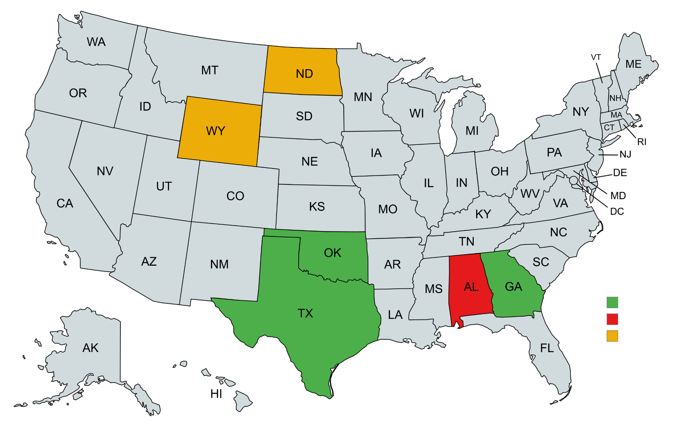
EPA Approval of State CCR Permitting Programs
EPA Approval
EPA Proposed Approval
EPA Denial
Image created with MapChart
Notes:
EPA state program updates: https://www.epa.gov/coal-combustion-residuals/permit-programs-coal-combustion-residual-disposal-units

Slide 10
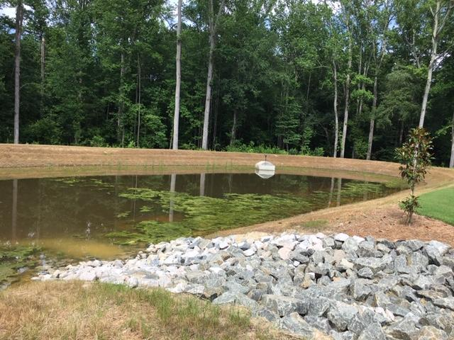
Coal Combustion Byproduct (CCB) Reg. Amendment –
Stormwater Citation Correction
Erosion and Sediment Control Regulations (9VAC25-840) repealed and replaced July 1, 2024
Corrects citation reference to Virginia Erosion and Stormwater Management Regulation (9VAC25-875)
Approved, Effective 1/15/25
Notice of Intended Regulatory Action
Proposed Regulation
Final Regulation
Approved & Effective

Slide 11

Hazardous Materials Transport Reg. Amendment – 2024 Annual Update
US DOT updates the federal regulations governing transport of hazardous materials under Title 49 of the Code of Federal Regulations
VA adopts sections of Title 49 by reference
VA State Police inspects and enforces requirements
Approved, Effective 1/15/25
Notice of Intended Regulatory Action
Proposed Regulation
Final Regulation
Approved & Effective

Slide 12
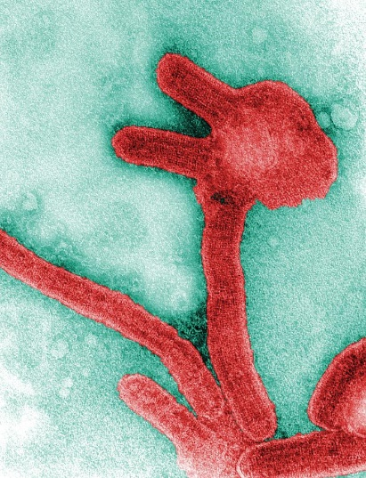
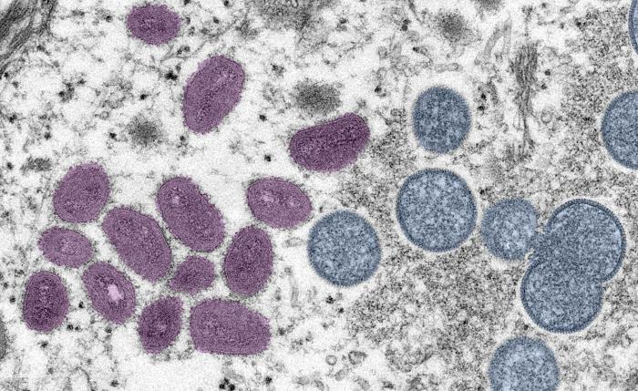
Regulated Medical Waste Reg. Amendment –Category A Waste Update
Incorporates 2024 federal Category A Waste guidance by reference
Reflects modern terminology for Mpox virus
Clarifies that NO patient waste from Mpox virus is considered Category A waste
Adds protocols for handling Marburg virus waste (same as Ebola, patient waste IS Category A)
Approved, Effective 5/22/25
Marburg Virus, CDC
Mpox Virus, CDC
Notice of Intended Regulatory Action
Proposed Regulation
Final Regulation
Approved & Effective

Slide 13
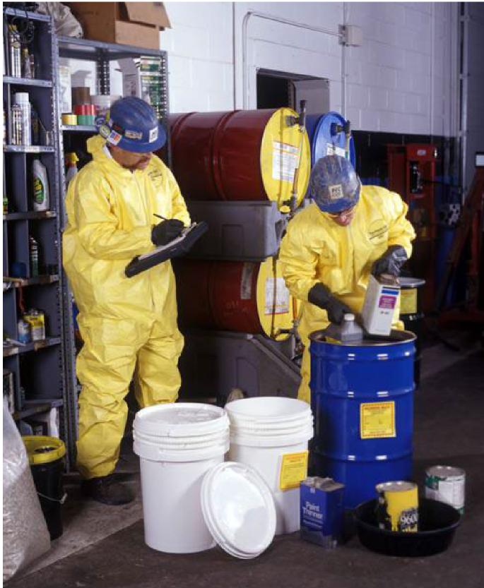
Hazardous Waste Reg. Amendment – 2023 Annual Update
Incorporates federal EPA regulations by reference
Updates Canada-specific hazardous waste import-export recovery and disposal operation codes
Adds final exclusion for identifying and listing hazardous waste (Emerald Kalama Chemical – Kalama, Washington)
Revises EPA Method 23: Determination of Polychlorinated Dibenzo-p-Dioxins and Polychlorinated Dibenzofurans from Stationary Sources
Approved, Effective 8/27/25
Notice of Intended Regulatory Action
Proposed Regulation
Final Regulation
Approved & Effective
Notes:
1 – Conforming Changes to Canada-Specific Hazardous Waste Import-Export Recovery and Disposal Operation Codes. Reflects changes to Canada’s import-export code numbers and descriptions effective Oct. 31, 2021. Affects export and import notices and subsequent movement documents for hazardous waste exchanged between Canada and the United States.
Conforming changes to US Federal HW Regulations for 12 HW import-export recovery and disposal operations. States do not receive authorization to administer the Federal government’s import/export functions in 40 CFR part 262 subpart H, or the import/export relation functions in any other section of the RCRA hazardous waste regulations; however, State programs are still required to adopt the provisions in this rule to maintain their equivalency with the Federal program. Adoption by reference through a regulatory amendment to 9VAC20-60 keeps our incorporated versions of 40 CFR 262, 40 CFR 264, and 40 CFR 265 consistent with the federal rule.
2 – Final Exclusion for Identifying and Listing Hazardous Waste. Response to petition from Emerald Kalama Chemical, LLC, in Kalama, Washington. Requires management in a Subtitle D landfill
Delists an annual volume of up to 3,500 cubic yards of wastewater treatment solids, U019 (benzene) and U220 (toluene). The rule doesn’t necessarily impact Virginia; however, adoption by reference through a regulatory amendment to 9VAC20-60 keeps our incorporated version of 40 CFR 261 consistent with the federal rule.
3 - EPA Method 23—Determination of Polychlorinated Dibenzo-p-Dioxins and Polychlorinated Dibenzofurans From Stationary Sources. Editorial and technical revisions to the EPA’s Method 23
Expands the applicability of Method 23 to include procedures for sampling and analyzing PAH and PCB. Adds Method 23 as an alternative to SW-846 Method 0023A.
Provides flexibility for sampling and measuring polychlorinated dibenzo-p-dioxins and polychlorinated dibenzofurans (PCDD/PCDF), PAH, and PCB.
Amendment finalizes technical revisions and editorial changes to clarify and update the requirements and procedures specified in Method 23 and reformatting the method to conform with the current EPA method format. The intent for the final revisions is to ensure that Method 23 is implemented consistently. EPA has updated the method procedures to include many current best practices.
Also expanding the applicability of Method 23 to include procedures for sampling and analyzing PAH – poly aromatic hydrocarbons and PCB – poly chlorinated biphenyls.
SW-846 = the Test Methods for Evaluating Solid Waste: Physical/Chemical Methods Compendium, which is EPA’s official collection of methods for use in complying with the Resource Conservation and Recovery Act (RCRA) regulations.
Adoption by reference through a regulatory amendment to 9VAC20-60 keeps our incorporated version of 40 CFR 266 consistent with the federal rule and adopts this flexibility for Virginia.

Slide 14
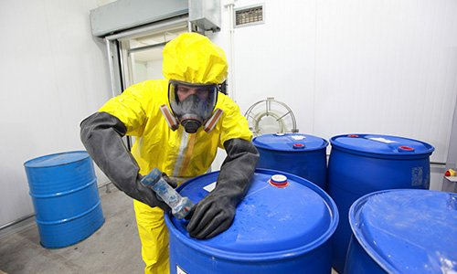
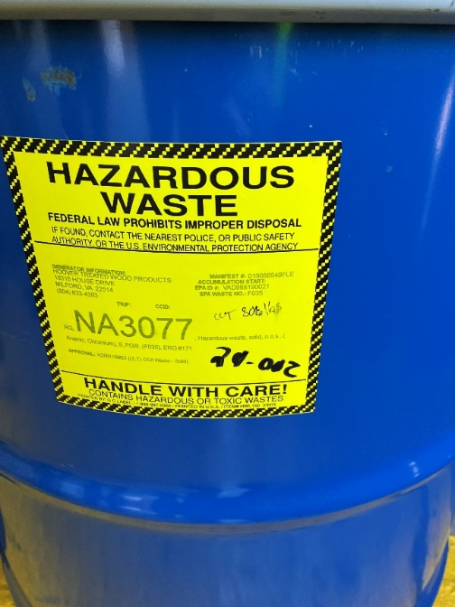
Hazardous Waste Reg. Amendment – 2024 Annual Update
Incorporates federal EPA regulations by reference
Technical Corrections:
  Hazardous Waste Generator Improvements Rule
  Hazardous Waste Pharmaceuticals Rule
  Definition of Solid Waste Rule
Pending Executive Review
Notice of Intended Regulatory Action
Proposed Regulation
Final Regulation
Approved & Effective

Slide 15
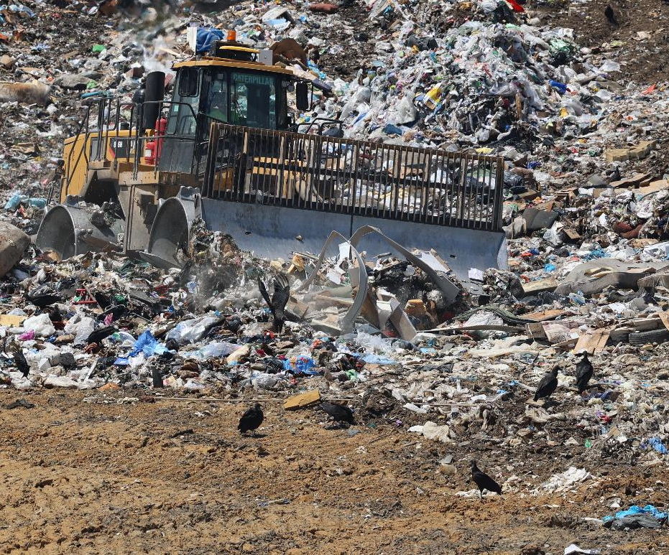
Solid Waste Management Regulations – Amendment 9
Updates landfill requirements including siting and setbacks, operations, and gas and groundwater monitoring
Bans open burning of household waste
Developed with input from Regulatory Advisory Panel and public comments
Pending Executive Review
Notice of Intended Regulatory Action
Proposed Regulation
Final Regulation
Approved & Effective

Slide 16
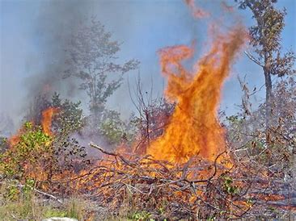
Solid Waste Reg. Amendment – Veg Waste Open Burning
SB342 requires amendment to Solid Waste Management Regulations
Conditionally exempts offsite burning of vegetative waste if onsite burning is impractical or unsafe
Proposed criteria developed by Regulatory Advisory Panel
Open for public comment from August 25, 2025 to October 24, 2025
Virginia Department of Forestry
Notice of Intended Regulatory Action
Proposed Regulation
Final Regulation
Approved & Effective

Slide 17








Solid Waste Reg. Amendment – Veg Waste Open Burning
Existing sources utilized:
Virginia Statewide Fire Prevention Code
Virginia Solid Waste Management Regulations ​
Virginia Air Board Open Burning Regulations
VDOT Best Practices for Open Burning of Vegetative Debris
17

Slide 18
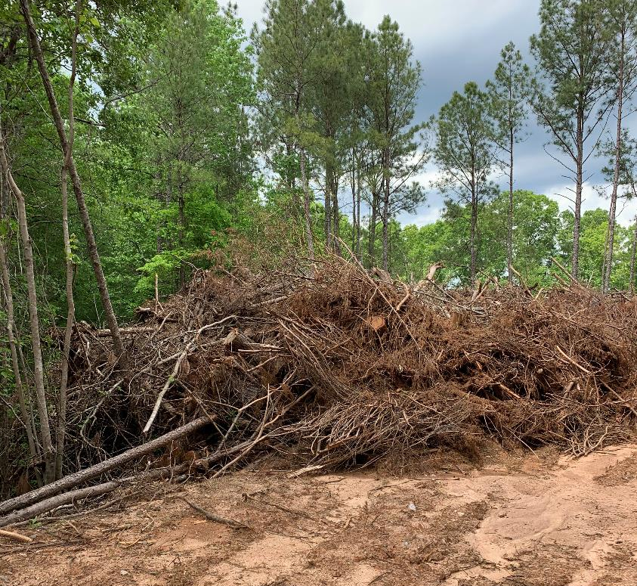
Proposed Criteria for Offsite Open Burning of Veg Waste
Existing wood waste storage requirements:
Less than 1/3 acre
No more than 15 ft high
50-foot setbacks
Ground slope cannot exceed 4:1
No leachate discharge
No vector attraction

Slide 19
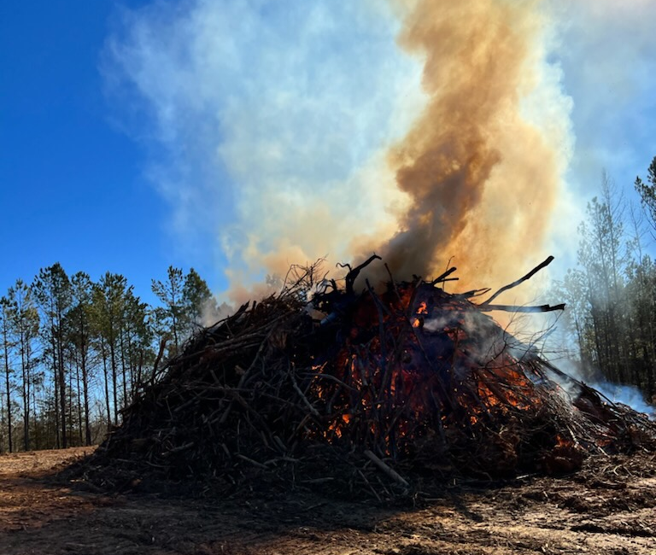
Proposed Criteria for Offsite Open Burning of Veg Waste
No more than 1 burn event every 60 days (per location or generator)
Each burn 72 hours max (no smoldering)
No more than 100 cubic yards vegetative waste burned per event
Notify state or local fire marshal 48 hours prior to burn
Burning activities shall comply with state and local ordinances
South Carolina Forestry Commission

Slide 20
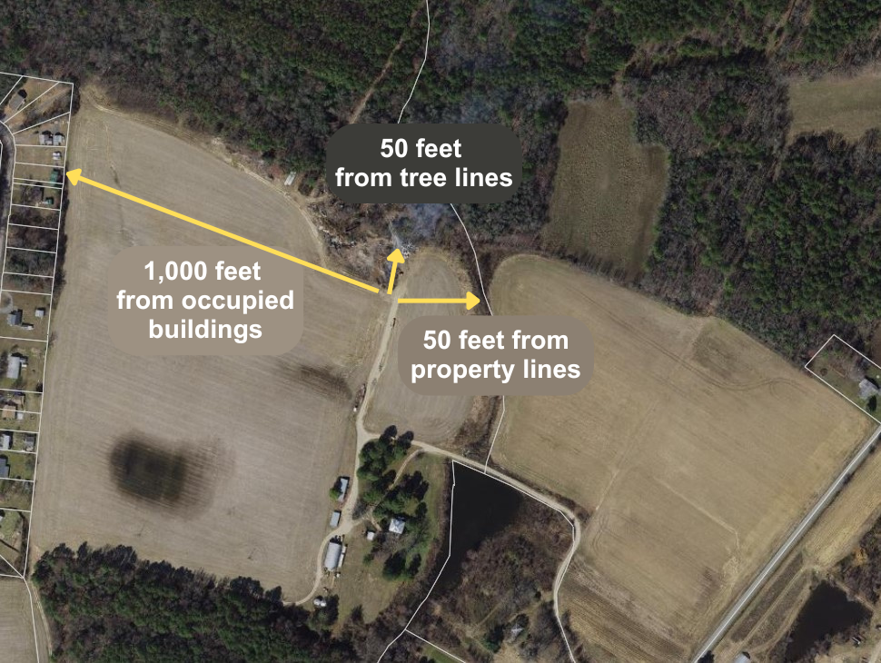
Proposed Criteria for Offsite Open Burning of Veg Waste
Location must meet required setbacks:
1,000 ft from occupied buildings (unless permission given)
300 ft from roads and structures
200 ft from drinking water sources
100 ft from surface waters, rivers, floodplains and wetlands
50 ft from property lines, utility lines, tree lines and combustible material

Slide 21
Proposed Criteria for Offsite Open Burning of Veg Waste
Cannot be conducted in Volatile Organic Compound (VOC) Emissions Control Areas
Northern VA
Fredericksburg
Richmond
Hampton Roads
Western VA
VOC Emissions Control Areas

Slide 22

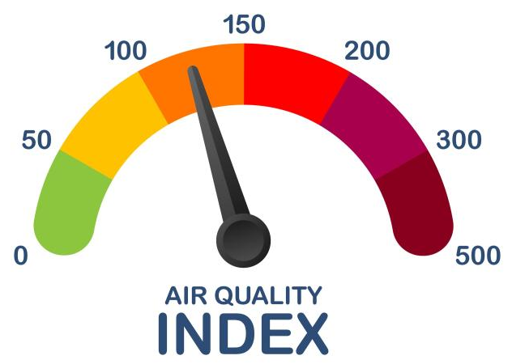
Proposed Criteria for Offsite Open Burning of Veg Waste
Fire must be attended at all times
No liquid accelerants or prohibited materials to start or maintain fire
Must have way to extinguish fire
Must extinguish fire if:
  Wind speeds over 20 mph
  Pollution alert, code red air quality day, or air quality health advisory
  Visibility impaired on roads or at surrounding airports
Science Learning Hub

Slide 23
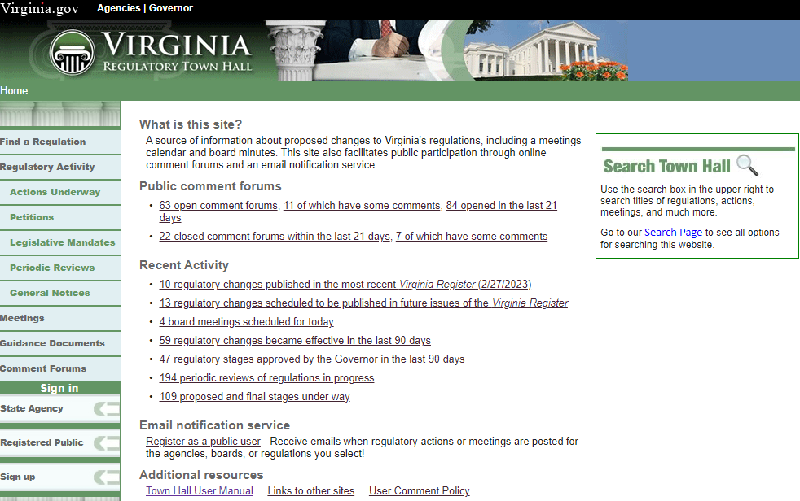

Virginia Regulatory Town Hall Public Comment Forum
townhall.virginia.gov

Slide 24
Solid & Hazardous Waste Permit Fee Increase Amendment
Proposes increase to SW permit application fees and all HW fees
Fees support DEQ waste permitting and inspection activities
NOIRA pending Executive Review
Public comment period to follow
Notice of Intended Regulatory Action
Proposed Regulation
Final Regulation
Approved & Effective

Slide 25

Waste Management Facility Operator (WMFO) Regulations
Regulatory Reduction Amendment – Effective 7/1/25
Reduced operational experience requirement from 1 year to 6 months
Reduced education requirement for license renewal from 8 hours to 6 hours
Clarified license requirements for:
  Surface Impoundments (Class I)
  Regulated Medical Waste (Class III)
Notice of Intended Regulatory Action
Proposed Regulation
Final Regulation
Approved & Effective

Slide 26
Waste Management Facility Operator (WMFO) Regulations
Fee Amendment – Effective 8/1/25
$85 License application fee
$60 License renewal fee
$100 Late license renewal fee
$200 License reinstatement fee
Notice of Intended Regulatory Action
Proposed Regulation
Final Regulation
Approved & Effective

Slide 27
Solid Waste Permitting Activities

Slide 28
Current Solid Waste Permits
Facility Type | Active | Post-Closure
Sanitary Landfill | 46 | 89
CDD Landfill | 14 | 10
Industrial Landfill | 22 | 7
Transfer Station | 58
Material Recovery Facility | 52
Compost Facility | 14
Regulated Medical Waste Facility | 12
Waste to Energy or Incinerator | 6
Surface Impoundment | 9
Barge Facility | 1
28

Slide 29
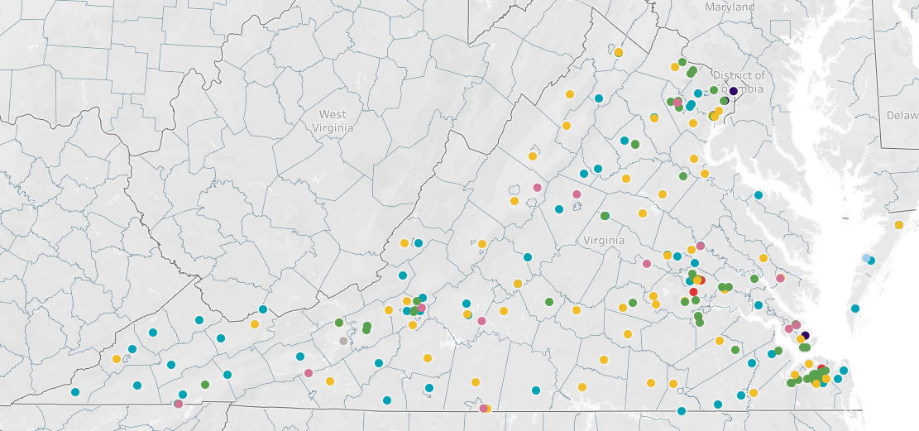
Permitted Active Non-Captive Solid Waste Facilities
Landfill
Transfer Station
Material Recovery Facility
Compost Facility
Incinerator & Waste-to-Energy
Regulated Medical Waste
Barge Off-loading

Slide 30
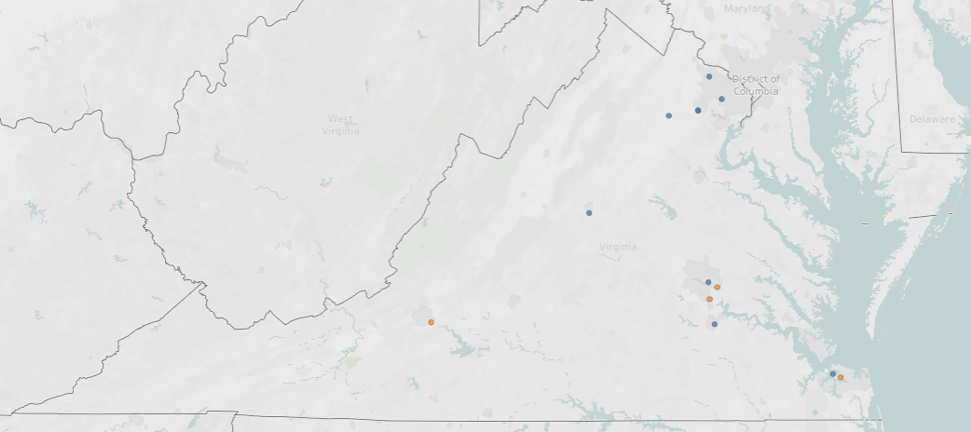
Permitted Regulated Medical Waste (RMW) Facilities
Microbac Laboratories
VDACS Lab
George Mason University – Prince William
American Type Culture Collection
UVA Health
VCU Health
Daniels Sharpsmart
Stericycle
NEIE Medical Waste Services
RMW Captive Treatment
Curtis Bay Medical Waste Services (PENDING)
Curtis Bay Medical Waste Services
RMW Commercial Treatment
RMW Transfer Station
Old Dominion University
Curtis Bay Medical Waste Services

Slide 31
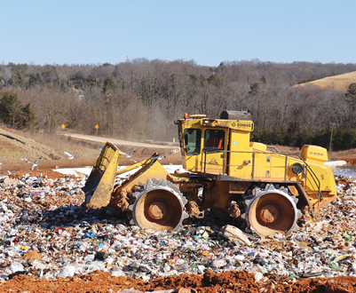
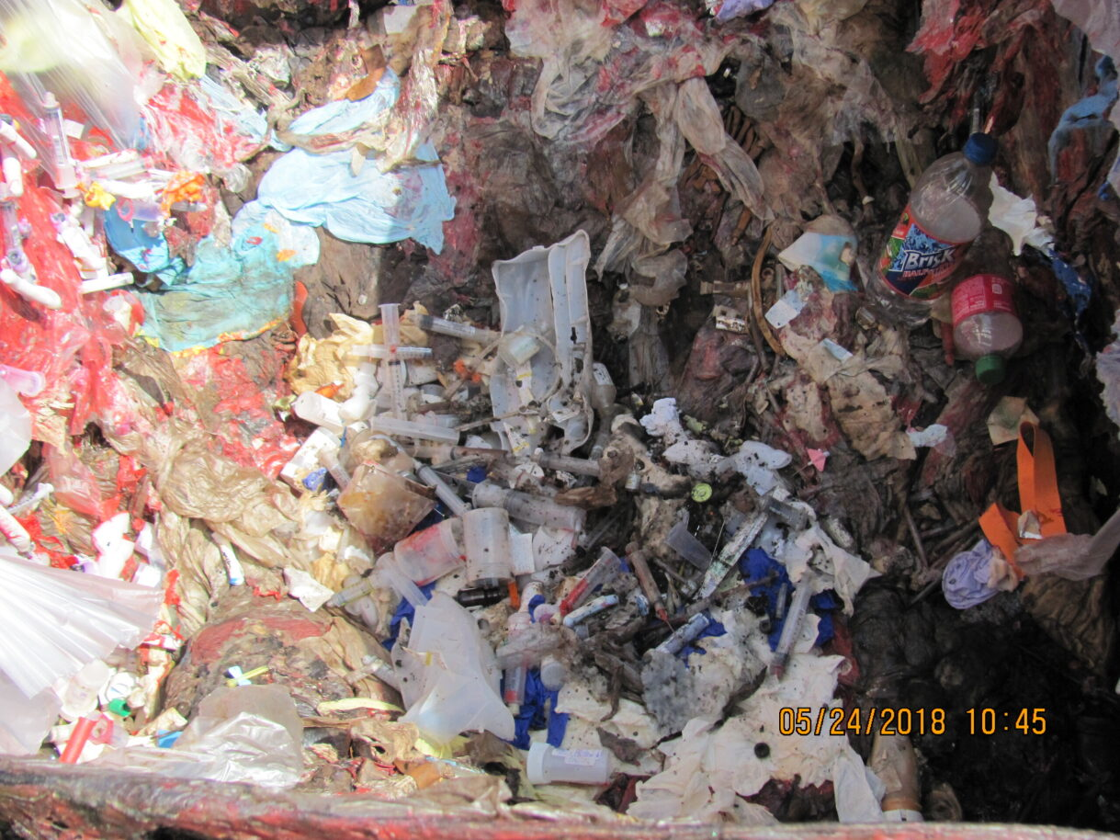
Disposal of Treated Medical Waste
Treated medical waste = solid waste
No shredding or load notifications required
RMW Treatment Facilities must provide Treated Waste Disposal Plans to receiving solid waste facilities
Landfill disposal procedures continue to be site-specific (Permit and/or Operations Manual)
Waste Today Magazine
Treated medical waste mixed with other solid waste

Slide 32
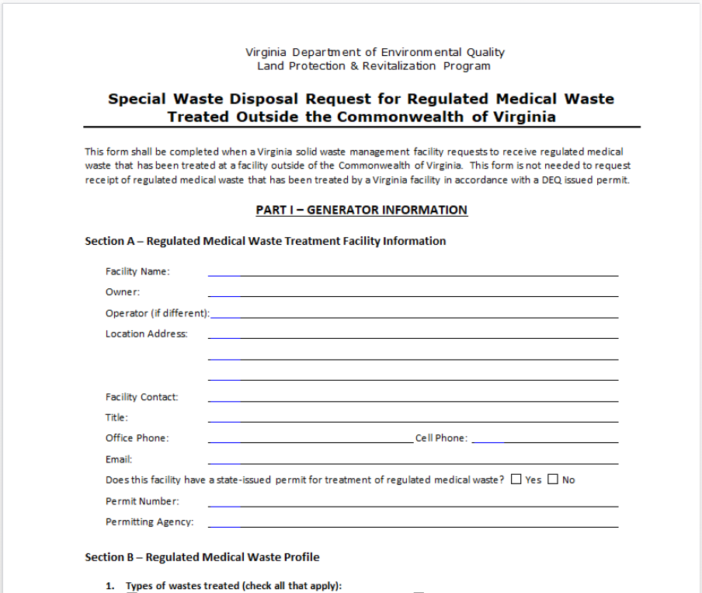

Disposal of Medical Waste Treated Out of State
All medical waste must be treated to Virginia standards to be disposed of in Virginia
New Special Waste Disposal Request Form
  Part 1 – Generator Certification
  Part 2 – Landfill Certification

Slide 33
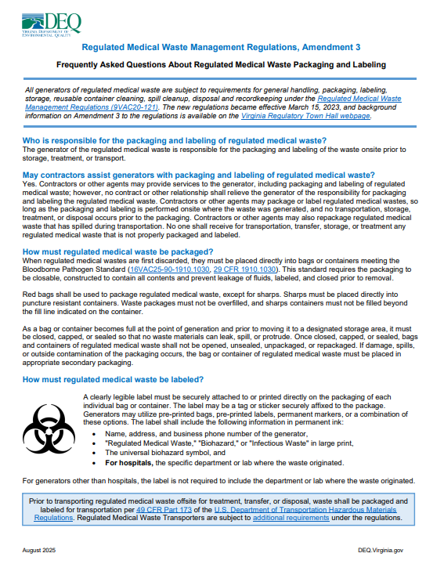

Regulated Medical Waste
Packaging and Labeling
Frequently Asked Questions Document on DEQ website
Labeling Requirements:
Generator’s name, address, and phone #
REGULATED MEDICAL WASTE, BIOHAZARD or INFECTIOUS WASTE written in large print
Universal biohazard symbol
For hospitals only, the specific department or lab where the regulated medical waste originated

Slide 34
Solid Waste Compliance Activities
679 Compliance Inspections
Inspection Results
Oct 1, 2024 – Sept 30, 2025

Slide 35

Questions

