Slide 1





An overview of
Recycled Asphalt Pavement (RAP) MSE Berm
Benjamin S. Allen, P.E.
Precise. Responsive. Solutions.

Slide 2
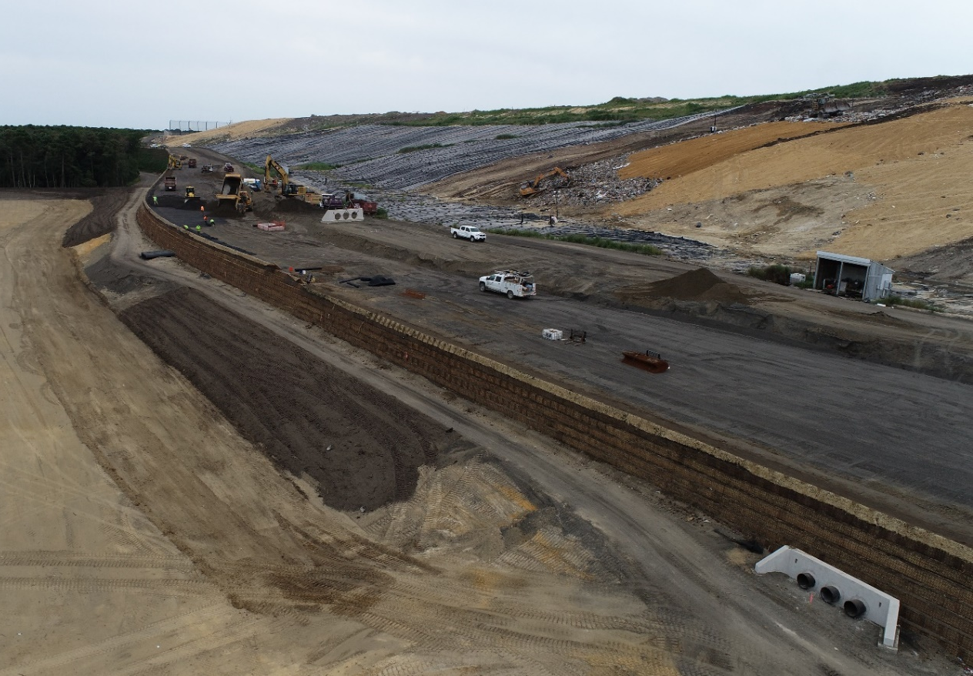
Presentation Overview
Discussion of “the problem” and overview of “the solution,” RAP.
Laboratory testing review and MSE berm design.
Review of permitting process.
Observations from RAP MSE berm construction.
Summary of the RAP MSE berm economics.

Slide 3
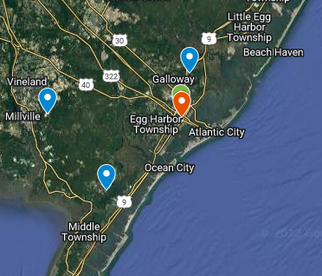
Soil Availability Near Site
The Problem:
Limited accessibility to large amounts of soil suitable for MSE berm construction. Closest source was 10 miles from the site. Backup sources were 20-25 miles from the site.
MSE berms use a considerable amount of soil (>250,000 CY for recent projects) that needs to meet various engineering properties.
The Solution:
Recycled or reclaimed asphalt pavement (RAP) is readily available in large stockpiles proximal to the site (≈1 mile from the site).
#354 May 2020
Soil and RAP sources in relation to the project site.

Slide 4
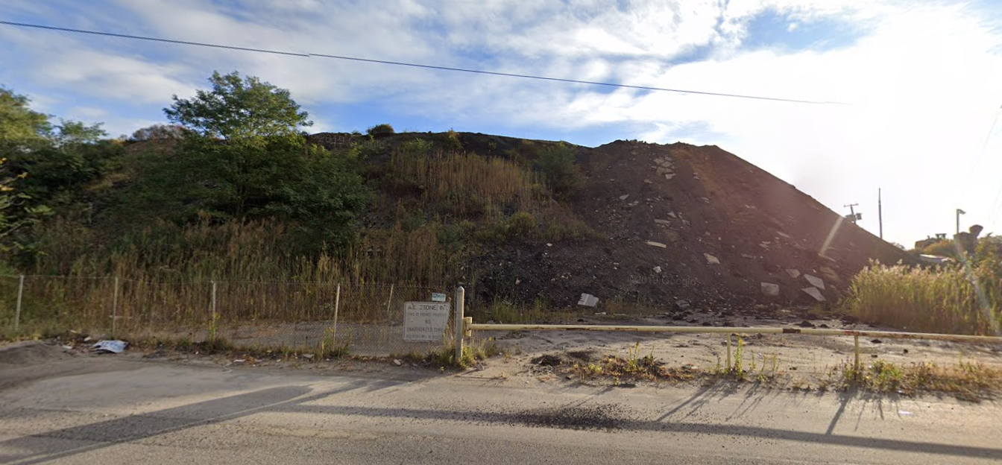
RAP Overview
#354 May 2020
RAP is obtained through milling and removal of existing pavement surfaces.
The New Jersey Department of Transportation (NJDOT) historically limited the use of RAP. RAP was not allowable in unbound applications.
Historical limitations on the allowable uses for RAP has led to excessive stockpiles of RAP throughout the state.
RAP stockpile near the project site.

Slide 5
RAP Overview
#354 May 2020
NJDOT and the Federal Highway Administration (FHWA) sponsored a study on the environmental impacts of RAP, which was published in May 2017 (FHWA-NJ-2017-008).
The study recommended that “RAP may be used as an unbound material in all environments except those which are highly acidic (pH ≤4).”
The NJ Senate and General Assembly subsequently signed into law P.L. 2017, Chapter 325, Senate No. 3521 allowing the expanded use of RAP, including “unbound or mixed with other materials for use as a base or subbase material in accordance with applicable engineering designs.”
The legislation and NJDOT study provided an avenue for the RAP to be used as backfill for an MSE berm.

Slide 6
RAP Laboratory Testing
A series of index tests were first performed on the RAP material, followed by a series of mechanical tests to determine appropriate design parameters.
A chemical analysis was completed to determine the leaching potential of the RAP contaminating the groundwater.
Synthetic Precipitation Leaching Procedure (SPLP)
Polynuclear Aromatic Hydrocarbons (PAHs)
Grain Size Analysis
Atterberg Limits
Specific Gravity
Absorption
Asphalt Content
Modified Proctor (at multiple temperatures)
Direct Shear
Pullout (with creep)
Triaxial
Deviotic Creep
Installation Damage

Slide 7
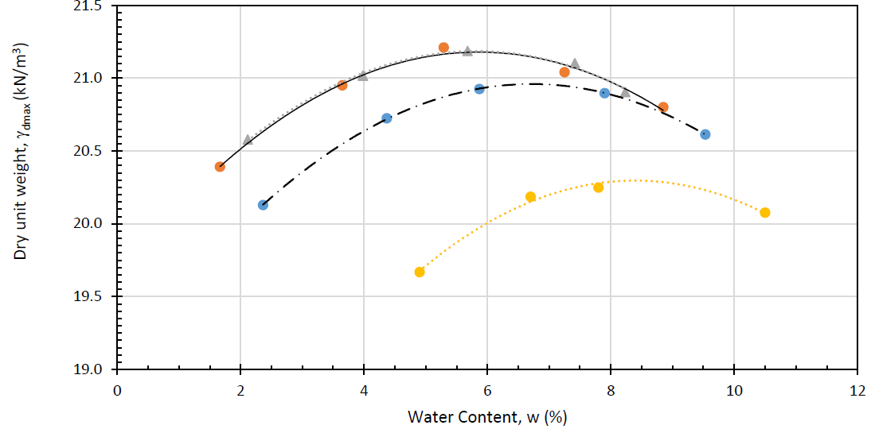
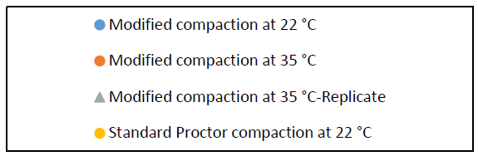
RAP Laboratory Testing
#354 May 2020
Chemical analysis indicated PAHs and select metals were not detected.
Compaction of material is temperature dependent.
Laboratory Modified Proctor Results.

Slide 8
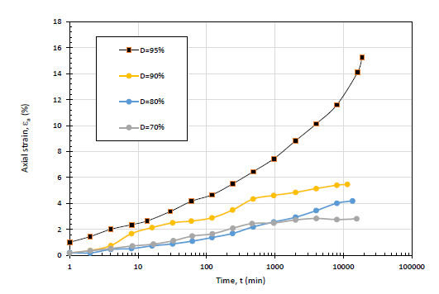
RAP MSE Berm Design
#354 May 2020
Lab testing showed that RAP undergoes creep strains at stress levels close to the maximum stress at failure.
No failure due to creep occurred at:
70% of compressive strength and 60% of pullout capacity.
Axial creep strain vs. time in compacted RAP at different stress levels.
Notes:
D is the ratio of the applied deviator stress to the deviator stress at failure as determined from triaxial compression testing. Excessive creep strain leads to creep rupture. No creep rupture observed when D is below 90%. At D=70%, the strain rate starts to decrease with no further increase at about 2000 minutes, indicating a stable condition.

Slide 9
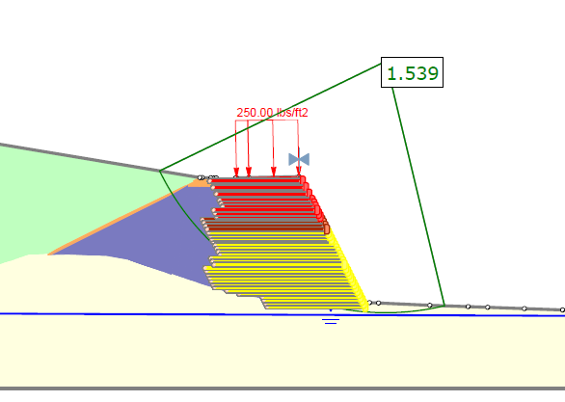
RAP MSE Berm Design
#354 May 2020
Slide and MSEW computer software programs were utilized to evaluate internal and external stability.
Analyzed circular and translational failure surfaces using both the Spencer method and GLE/Morgenstern-Price methods.
Global stability factors of safety were greater than 1.5 for static conditions and 1.1 for seismic conditions.
Slope stability analysis in Slide.

Slide 10
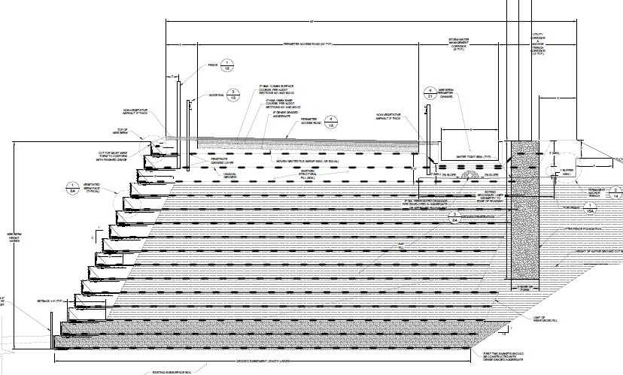
NJDEP Permitting
#354 May 2020
The RAP MSE berm was permitted as a Minor Modification through the NJDEP.
ARM conducted chemical testing to show there is not potential for groundwater contamination.
Special design considerations were incorporated to insulate the RAP portion of the MSE berm.
Notes:
Discuss insulation with structural fill.
Impermeable layers on top of the MSE berm.

Slide 11
Construction Specifications
#354 May 2020
RAP Gradation (processing required):
Sieve Size | Percent Passing
3” | 100
¾” | 100-60
No. 4 | 20-80
No. 40 | 10-50
No. 200 | 0-5
Minimum shear strength envelope: 39 degrees, 0 psf cohesion
RAP to be compacted to a minimum of 91% of the maximum dry density in accordance with the Modified Proctor.
RAP may not be compacted at ambient air temperatures less than 60 degrees Fahrenheit (generally May – October).

Slide 12
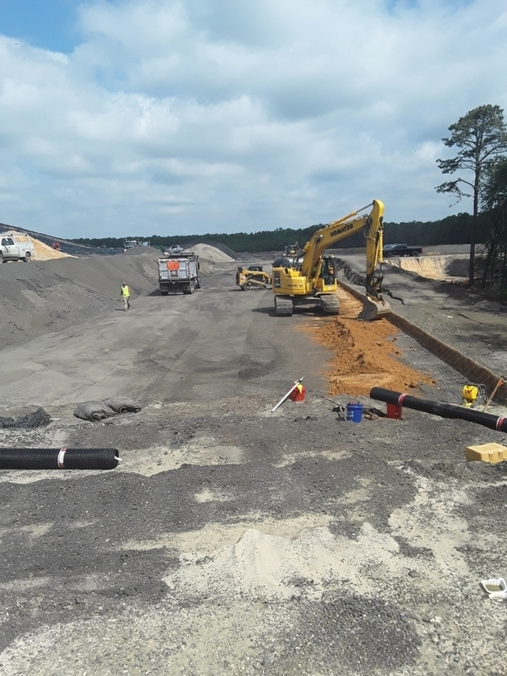
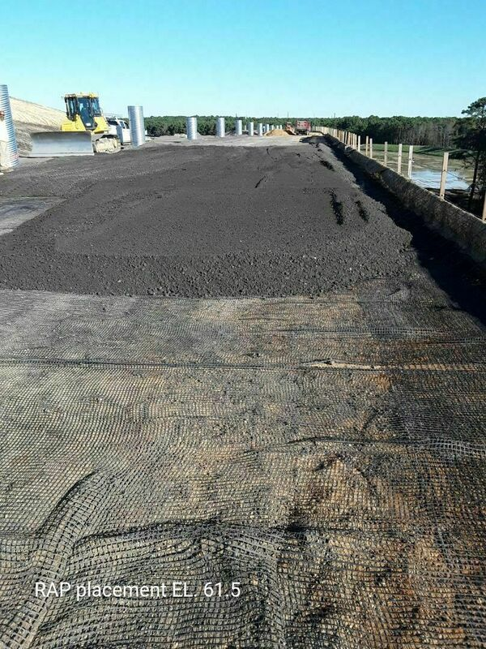
Construction of the RAP MSE Berm
#354 May 2020
Placing structural fill at the face of the berm.
Installing RAP above geogrid.

Slide 13
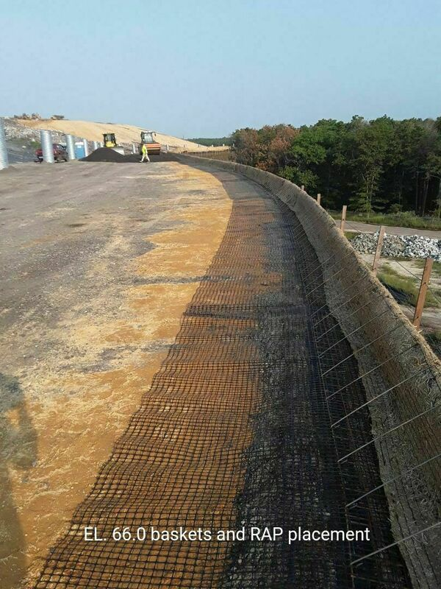
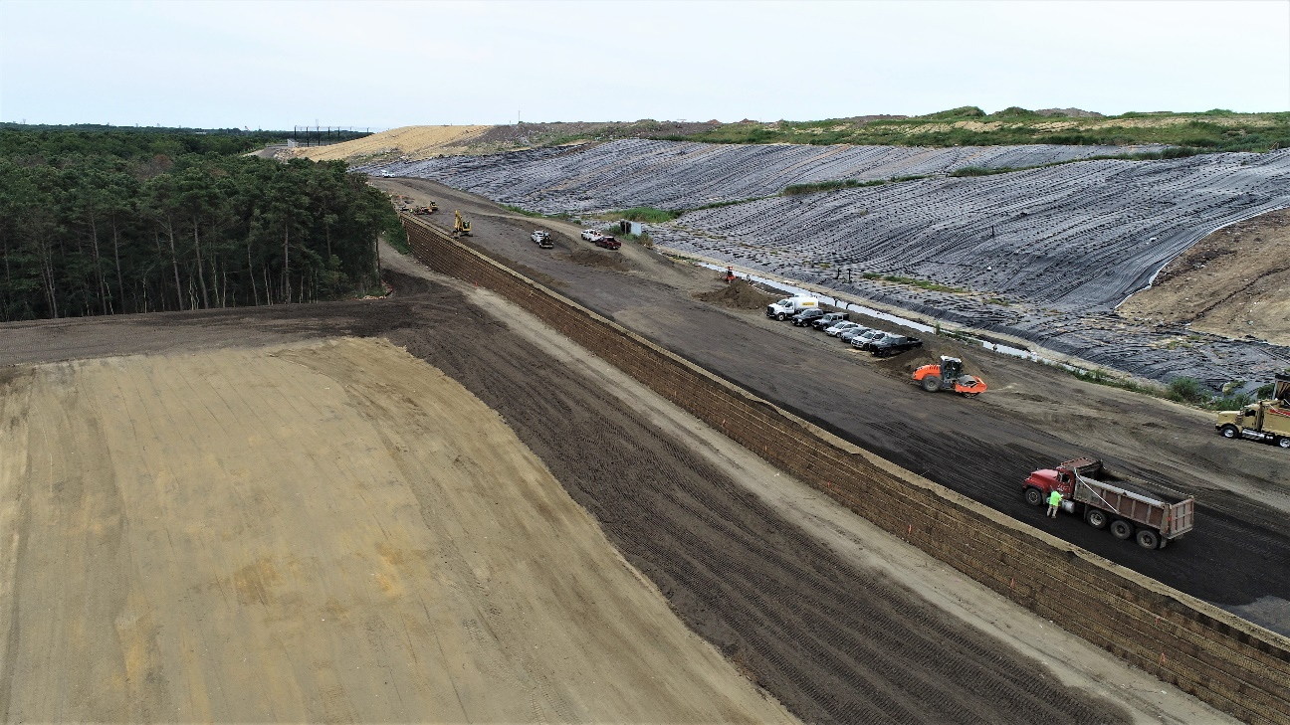
Construction of the RAP MSE Berm
#354 May 2020
Face of the MSE berm during construction.
MSE berm facing elements.

Slide 14
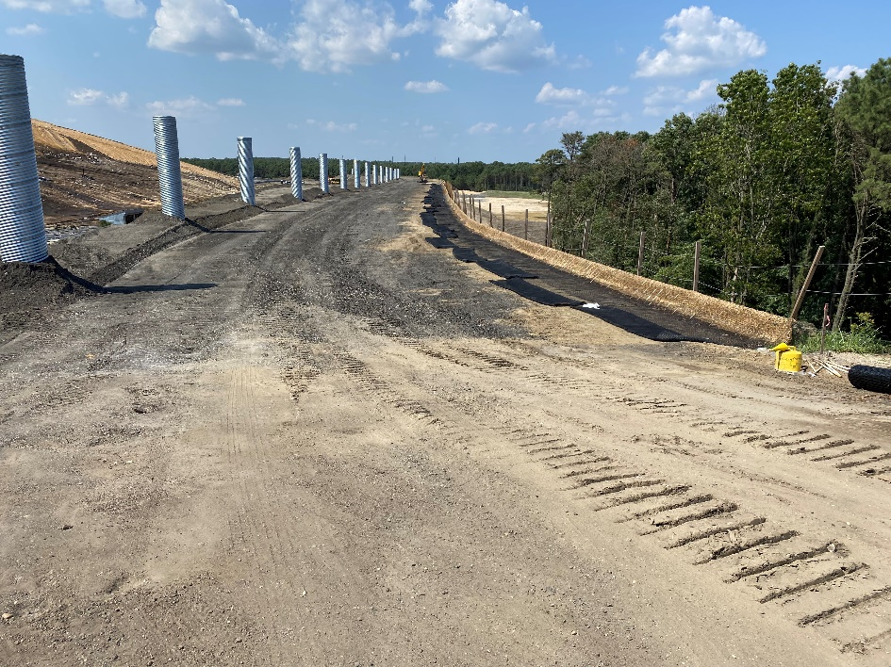
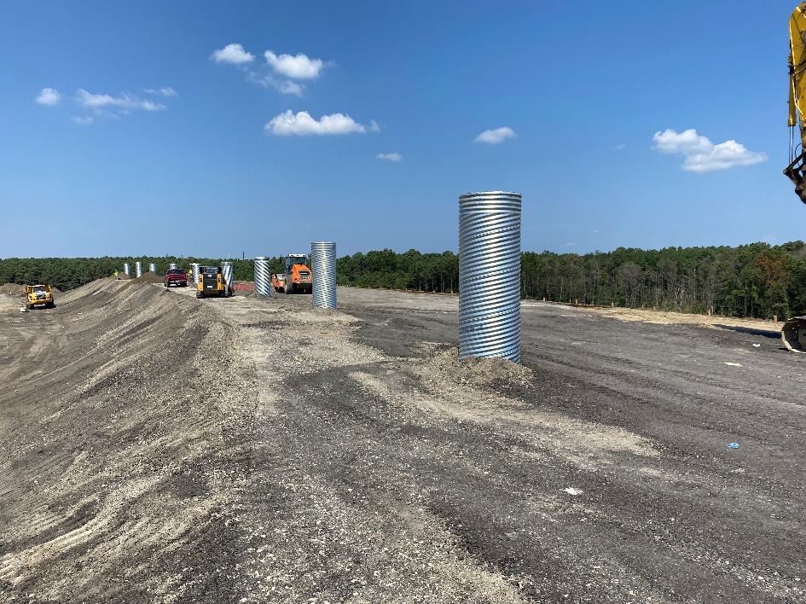
Construction of the RAP MSE Berm
#354 May 2020
Prepping geogrid for deployment.
Installation of litter fence foundation sleeves.

Slide 15
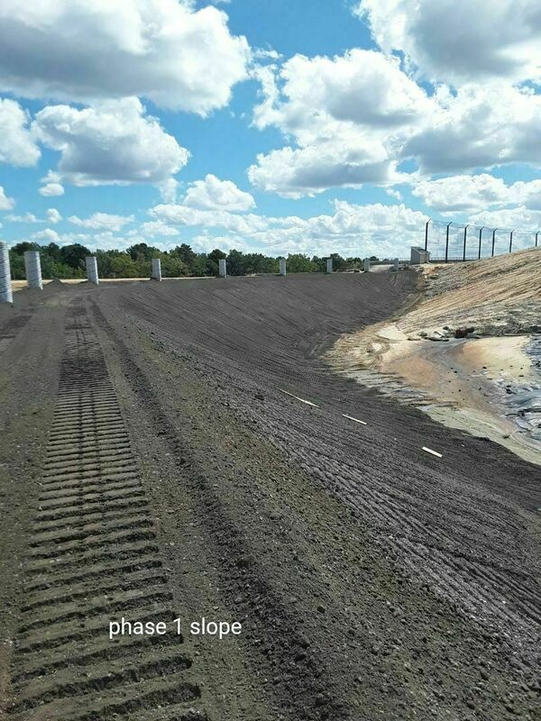
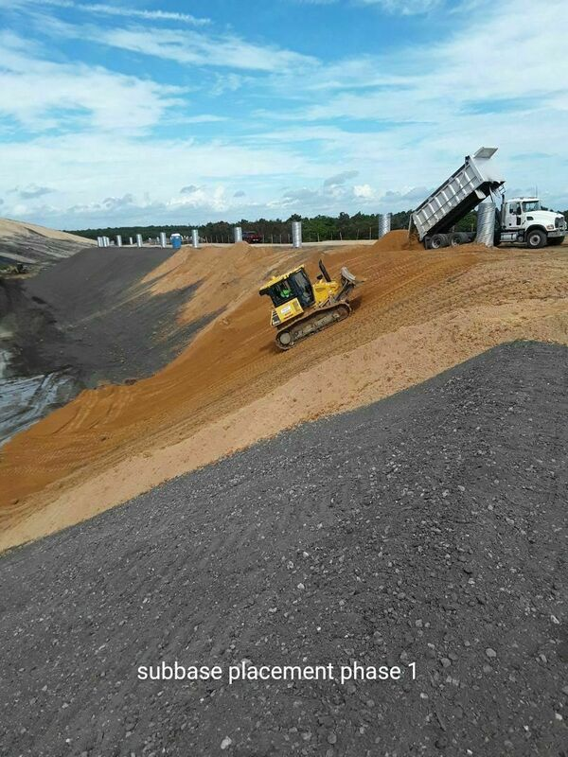
Construction of the RAP MSE Berm
#354 May 2020
Interior slope of RAP.
Placing structural fill cap on top of the RAP interior slope.

Slide 16
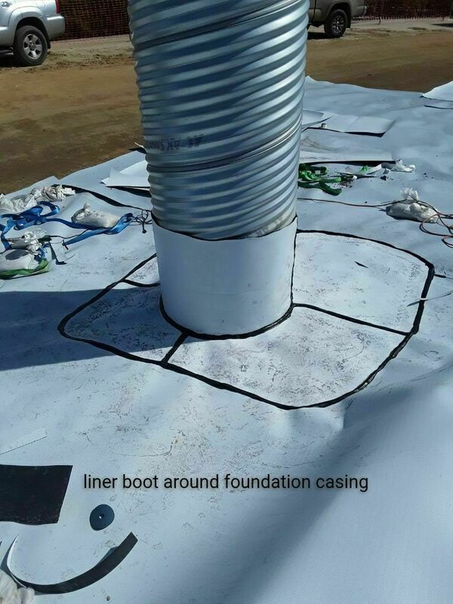
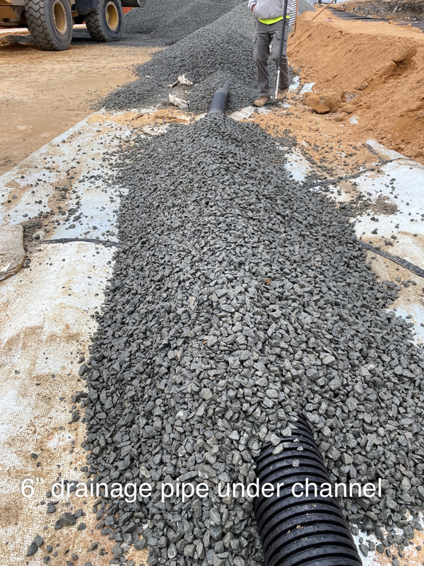
Construction of the RAP MSE Berm
#354 May 2020
Additional geomembrane placed below
the stormwater channel.
Drainage pipe installed on top of
the geomembrane layer.

Slide 17
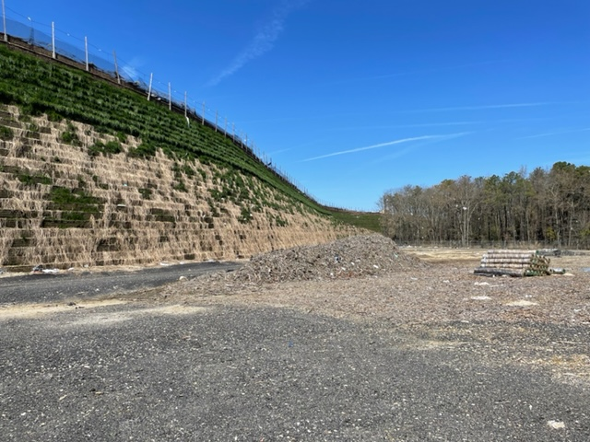
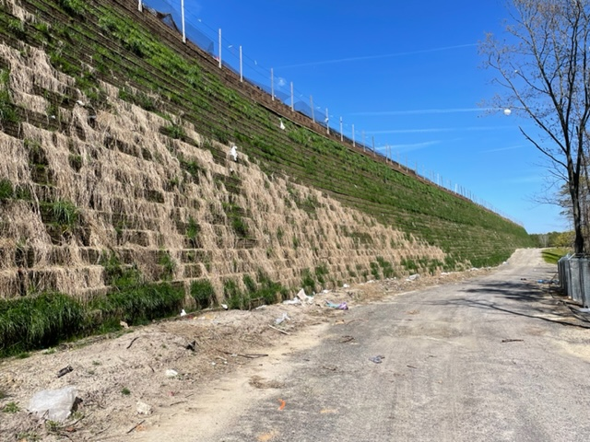
Construction of the RAP MSE Berm
#354 May 2020
Portion of the RAP MSE Berm exterior slope
(prior to hydroseeding). MSE berm height
is 51 feet.
Portion of the RAP MSE Berm exterior slope
(prior to hydroseeding). MSE berm height
is 49 feet.

Slide 18
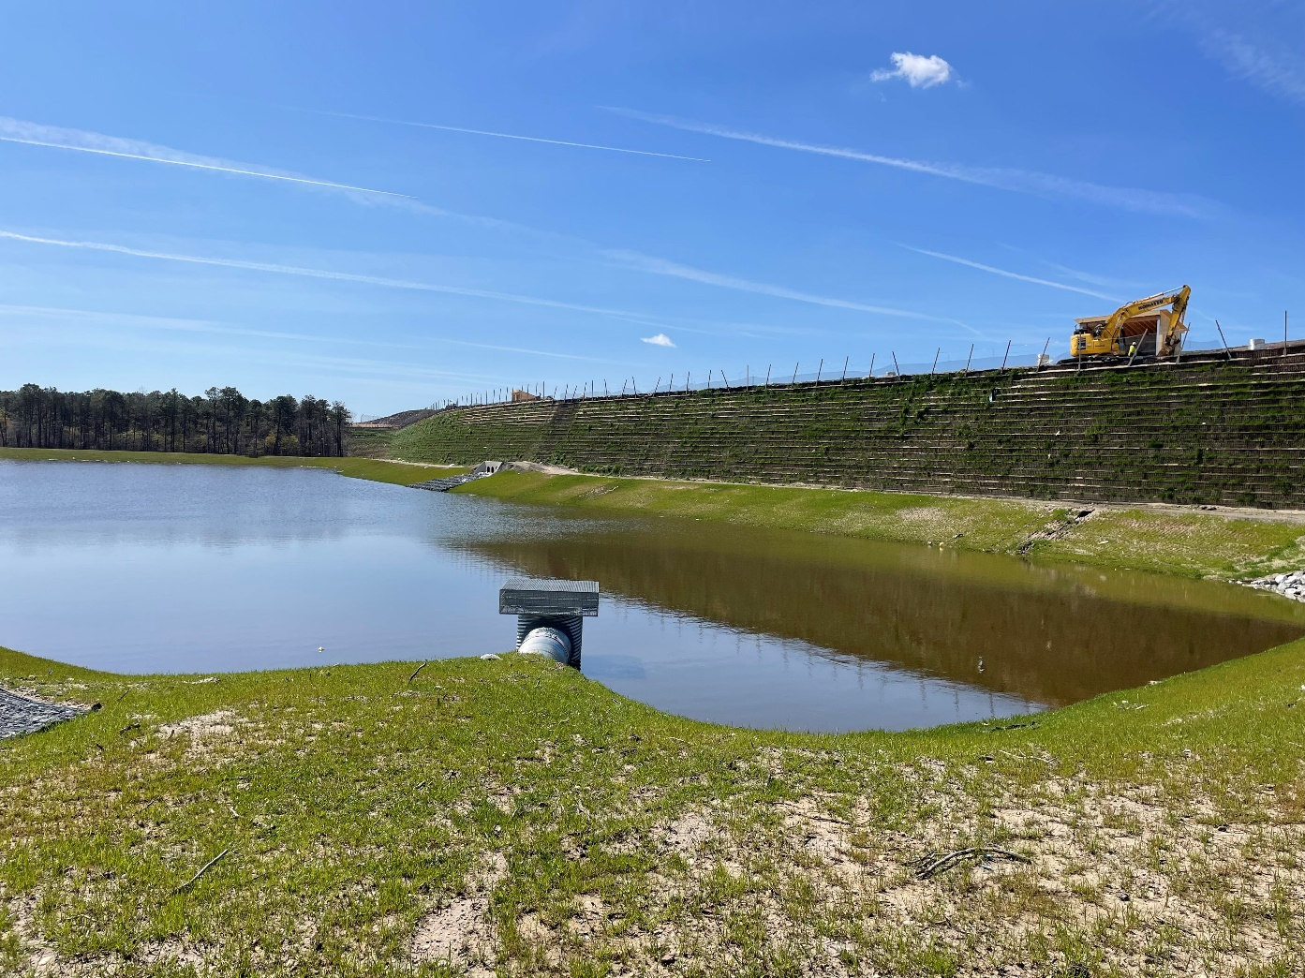
Construction of the RAP MSE Berm
#354 May 2020
RAP MSE berm with a stormwater basin in the foreground.
MSE berm height is 34 feet.

Slide 19
Cost Savings
#354 May 2020
RAP MSE berm was approximately 17% less ($1.3MM) than a soil MSE berm, according the low bid Contractor.
Multiple benefits from using RAP include cost savings as well as ease of construction during installation.
RAP is not as sensitive to precipitation events as soil materials, which expedited construction resuming following a storm event.
RAP stockpile was local with short haul distances, increasing productivity and reducing trucking costs.
Notes:
200,000 CY of RAP
55,000 CY of soil
88,000 SF of MSE berm facing
2,000 LF of drainage pipe/secondary extension
Originally bid as half soil and half RAP due to weather constraints.
Contractor came back and proposed to build the entire project with RAP. Increasing RAP from 106k CY to 200k CY.

Slide 20

Thank You
Benjamin S. Allen, P.E. (NJ, PA)
Senior Engineer
Phone: 717-250-5581
Email: ballen@armgroup.net
11 Eves Drive, Suite 190
Marlton, NJ 08053

