Slide 1
Management Challenges Associated w/ High Moisture Content in Landfills
VRA + SWANA Conference
VA Beach, Virginia
May 4, 2022

Slide 2
Overview
Causes of High-Moisture “Wet” Landfills
Inventory of Primary Challenges
Circumstances Associated with Challenges
Potential Solutions & Protocols to Improve Circumstances

Slide 3
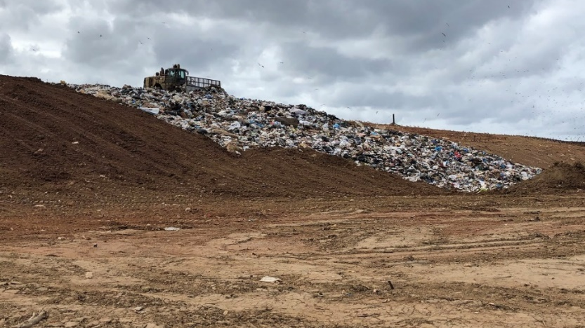
Why are landfills retaining substantial quantities of free liquids elevated within waste matrix?
Reduced Porosity/Permeability Due to Waste Characteristics
Increased Waste Densities
Enhanced Biological Decomposition
Increased Quantities of Plastic Waste

Slide 4
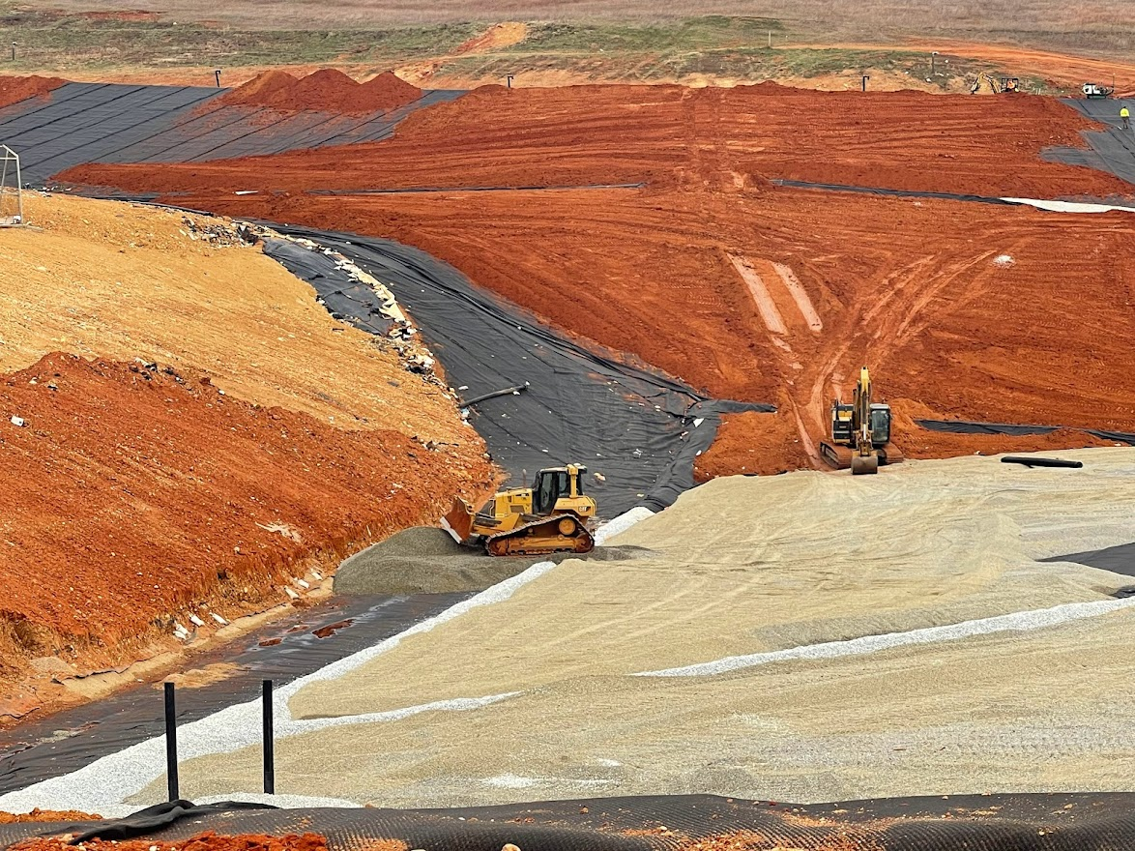
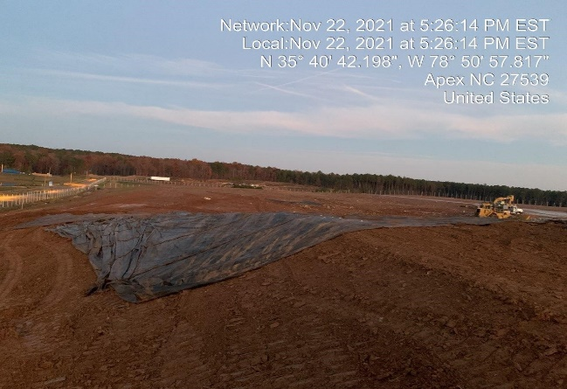
Why are landfills retaining substantial quantities of free liquids elevated within waste matrix?
Impermeable Zones Due to Design / Operations
“Protective Cover” - Placement of relatively low-permeable soil above the leachate drainage layer (typically a Geocomposite Drainage Net) and below the initial “fluff lift” of waste
Compacted Daily / Intermediate Cover Soil Layers

Slide 5
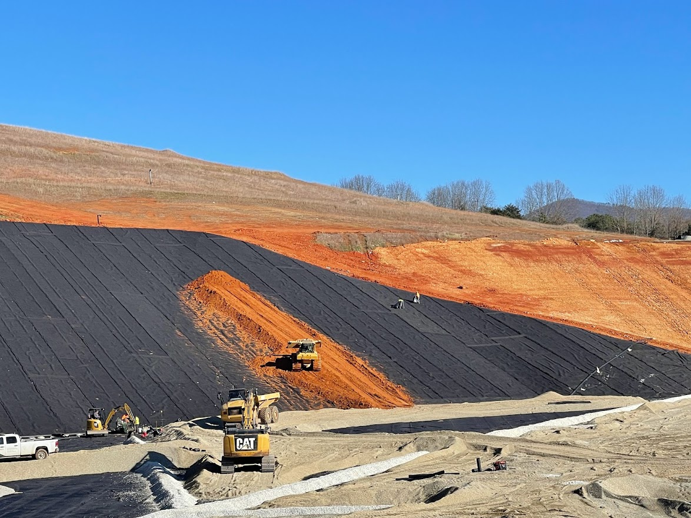

Slide 6
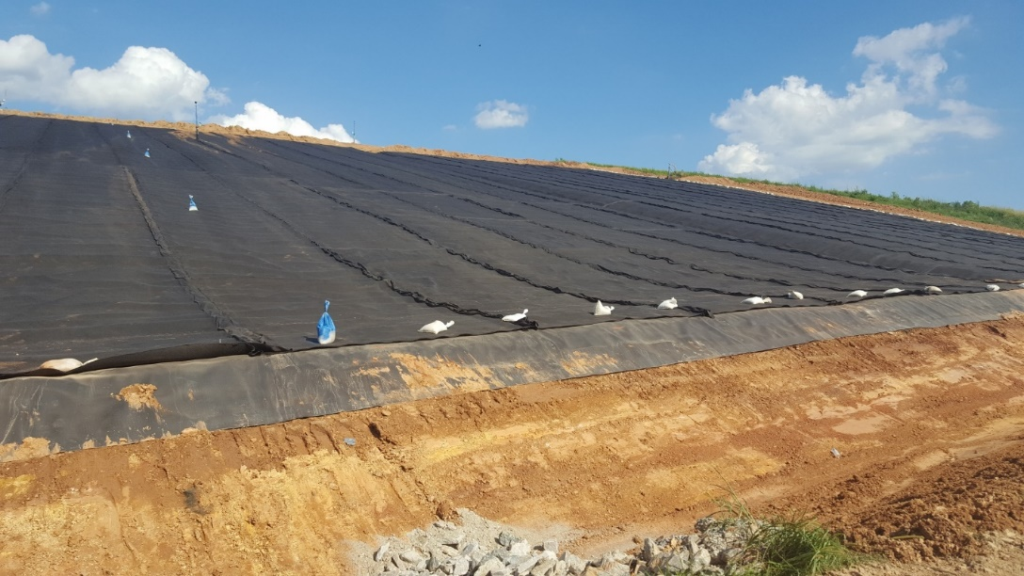
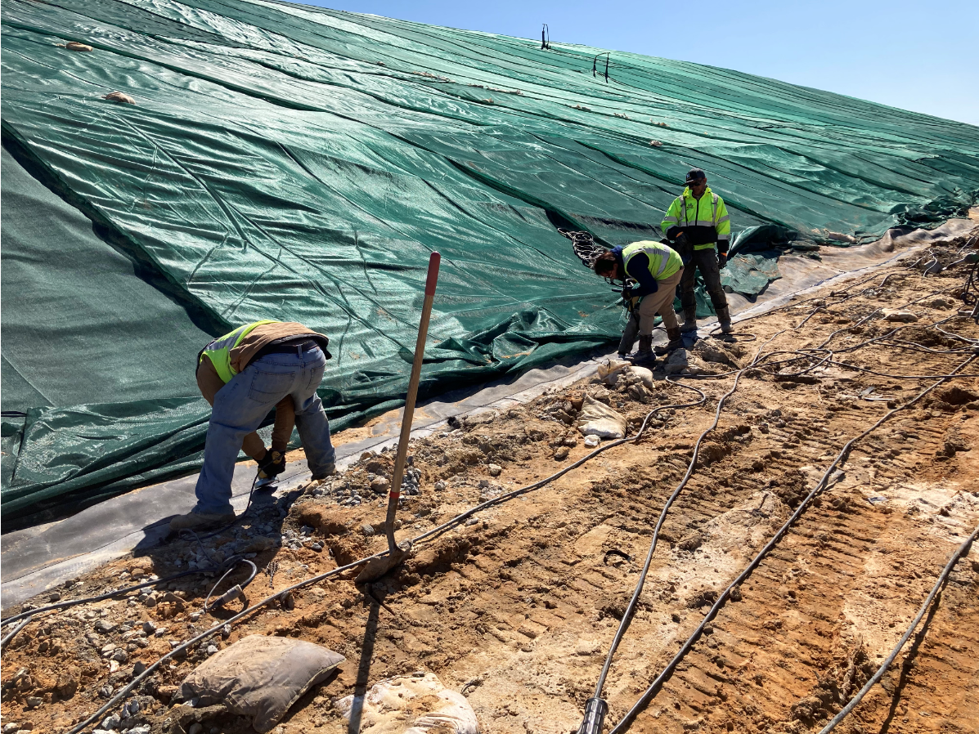
Why are landfills retaining substantial quantities of free liquids elevated within waste matrix?
Precipitation Infiltration
Delayed Timing of Final Cap Installation
Reluctance to Utilize EGCs as Interim Cover

Slide 7
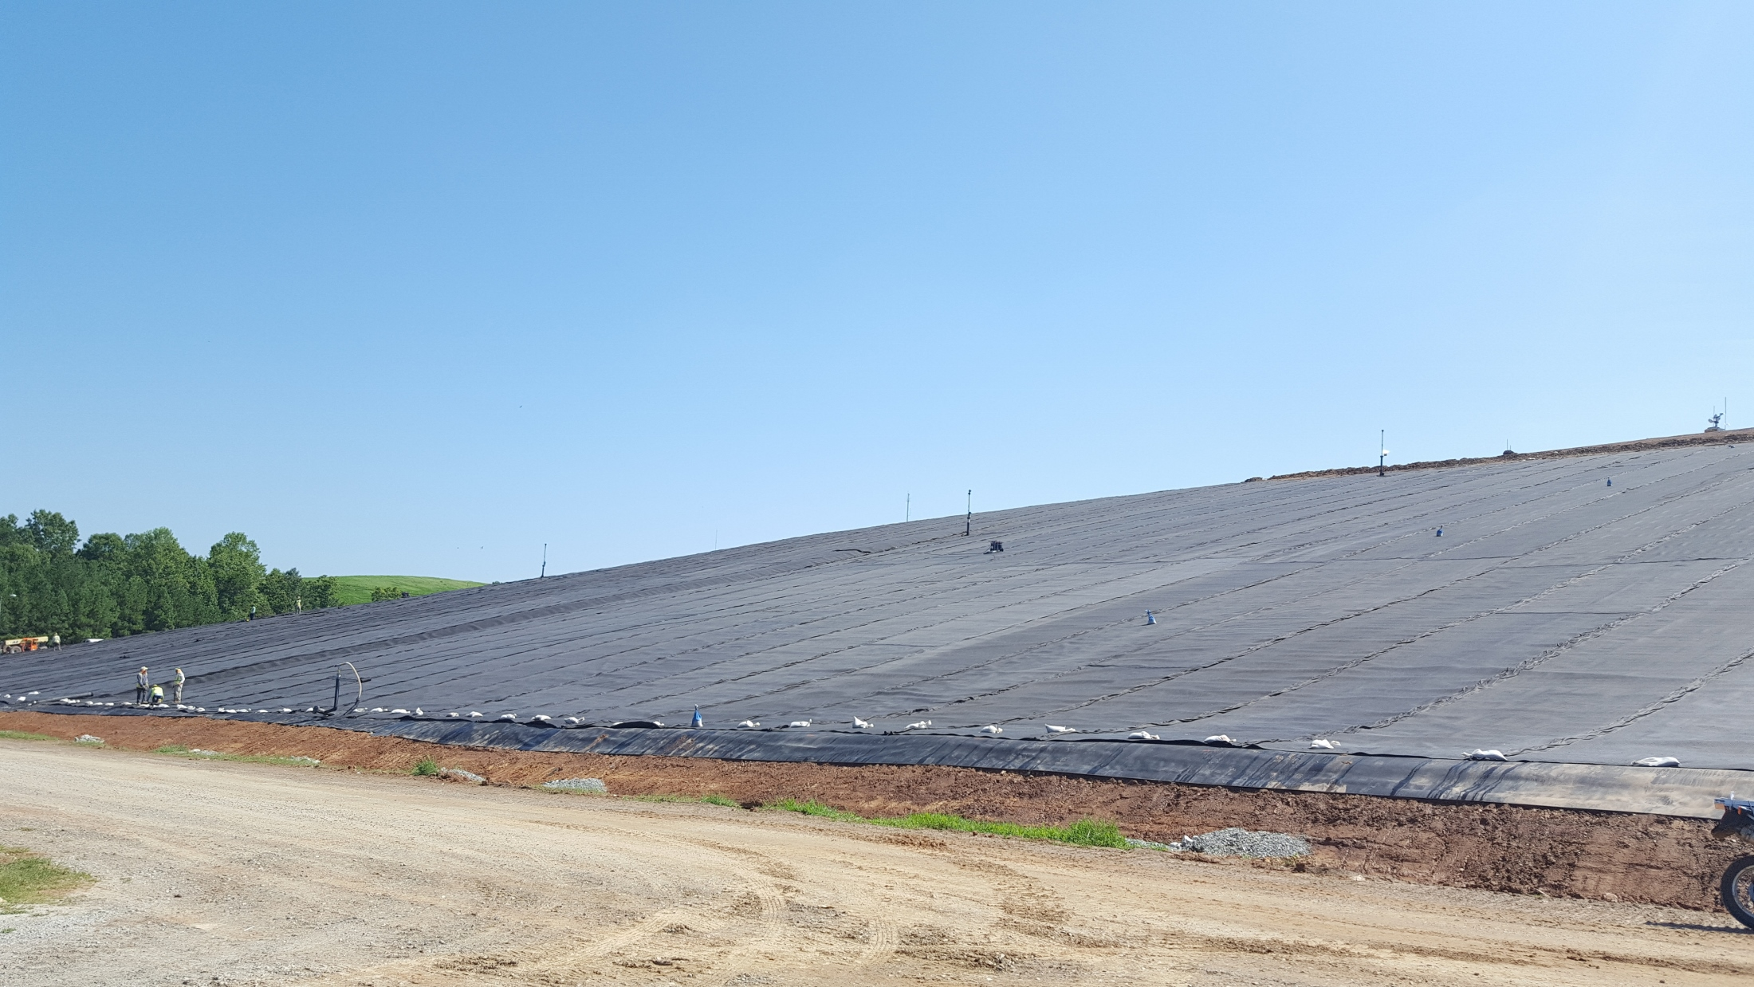

Slide 8
Inventory of Primary Challenges
Extraction of Liquids From Waste Mass
Handling / Disposal of Extracted Liquids

Slide 9
Circumstances Associated with Challenges – Secondary Problems
Insufficient LFG Collection System Effectiveness
- Odors
- Reduced LFGE Fuel
- Forcemain Clogging
- Non-Compliance
Slope Stability
Leachate Seeps

Slide 10
Inventory of Primary Challenges
Is Landfill capable of handling/disposing of extracted liquids?
- Storage
- Transport
- Treatment
- Discharge/Disposal)
Limitation on Storage Tank Capacity
Limitation on Transport (Tanker Truck) Capabilities
Leachate Quantity Limitations
Leachate Quality Limitations

Slide 11
Potential Solutions & Protocols to Improve Leachate Extraction
Mezzanine Leachate Collection Layers
GDN, Aggregate, Sand, Perforated Piping
Infrastructure to Enhance Liquids Movement
Bottom Liner Augmentation Features
Deep Dewatering Wells
Multiple Sump Locations

Slide 12
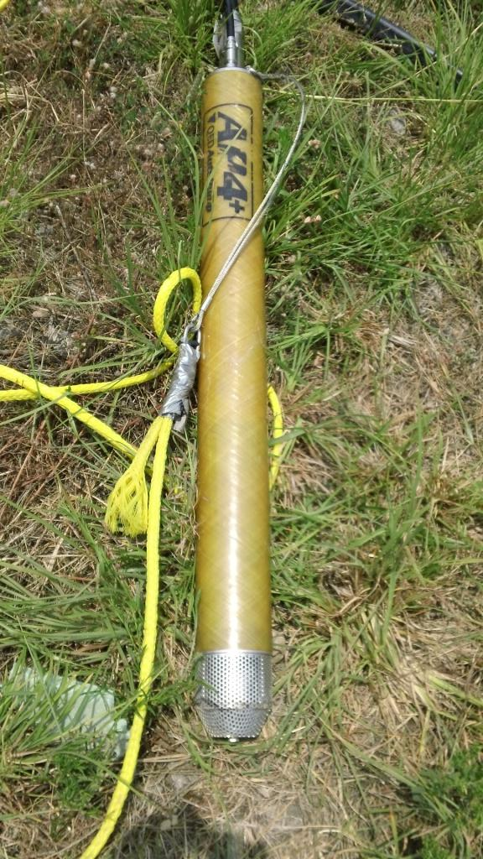
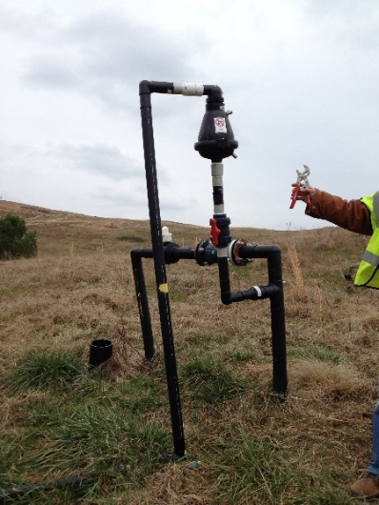
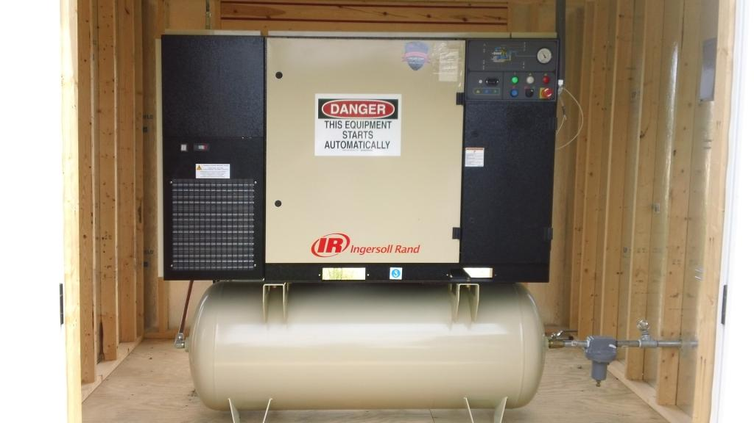
Dewatering Liquids Infrastructure
Dedicated Pneumatic Pump
Air Supply Line & Regulator
Liquids Discharge Forcemain
Isolation Valves
Air Release Valve
Air Compressor
Pump Stations

Slide 13
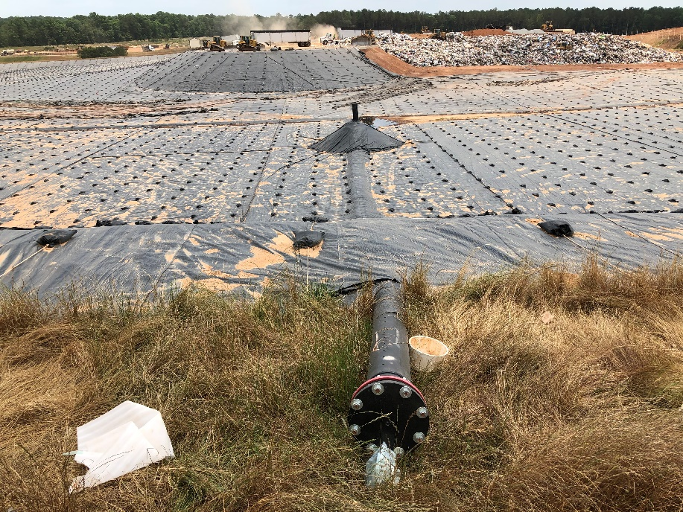
Bottom Liner Augmentation Features
Objective: Enhanced LFG Extraction Combined with Passive Liquids Drainage
LFG Well Aggregate Target Pile
“Rock Points” / “Gabion Cube”
Slope Collector Stub-Up Pipe
Bottom-Up Tiered Collectors
Chimney Drains; Caisson Wells
Sustainable Imperatives & Initiatives Achieved:
Reduced LFG & GHG fugitive emissions
Reduced environmental risk (leachate seeps)
Reduced energy consumption (fewer dewatering pumps)

Slide 14
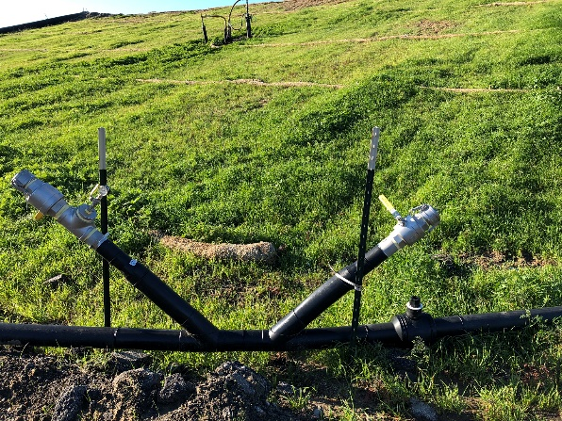
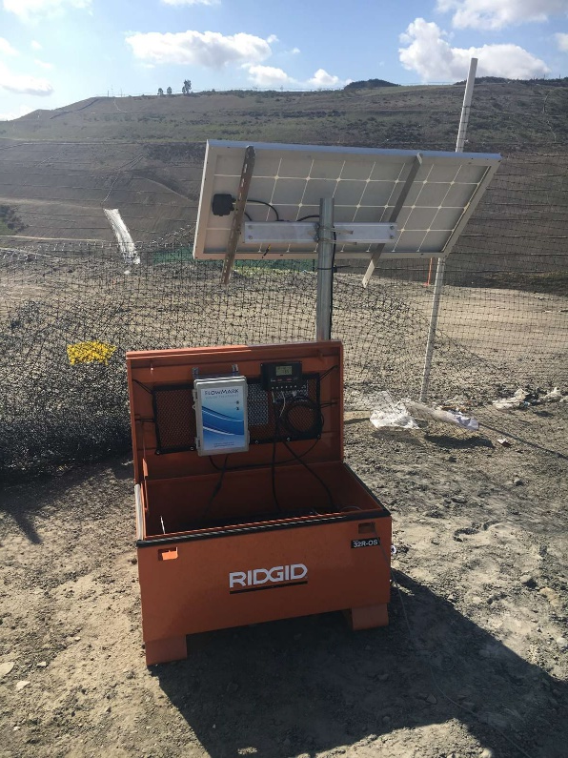
Leachate Collection & Liquid Management Systems
Increased Frequency of Cleaning:
Jetting & Chemical Cleaning of Piping
Cleaning & Servicing Wastewater Pumps
Cleaning & Debris Removal within Sumps
More Cleanouts & Access Points
Anti-Foam Agent Injection from Totes
Electronic Descaling
Sustainable Imperatives & Initiatives Achieved:
Reduced environmental risk of leachate release
Reduced energy consumption
Increased resiliency

Slide 15
Potential Solutions & Protocols to Improve Handling/Treatment/Disposal
Solidify
Install Pre-Treatment Plant
Nitrogen (NH3, TKN)
BOD / COD
TSS, TDS
Other Constituents (PFAS, VOCs, etc.)
Leachate Evaporators
VA - 6 Heartland Units
SC – 2 Heartland Units & 4 Aptim Units
NC – 1 Aptim Unit
Incur Additional Cost for T&D

Slide 16
Conclusions
High-Moisture Conditions will continue to plague landfills
Some aspects are more within our control
Consider implementing BMPs both for liquids extraction as well as subsequent handling/disposal

