Slide 2
Virginia DEQ Regulatory Update
VRA + SWANA Sharing Solutions
2022 Conference
Melinda Woodruff
Land Protection and Remediation Program Manager
Tidewater Regional Office

Slide 3
Outline
DEQ Leadership Updates
2022 Virginia General Assembly Update
Regulatory Amendments
Other DEQ Efforts
Guidance Updates
SWIA, Litter Grant and Recycling

Slide 4
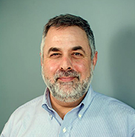
DEQ Leadership Updates
Michael Rolband
DEQ Director
Notes:
Michael Rolband, new DEQ Director, appointed by the Governor January 2022; succeeding David Paylor; Michael Rolband founded Wetland Studies and Solutions Inc. in 1991

Slide 5
DEQ Leadership Updates
Central Office
Land Division
Kathryn Perszyk
Director, Division of Land Protection & Revitalization
Brent Williams
Director, Office of Financial Responsibility & Waste Programs
Notes:
Brent Williams, new Office Financial Responsibility Waste Programs Director (1/25/22) - SW, HW, SWMP, Litter Grants & Recycling, SWIA, FA
Kathryn Perszyk, Land Division Director – OFRWP + Office of Remediation Programs (RCRA CA, Site Assessment, Brownfields, VRP, CERCLA, Risk Assessment), & Office of Spill Response & Remediation (Tanks/Petroleum Program)

Slide 6
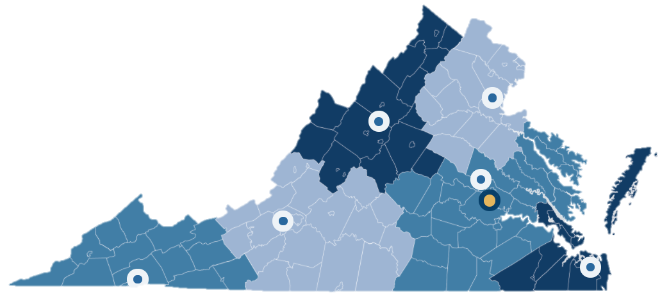
DEQ Leadership Updates
Regional Office Land Protection Managers
Richard Doucette Northern
Graham Simmerman Valley
Shawn Weimer Piedmont
Stacy Bowers
Southwest
Melinda Woodruff Tidewater
Nikki Herschler Blue Ridge
Notes:
Stacy Bowers, new SWRO LPM (11/25/21)
FYI – agency transitioned from desk phones to cell phones; new phone #s; pay attention to email taglines

Slide 7
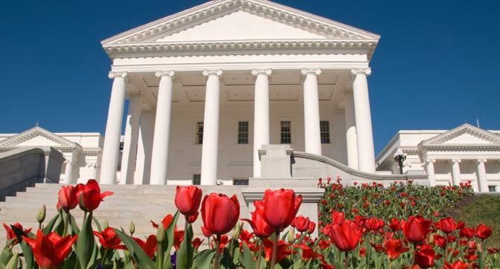
2022 Virginia General Assembly Update
virginiageneralassembly.gov
Notes:
2022 session convened January 12th. Adjourned March 12th.
30-day short session in odd-numbered years, 60-day long session in even-numbered years
Governor’s action deadline for bills that passed both House & Senate during the regular session = April 11, 2022
2022 Special Session I convened April 4, 2022 to resolve remaining bills & budget
Governor can call special session when necessary or petitioned by 2/3 members of both houses
Reconvened session scheduled for April 27, 2022
Reconvened session held on 6th Wednesday after adjournment of each session to consider governor's recommendations and vetoed legislation.

Slide 8
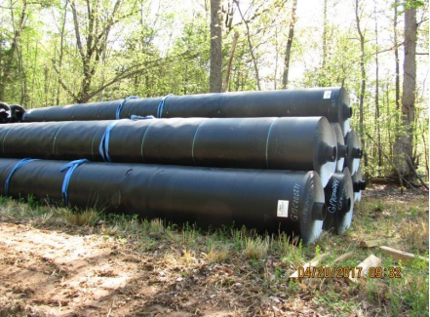
HB148/SB684 Pollution Control Equipment Tax Certifications
For pollution control equipment & facilities used as part of a political subdivision's water, wastewater, stormwater, or solid waste management facilities or systems
Equipment may now be certified by the political subdivision itself
If certified by the political subdivision, state (DEQ) certification not required
Approved by the Governor
Effective July 1, 2022
Notes:
HB148 signed by Governor 3/2/22, effective July 1st ; identical to SB684; Gov’s action deadline April 11th)
Certified pollution control equipment – property (real or personal property), equipment, facilities, or devices, used primarily to abate or prevent pollution and certified to Dept. of Taxation as constructed in conformity with the state requirements for abatement or control of pollution or contamination
Examples = liner components, leachate management materials, gas collection components and final cover components
Equipment, facilities, devices, or other property intended for use by any political subdivision in conjunction with the operation of its water, wastewater, stormwater, or solid waste management facilities or systems, it can be certified prior to construction
HB148 amends §§ 58.1-609.3 and 58.1-3660 of the Code of Virginia. For pollution control equipment to be used as part of a political subdivision's water, wastewater, stormwater, or solid waste management facilities or systems, such equipment may be certified by the political subdivision itself instead of by the state certifying authority.
"Subdivision certifying authority" means the body of a political subdivision responsible for administering the political subdivision's water, wastewater, stormwater, or solid waste management facilities or systems. A subdivision certifying authority may only certify property pursuant to this section if the property being certified is equipment, facilities, devices, or other property intended for use by the political subdivision in conjunction with the operation of its water, wastewater, stormwater, or solid waste management facilities or systems.
DEQ Guidance on Tax Certification for Pollution Control available on town hall
More information on tax incentive programs on DEQ website
Certified pollution control equipment & facilities are declared a separate class of property and exempt from state and local taxation
Retail sales and use taxes do not apply to certified pollution control equipment and facilities

Slide 9
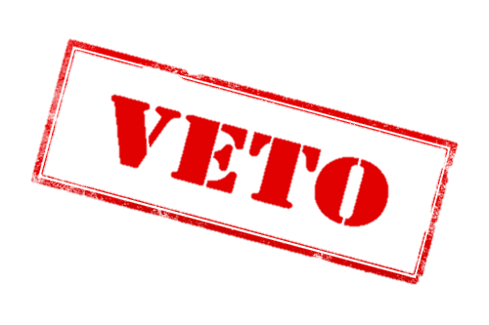
SB250 Solid Waste Permits – Annual Fee Increases
Solid Waste Management Facility | *Existing Annual Fee | New Proposed Annual Fee
Sanitary, CDD, & Non-Captive Industrial Landfills | $0.115 / ton | Greater of $12,000 or $0.30 / ton
Active Captive Industrial Landfills (Small < 100,000 tons/yr) | Small $2,500 Large $7,500 | Active Captive Landfills $32,000
Permitted Surface Impoundments | - | $12,000
Units in Post-Closure | $1,000 | $7,500
Incinerators & Waste-to-Energy | $0.055 / ton | Greater of $6,000 or $0.0647 / ton
Composting | $1,200 | $5,500
Regulated Medical Waste | $2,500 | $5,500
Materials Recovery | $4,500 | $6,500
Transfer Stations | $5,500 | $6,500
*Fees as of 2011 at §10.1-1402.1:1. Rates adjusted annually for inflation.
Notes:
SB250 signed by both House & Senate during regular session & Gov’s action deadline = April 11, 2022 (vetoed)
Reconvened session April 27, 2022 to consider governor's recommendations and vetoed legislation.
Currently DEQ collects annual fees & permit application fees pursuant to statute & fee regs
SB1210 (2021) directed DEQ to convene work group to study and recommend new fees to cover program costs – final report online
Workgroup recommended continuing annual inflation updates & proposed annual fee increases depending on fac type & workload
Annual fees = base fee rates by facility type and/or based on volume of waste landfilled or incinerated; calculated from tonnage reported on SWIA reports for preceding CY & adjusted annually by Consumer Price Index for inflation
Fees collected only cover ~42% (~$2.9 mil) of total direct costs of the program (~$6.8 mil)
Additional fees (based on current fac #/type/tonnage) should cover direct costs needed to run DEQ SW permit/comp/mon program
Some LFs remain active & take in small amts of waste, but DEQ workload still the same, so san/cdd/non-cap ILF annual fee greater of $12,000 or $0.30/ton.
Similarly, inc/WTE annual fee greater of $6,000 of $.0647/ton
Single flat fee for active captives (DEQ workload about the same for small/large) -> annual fee $32,000
Adjusted flat fee for PBRs (compost, RMW, MRFs, TS)
New flat fee of $12,000 for SI’s w/permit
No changes to barge fac
Bill as proposed didn’t indicate the implementation date

Slide 10
SB250 Solid Waste Permits – Application Fee Increases
New or Initial Issuance or Action
Type of Facility/Permit | Existing Fee | New Proposed Fee
Landfill – Part A Application | $4,180 | $5,500
Landfill – Part B Application | $18,680 | $25,000
Experimental Solid Waste Facility | $2,090 | $3,000
PBR Initial Review/Confirmation | $390 | $1,500
Emergency Permit | $2,310 | $3,000
Major Permit Actions, Amendments, or Modifications
Type of Permit Module | Existing Fee | New Proposed Fee
Landfill Part A | $4,180 | $5,500
General – Module I | $390 | $750
Facility – Module II | $1,310 | $1,750
Notes:
SB250 signed by both House & Senate during regular session & Gov’s action deadline = April 11, 2022 (vetoed)
Reconvened session April 27, 2022 to consider governor's recommendations and vetoed legislation.
If SB250 becomes law, statutory change also allows DEQ to amend fee regulations (9VAC20-90) per work group recommendations to increase permit application fees, establish a new fee for minor permit mods, and incorporate an annual adjustment to permit application fees for inflation.
Permit application fee schedules in fee regs had not been adjusted since 2004
Workgroup recommended (w/a few exceptions), adjusting all permit application fees to account for inflation since 2004 (approximately 32%)
Exception- application fees for Permit by Rule initial review $1500 & $750 for each modification
Major permit actions, amendments or modifications (including all modules) should be adjusted for CPI increases since 2004 but should be no lower than $750

Slide 11
SB250 Solid Waste Permits – Application Fee Increases
Major Permit Actions, Amendments, or Modifications (continued)
Type of Permit Module | Existing Fee | New Proposed Fee
*Landfill – Module III, IV, or V | $7,050 | $9,300
**Groundwater mon. – Module X or XI | $3,260 | $4,300
Closure – Module XII | $390 | $750
Post-Closure – Module XIII | $390 | $750
Corrective action – Module XIV | $3,000 | $4,000
Leachate handling – Module XV | $1,310 | $1,750
PBR Modification Review/Confirmation | $390 | $750
Public Participation | $1,040 | $1,500
Minor Modifications | - | $750
*Fees for review of specific types of plans, designs, and systems vary
**Fees for well placement, materials & specifications, and sampling plan vary
Notes:
SB250 signed by both House & Senate during regular session & Gov’s action deadline = April 11, 2022 (vetoed)
Reconvened session April 27, 2022 to consider governor's recommendations and vetoed legislation.
Exception- application fees for Permit by Rule initial review $1500 & $750 for each modification
Establishing new $750 permit application fee for minor modifications (requires statutory change)
***Public participation (does not include costs of newspaper advertisements or radio broadcasts)

Slide 12
SB250 Solid Waste Permits – Application Fee Increases
Variance Requests
Type of Variance | Existing Fee | New Proposed Fee
Base fee for all variances | $390 | $750
Supplemental fees based on variance type Exemption from classification as SW | $520 | $700
Variance to permitting requirements Siting requirements Facility design (except alt liner design) Groundwater (except GPS & location) | $520 $520 $920 | $700 $700 $1,200
Alternate liner system design | $1,570 | $2,000
Location of groundwater mon. system | $920 | $1,200
No fee is charged for variances to permit operational requirements, permit closure requirements, permit post-closure requirements, or GPS
Notes:
SB250 signed by both House & Senate during regular session & Gov’s action deadline = April 11, 2022 (vetoed)
Reconvened session April 27, 2022 to consider governor's recommendations and vetoed legislation.
Exception- base fee associated with an application for a variance should be $750
Annual CPI adjustment to all permit application fees going forward (requires statutory change)

Slide 13
HB1261/SB657 State Environmental Boards & Authorities
Impacts DEQ Environmental Boards
VA Waste Management Board
State Water Control Board
State Air Pollution Control Board
Changes how members of all boards are appointed (HB1261)
Removes Air & Water Board authority to issue permits & orders, but keeps authority to issue regulations, similar to the Waste Board (SB657)
RVAmag.com
Notes:
HB1261 was still pending at the end of the regular session so it was carried forward to the 2022 Special Session I (convened Apr 4, 2022)
HB1261 - Currently, all members of such boards are appointed by the Governor.
This bill would make appointment of members to air, water & waste boards the Governor, the Senate Committee on Rules, and the Speaker of the House of Delegates.
SB657 signed by both chambers during regular session & Gov’s action deadline = Apr 11, 2022.
Governor approved to become law.
SB657 removes authority of air/water to issue any environmental permit, or abridge or deny any environmental permit issued by DEQ
Rvamag.com photo of VA State Water Control Board hearing in 2017

Slide 14
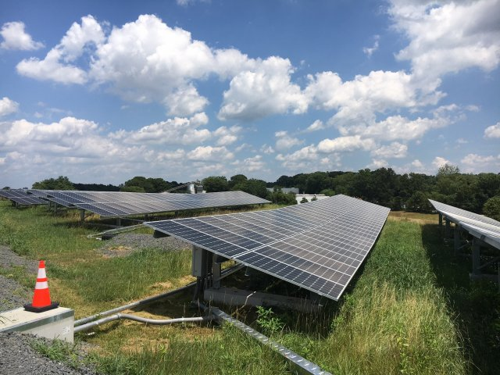
SB499/HB774 Life Cycle of Renewable Energy Facilities
Directs the SCC (with VA Energy & DEQ) to create a task force to analyze the life cycle of renewable energy facilities
Requires Task Force Report by May 1, 2023
Approved by Governor & effective July 1, 2022
SOLAR, WIND, & BATTERY STORAGE COMPONENTS
Feasibility, costs, recycling, waste strategies, & liability of decommissioning
Impacts of underground infrastructure
Impacts on farming, forestry, & sensitive wetlands
Beneficial economic impacts of solar, wind, and battery storage development
EPA
Notes:
SB499 & HB774 identical; signed by both chambers during regular session; approved by Governor April 1 & become effective July 1, 2022
Directs State Corporation Commission, in consultation with Dept of Energy and DEQ to create task force to analyze life cycle of renewable energy facilities in the Commonwealth, including solar, wind, and battery storage components
SCC to report to the Governor & GA committees no later than May 1, 2023.
The analysis shall assess the
(i) feasibility, costs, recycling and salvage opportunities, waste strategies, and liability for the decommissioning of materials;
(ii) potential impacts of underground infrastructure post-decommissioning;
(iii) potential impacts of the life cycle on farming, forestry, and sensitive wetlands; and
(iv) potential beneficial economic impact of solar, wind, and battery storage development.
Task force = reps of local governments, VA Solar Energy Development and Energy Storage Authority, Dept of Energy, and DEQ and at least one representative for each of the following sectors: agriculture, forestry, regulated electric service providers, competitive electric service providers, rural utility consumer services cooperatives, and renewable energy service providers, as well as organizations with expertise in the climate and environment.
Note: DEQ has HW solar panel disposal guidance doc (solar panels can sometimes be HW); wind turbine blades likely SW (not likely HW) but hard to recycle and also hard to dispose at landfills
ASTSWMO recently looking into electric vehicle batteries, solar panels, wind turbine blades, and other emerging wastes from renewable energy sources.

Slide 15
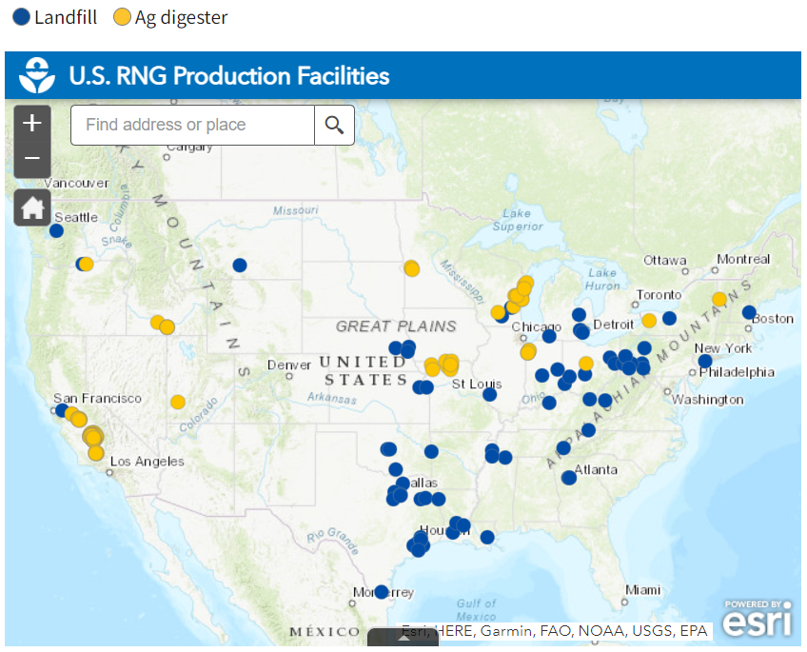
HB558/SB565 Natural Gas, Biogas & Methane Reduction
Allows natural gas utilities to include in their fuel portfolios other gas sources (e.g. biogas) that meet certain standards and reduce emissions intensity
Directs DEQ to convene work group to study feasibility of state methane reduction goal (Report due July 1, 2023)
Operational renewable natural gas projects with biogas from landfills or livestock waste anaerobic digesters (EPA LMOP)
Notes:
HB558 & SB565 identical; signed by House & Senate during regular session & Gov action deadline April 11, 2022.
Governor made recommendations/minor tweaks.
Permits natural gas utilities to include in their fuel portfolios, submitted to the State Corporation Commission to monitor fuel prices and purchases, supplemental or substitute forms of gas sources, defined in the bill, that meet certain standards and that reduce emissions intensity.
DEQ to convene a work group of stakeholders to determine the feasibility of setting a statewide methane reduction goal and plan to achieve the same. DEQ to report findings and recommendations to GA by July 1, 2023.
May incentivize renewable natural gas projects & encourage investment in methane emissions reductions but still regulated under SCC
DEQ involvement is small part of this bill – Air & Renewable Energy Group would assist with work group study
EPA’s Landfill Methane Outreach Program (LMOP) supports the development of RNG projects and encourages recovery and beneficial use of biogas generated from organic municipal solid waste. LMOP maintains a database that includes operational RNG projects (from anaerobic digesters and landfills) as well as opportunities for landfill sites where RNG could potentially be generated.
---
The bill amends provisions of the Code related to conservation and energy efficiency programs, removes certain cost-effectiveness requirements for conservation and energy efficiency programs, and adds appliance rebates to the types of programs the Commission may consider.
The bill expands conservation and ratemaking efficiency provisions of the Code that currently apply to natural gas consumption specifically to instead apply generally to energy consumption.
The bill introduces enhanced leak detection and repair programs, defined in the bill, as a type of eligible infrastructure replacement for a natural gas utility facility. Costs of detecting and repairing leaks may be added to a natural gas utility's plan to identify proposed eligible infrastructure replacement projects and related cost recovery mechanisms, known as the utility's Steps to Advance Virginia's Energy (SAVE) Plan.
The bill adds provisions to the Code related to biogas supply infrastructure projects. Eligible infrastructure costs for these projects include (i) the investment in eligible biogas supply infrastructure projects, (ii) the return on the investment, (iii) a revenue conversion factor, (iv) operating and maintenance expenses, (v) depreciation, (vi) property tax and other taxes or government fees, and (vii) carrying costs on the over-recovery or under-recovery of the eligible biogas supply infrastructure costs. Under the bill, natural gas utilities can recover these eligible infrastructure costs on an ongoing basis through the gas component of the utility's rate structure or other recovery mechanism approved by the Commission. The plan submitted by the utility may include an option to receive the biogas or sell the biogas at market prices. The timeline for the Commission to approve such plan is included in the bill. The bill further states that a natural gas utility with an approved biogas supply infrastructure plan must file a report of the investments made, the eligible infrastructure costs incurred and the amount of such costs recovered, the volume of biogas delivered to customers or sold to third parties during the 12-month reporting period, and an analysis of the price of biogas delivered to customers and the market cost of biogas during the reporting period.
Additionally, the bill requires each natural gas utility with an eligible biogas supply infrastructure project to report annually to the Commission the reduction in methane and carbon dioxide equivalent emissions from each such approved project.

Slide 16
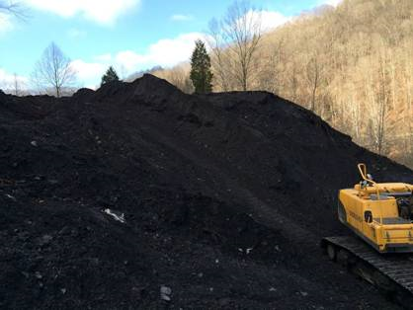
SB120/HB657/HB1326 Waste Coal Piles
Directs VA Energy to identify waste coal piles and options for clean-up
Directs DEQ (with VA Energy & VDOT) to convene work group to evaluate opportunities for development of public infrastructure projects at current or proposed sites for storing coal ash
Reports due December 1, 2022
Dominion Energy
Notes:
SB120 & HB657 now identical; passed house & senate during regular session; Gov’s action deadline Apr 11
(!) Governor made recommendation to direct VA Dept of Energy to convene the public infrastructure opportunities work group with DEQ & VDOT to be participants.
Dept of Energy in cooperation with the public institutions of higher education serving coalfield region of VA, shall identify the approximate volume and number of waste coal piles present in the coalfield region of the Commonwealth and options (& best practices) for cleaning up such waste coal piles, including the use of waste coal in generation of electricity.
For purposes of this act, "waste coal" means usable material that is a by-product of previous coal processing operations.
According to a study published January 2022 by the Appalachian School of Law (ASL) and Econsult Solutions, Inc. (ESI), Va Energy has identified 245 legacy Garbage of Bituminous (GOB, aka waste coal) piles in Virginia concentrated in the southwest region.
DEQ to convene a working group, with representatives from Dept of Energy, VDOT’s Transportation Research Council, and other stakeholders, to evaluate the opportunities for the development of public infrastructure projects at current or proposed sites for the storage of coal ash in the Commonwealth.
Original bill required study of potential use of coal ash in construction related to public infrastructure projects (language now removed)
Reports due to GA from both groups by Dec 1, 2022
HB1326 emphasizes that removal of waste coal piles from previously mined sites is in the public interest
HB1326 signed by both House & Senate during regular session and Gov’s action deadline = Apr 11
HB1326 changes sunset date of commission on electric utility regulation from 2022 to 2024 & asks Commission on Electric Utility Regulation to review waste coal pile info & options for clean-up
Dominion & AEP are required to close coal ash impoundments under SW permits by removing ash for landfill disposal or encapsulated beneficial use
Waste coal is not considered coal combustion residuals requiring management in accordance with the EPA CCR Rule.
Management of wastes regulated by VA Energy are exempt from DEQ solid waste regulations (9VAC20-81-95.E.1.).

Slide 17
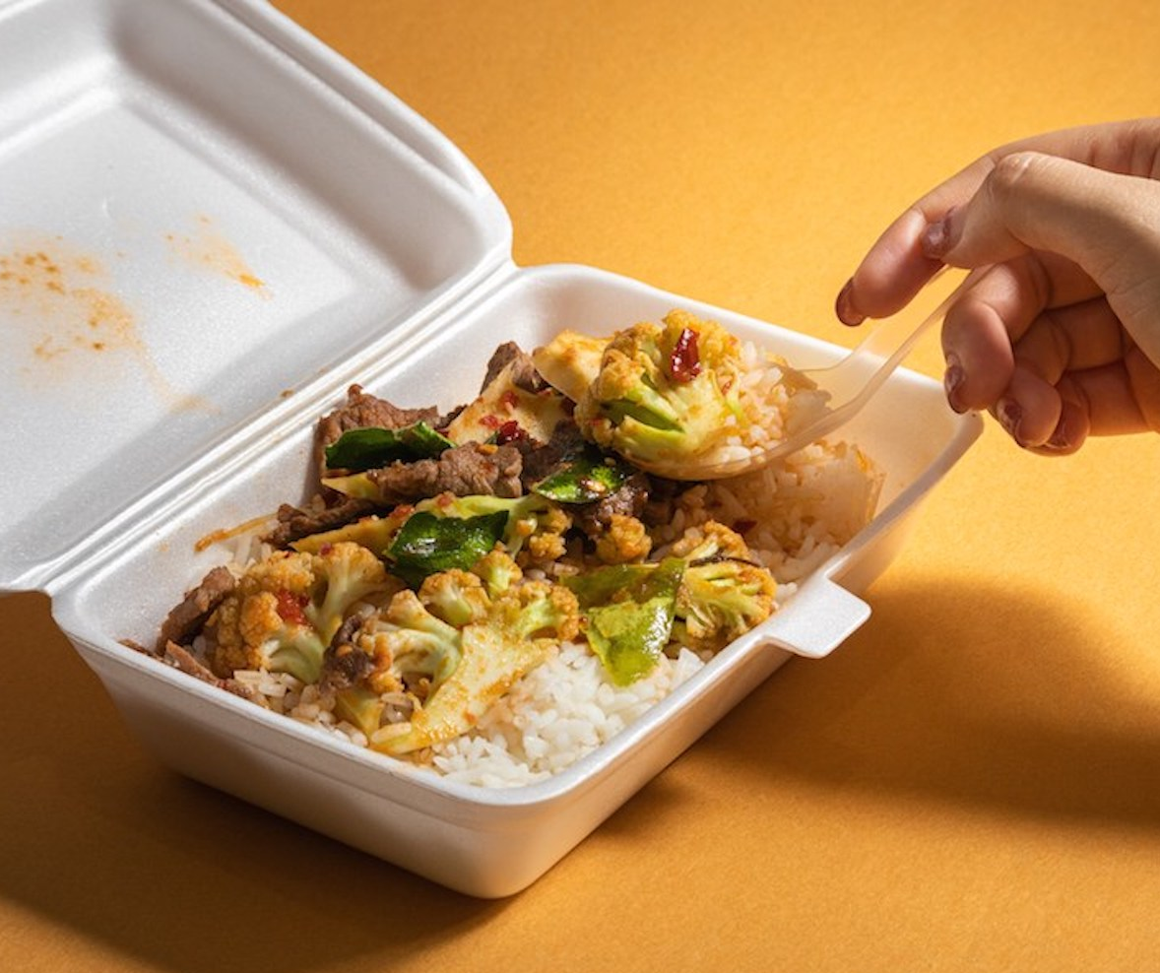
HB30/SB30 Budget Bill (Proposed Amendments)
Delays phased prohibition on polystyrene containers from food vendors, restaurants and other retail food establishments
Directs DEQ to perform market analysis of Virginia’s recycling infrastructure and programs with 2023 report deadline
Shutterstock
Notes:
Styrofoam ban set to start 2023 (certain larger chains) & 2025 for all food vendors
Budget bill amend delays phased prohibition on the use of polystyrene containers until July 1, 2028 and July 1, 2030 respectively
Also requires that DEQ conduct a plastic recycling economic and environmental impact assessment in accordance with the Administrative Process Act, including public participation and comment. The assessment would consider the total lifecycle of human and environmental benefits, and impacts of plastic recycling pursuant to generally accepted frameworks and standards. Report out by October 1, 2023
Distinction between HB30 & SB30 (SB30 proposed funding & HB30 did not)
SB30 left in appropriations committee at end of regular session; HB30 as carried forward to Special Session
Budget bill is to be resolved as part of the 2022 Special Session I. Status unknown.
DEQ is already is staffing both a Plastic Waste Advisory Council and a Waste Diversion Task Force pursuant to legislation introduced in 2020.
Budget bill amendment would enhance the work of those groups

Slide 18
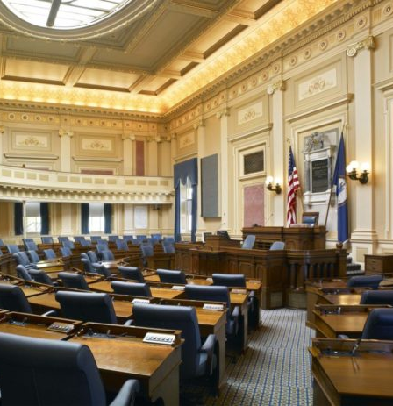
Failed Bills
Packaging Stewardship (HB647, HB709, HB918)
Tribal Consultation (HB715)
Beverage Container Deposit/Redemption (HB826)
Discharges & Citizen Right-To-Know (HB959)
PFAS Study in Public Drinking Water (HB1011)
Landfill Siting Near Private Wells (HB1200)
Southwest VA Regional Waste Study (HJ86)
vageneralassembly.gov

Slide 19
DEQ Regulatory Amendments
Solid Waste
Regulated Medical Waste
Hazardous Waste
Ongoing actions
Recent updates
What’s on the radar?
Coal Combustion Residuals
Voluntary Remediation
P2P Compliance

Slide 20
Solid Waste Management Regulations
NOIRA
Executive review/approval
Public comment period
RAP meetings, text drafted
Proposed Regulation
Executive review/approval
Public comment period
on draft text
Feb 14 – May 16, 2022
Comments considered & final text drafted
Final Regulation
Executive review/approval
30-day adoption period
Full Standard Regulatory Process (3 Stages)
Notes:
Amendment 9; Full process – 3 stages; prompted by 2019 Periodic Review (last major amd = Amd 7 in 2011)
RAP formed in 2021 & included representatives of both public and privately owned landfills, consulting companies, citizens, and a non-governmental environmental organization.
RAP met May, June, July 2021 to discuss and consider public comments and discuss other topics where DEQ needed more stakeholder input.
DEQ drafted proposed regulation for Waste Management Board; approved fall of 2021 (posted on Town Hall)
Submitted draft for Executive Review fall of 2021
Approved & published for public comment period (ongoing) ends May 16
After public comment period, DEQ considers comments & drafts final regulation for Executive Review
RAP-regulatory advisory panel; NORIA notice of intended regulatory action

Slide 21
Major Areas of Revision to Solid Waste Regulations
Landfill Siting & Setbacks
Landfill Operations
Landfill Gas Monitoring
Landfill Groundwater Monitoring
Operations at Other Waste Facilities
Open Burning Exemptions
Based on public comments, stakeholder feedback, DEQ input, and recommendations from the Secretary of Natural & Historic Resources

Slide 22
Regulated Medical Waste Management Regulations
NOIRA
Executive review/approval
Public comment period
RAP meetings, text drafted
Proposed Regulation
Executive review/approval
Public comment period
on draft text
Jan 31 – Apr 18, 2022
Comments considered & final text drafted
Final Regulation
Executive review/approval
30-day adoption period
Full Standard Regulatory Process (3 Stages)
Notes:
Amendment 3 began with Notice of Intended Regulatory Action (NOIRA) phase in June 2018 & public comment in 2019
Regulatory Advisory Panel held meetings in 2019
DEQ drafted proposed regulation for Waste Management Board; approved fall of 2019 (posted on Town Hall)
Submitted draft for Executive Review Dec 2019
Approved & published for public comment period ended April 18th
After public comment period, DEQ will consider comments & drafts final regulation for Executive Review

Slide 23
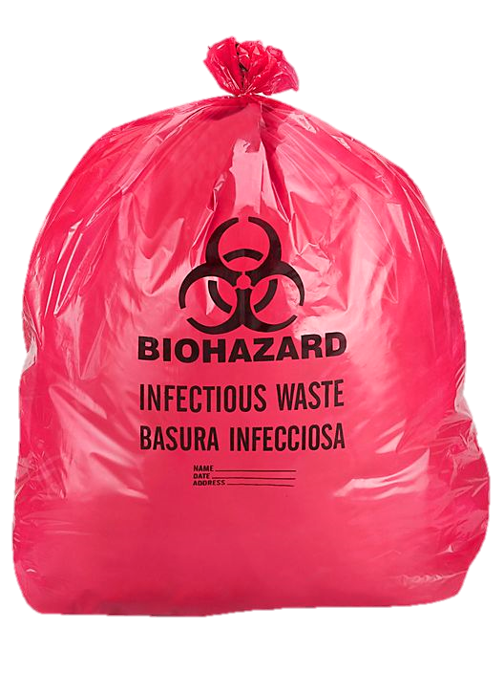
Regulated Medical Waste Management Regulations
Regulation
Amendment
Identifies types of regulated medical waste
Sets standards for safe handling, storage, transfer and treatment
Streamlines & modernizes standards
Primarily affects permitted RMW facilities
Highly infectious Category A waste (Ebola)
Treated Waste Packaging
Waste Today Magazine
Notes:
Regulated Medical Waste: (1) Any SW suspected by health care professional in charge of being capable of producing infectious disease in humans; and (2) Cultures & stock of microorganisms and biologicals, (3) Human blood & body fluids, (4) Tissues & other anatomical wastes, (5) Sharps (needles), (6) Animal carcasses & related wastes when intentionally infected, and (7) Mixtures & residues of RMW
This regulations Establishes standards and procedures for the management of RMW in order to protect public health and safety
Regulations primarily pertain to RMW: Generators, Transporters, Transfer Stations, Treatment Facilities
1 area of interest for landfills = requirement for written agreements between RMW treatment facilities & landfills receiving treated waste to include packaging profile. More flexibility to allow repackaging of treated waste into bags that more clearly distinguish that the waste has been treated - clear bags or bags with sterilization indicators, opaque bags w/special labels; gives the landfill some say and makes it easier to determine if you have received unauthorized regulated medical waste or not
Shredding not required & no red bags for treated waste

Slide 24
townhall.virginia.gov
Notes:
Not all proposed changes covered in today’s presentation
Written comments can be submitted through VA Regulatory Town Hall website only when public comment period is open (public comment forums link)
DEQ will consider and respond after the comment period is over
You can also register as a Town Hall Public User – free service – allows you to sign up for email notifications for any public meetings or regulatory actions

Slide 25
Other DEQ Regulatory Actions
Voluntary Remediation Regulations (fee amendment)
Hazardous Waste Regulations (annual update)
CCR Rule (watching federal amendments)
Upcoming Periodic Reviews (FA, Fees, Barge, HMT)
Notes:
Voluntary Remediation Regulations - Undergoing amendment to address eligibility and fees; Public comment period ongoing; Jan 31, 2022 – Apr 18, 2022; Fee increases proposed to provide sustainable program funding; Registration fee increases (Phase 1 & 3 fees); Annual registration fees for all sites in VRP (Phase 3 fees); Annual adjustment to all fees for inflation (Phase 1, 2, 3);
Hazardous Waste Regulations - 2021 Annual Update effective 12/22/2021; Incorporates EPA’s ignitability rule (definition, test methods); Does not include EPA’s addition of aerosol cans to universal waste regulations yet, but DEQ will be incorporating EPA’s aerosol can regulations into our regs by reference later this year.
Coal Combustion Residuals Rule – CCR Rule promulgated October 4, 2016 incorporated by reference into VSWMR; Multiple federal amendments have occurred and are ongoing; DEQ is currently evaluating newer federal amendments for potential amendment to solid waste regulations’
Upcoming periodic reviews (every 4 years) – FA (70), Fees (90), barge (170), haz mat transport (110)

Slide 26
DEQ Guidance Updates
Draft Director’s Determination Guidance (withdrawn)
Enforcement Manual (revised)
Notes:
Draft Director’s Determination Guidance for New Solid Waste Permits & Modifications for Expansions & Increases in Capacity; Public comment held January 3, 2022 – February 2, 2022; DEQ has decided to withdraw this draft guidance.
DEQ Enforcement Manual updated effective January 2022. Clarified how enforcement decisions are made & revised civil charge & civil penalty worksheets.

Slide 27
Waste Diversion & Recycling Task Force
Approx. 25 stakeholders / members
Report due Nov 1, 2022
Source Reduction
Reuse
Recycling
Resource Recovery (WTE)
Incineration
Landfill
Waste reduction & landfill diversion
Increased recycling
Food donation & composting
Out-of-state waste impacts
Litter Control & Recycling Fund grant program improvements
Electric battery waste management
Notes:
SB1319 (2021) requested DEQ to continue and expand scope and membership of Waste Diversion and Recycling Task Force (first requested in 2020 under SJ42); Task Force includes stakeholders and topics named in both SJ42 and SB1319
Task Force held first meeting in 2021 - brainstorming session – waste reduction & diversion, recycling improvements, litter grant, food donation & composting, EV batteries – no formal recommendations yet
First Report summarizing work so far published January 2022 - https://rga.lis.virginia.gov/Published/2021/SD16/PDF
Plan to meet 3x in 2022; 2nd meeting March 15, 2022; agenda - bottle bills, packaging stewardship, plastic waste pollution advisory council, food waste policy
Tasked with publishing executive summary and report of its findings and recommendations no later than November 1, 2022.
Policy of WMB is to promote development of comprehensive waste management programs that include this waste management hierarchy
Next (3rd) meeting has been scheduled for June 14th. The meeting start time might be 9 or 10 am. The exact meeting time will be decided a few weeks before the meeting and we will be meeting in DEQ’s CO in Richmond.
Last meeting – Members discussed recycling rate, EPA’s goal to increase recycling rate to 50% by 2030.
SJ = Senate Joint Resolution
Report due Nov 1, 2022

Slide 28
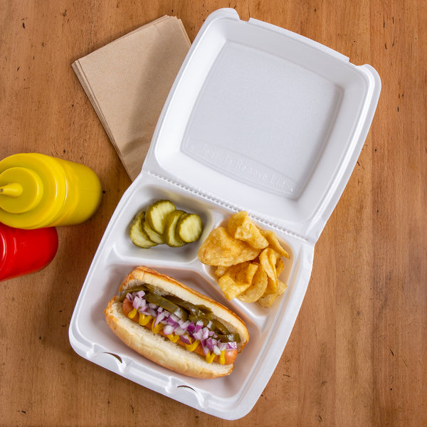
Plastic Waste Prevention Advisory Council
Advises the Governor on policy and funding priorities to:
Eliminate plastic waste that impacts native species and pollutes VA’s environment
Contribute to achieving plastics packaging circular economy industry standards
Only authorized thru June 2023
Webstaurantstore.com
Notes:
HB1354 (2020) established advisory council w/in exec branch of state govt. Expires June 30, 2023.
Met in 2021 – focused on state wide expanded polystyrene ban on food vendors/restaurants & disposable plastic bag tax
This year will focus more on circular economy for plastics including extended producer responsibility, bottle bills, & other recycling policy rec’s
Will submit a final report before the next GA session & there are no plans to extend the council beyond the June 2023 sunset date in the statute

Slide 29
SWIA, Recycling and Litter Grant Updates

Slide 30
CY2021 Solid Waste Information and Assessment (SWIA) Update
SWIA reports submission deadline – March 30, 2022
225 reports received for CY2021 (captive and non-captive)
SWIA data QA
Draft annual SWIA report by May 15th
Final report published by June 30th
Notes:
The deadline to submit SWIA reports was March 30th.
For CY2021, 225 SWIA reports were received. 22 were from captive facilities and 203 were from non-captive facilities. The captive facilities submit reports for tonnage and billing purposes.
Currently, we are reviewing and conducting QA of the SWIA reports that have been received.
Once the QA and any revisions have been completed, the draft annual SWIA report will be prepared and sent for review to our Policy team by May 15th
The final report is then published by June 30th on the DEQ website

Slide 31
Total Solid Waste Received from 2012 through 2020
Notes:
Throughout the years, there has been a steady stream of incoming waste into Virginia in the 20-22 million tons range.
In 2020, there were about 16.8 million tons of solid waste received in-state, which was a slight increase from the previous year. 5.6 millions tons of waste was received from out-of-state, with the top 5 states being MD, NY, NJ, DC and NC.
Overall the waste received both in and out of state have been constant throughout the years as you can tell from the graph. We anticipate that this trend will continue in the following years.

Slide 32
Recycling in Virginia in CY2020
State recycling rate for CY2020 = 45.5%
For CY2020, all 71 Solid Waste Planning Units (SWPU) were required to report
68 planning units met and exceeded the recycling rate
3 planning units were unable to meet their minimum mandated rate
SWPUs with populations greater than 100,000 report annually
Currently, 17 SWPUs have populations greater than 100,000
SWPUs with populations less than or equal to 100,000 are required to report every 4 years
Next reporting will be in 2025 for CY2024
Notes:
The state recycling rate for 2020 was 45.5%, which was a 2.3% increase from the 2019 rate.
For 2020, all 71 solid waste planning units were required to report. 68 planning units met and exceeded their minimum mandated rate and 3 planning units were unable to do so. We are working with the 3 that were unable meet the rate on their next steps to meet their mandated rates as well as their recycling action plans
Planning units with populations greater than 100,000 are required to report annual – currently we have 17 that fall under that category
Planning units with populations less than or equal to 100,000 are required to report every 4 years – the next reporting cycle will be for CY2024 and those reports will be due in April 2025

Slide 33
Materials Recycled in CY2020
Notes:
Based on data reported by all 71 solid waste planning units
These are the key materials recycled in 2020 – metal, commingled, paper, yard waste, waste wood, plastic, waste tires and glass
Throughout the past few years, we have noticed that the trend has remained the same. The big ticket items are metal, commingled, paper and yard/wood waste. There is a small amount of plastics, tires and glass recycled due to the lack of markets and infrastructure
DEQ is in conversation with VDOT/changes to specs on use of waste tire for making rubberized asphalt
DEQ had been in conversation with Virginia Asphalt Association on use of recycled plastic with asphalt

Slide 34
Virginia’s MSW, Recycling Tonnage and Recycling Rates
Notes:
The state recycling rate for CY2020 was 45.5%. This number was based on data submitted by all 71 solid waste planning units that reported for CY2020.
The 71 planning units reported generating almost 11 million tons and recycling 5.3 million tons of principal recyclable materials.
On the screen, you can see the graphical representation of the MSW, recycling tonnage and recycling rate in Virginia for the last 5 years. We also have a increase in the recycling rate from CY2019 to CY2020 due to all 71 planning units being required to report.
There was a drop in the amount of materials recycled in CY2019 due to China’s National Sword and lack of recycling markets for some of the key recyclable materials. Also, a lot of the localities facing the more severe recycling issues are located in rural areas.
CY2020 recycling rate includes data from 70 planning units. The increase in MSW generated is due to some planning units being able to obtain recycling data from more businesses and also people generating more waste being at home due to the Covid-19 pandemic
Here you can see the amount of waste received to the amount in tons recycled or diverted from being landfilled for sanitary landfills, construction, demolition and debris landfills, and industrial landfills.
As the waste received in Virginia has been increasing across the board, the amount recycled has been increasing as well. We hope the facilities will keep up the efforts to keep recycling and diverting as much as they can out of the landfills.

Slide 35
GY2022 DEQ Non-Competitive Grants
GY2022 Total Non-Competitive Grant Funds: $2,440,116
187 Applications received (single and coop)
Approximately 20 localities did not apply
Total unspent Funds from GY2021: $59,106
Grants disbursed and letters sent out in December 2021
Notes:
The total amount of funding available for the non-competitive litter grants for GY2022 was approximately $2.4 million
187 single and coop non-competitive applications were received
There were about 20 localities in Virginia that did not apply for the funding
The total amount of unspent non-competitive grant funds from previous years was about $59000
The grants were awarded and letters were sent out in December 2021

Slide 36
GY2022 DEQ Competitive Grants
GY2022 Total Competitive Grant Funds: $138,339
19 Applications received – single and joint applications
Reviewed by Litter Fund Board at November 6th meeting
16 applications received funding; 3 applications did not
Total unspent Funds from GY2021: $9,495
Grants disbursed and letters sent out in December 2021
Notes:
The total amount of funding available for the competitive litter grants for GY2022 was approximately $138,000
19 single and coop non-competitive applications were received and were reviewed by the Litter Fund Board at the November 6, 2021 meeting
Out of the 19 localities, 16 were awarded with grant funding and 3 were not
The total amount of unspent non-competitive grant funds from previous years was about $9000
The grants were awarded and letters were sent out in December 2021

Slide 37
Litter Grant - Expanded Polystyrene (EPS) Campaign
House Bill 1902 - Expanded polystyrene food service containers prohibited
2021 General Assembly session – changes to § 10.1-1422.01
Operation of public information campaigns to discourage sale and use of polystyrene products and to promote alternatives to expanded polystyrene
Litter Control and Recycling Fund
5% of Litter Fund - Operation of public information campaigns
Notes:
Two changes made: Operation of public information campaign and also changes to allocation of litter funds
Action items:
Litter Fund Board approved changes to the LF guidelines to incorporate changes made to the stature to allocate funds for public information campaign. This slide is related to the slide from la HB30/SB30 delay in implementing the ban on use of Styrofoam products by restaurants

Slide 38
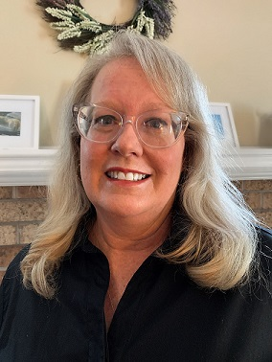
Questions?
Melinda Woodruff
Land Protection and Remediation
Program Manager
Virginia Department of Environmental Quality
Melinda.woodruff@deq.virginia.gov
(757) 407-2516
Notes:
Are there any questions?
Thank you for your time.

