Slide 1
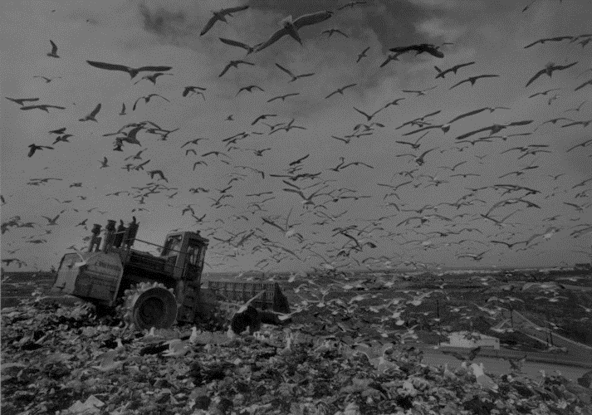
Emerging Solutions
PFAS in
Landfills:
Alexander Hajek

Slide 2
Contents
PFAS Chemistry, Health, and Exposure
PFAS Regulations
Types of Remediation
Landfill-Specific Technologies

Slide 3
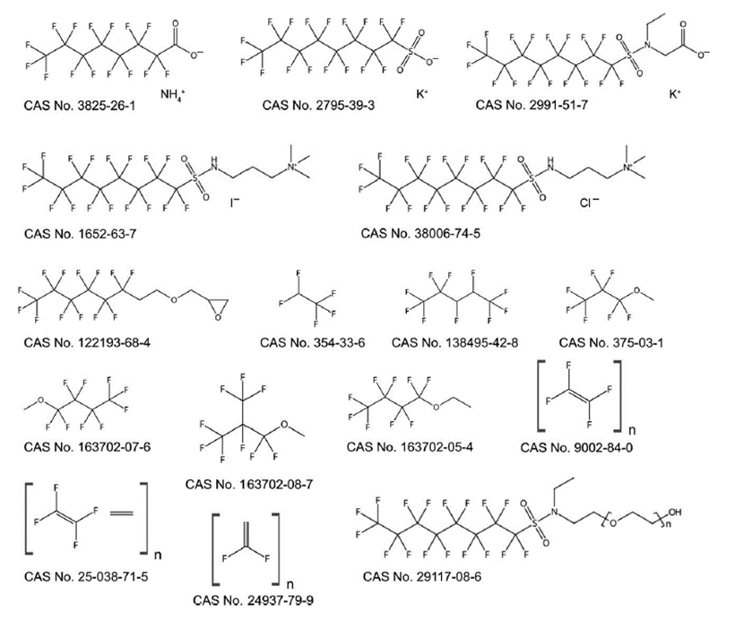
Polyfluoroalkyl Substances (PFAS)

Slide 4
PFAS Health Effects

Slide 5
PFAS Exposure

Slide 6
PFAS Regulations

Slide 7
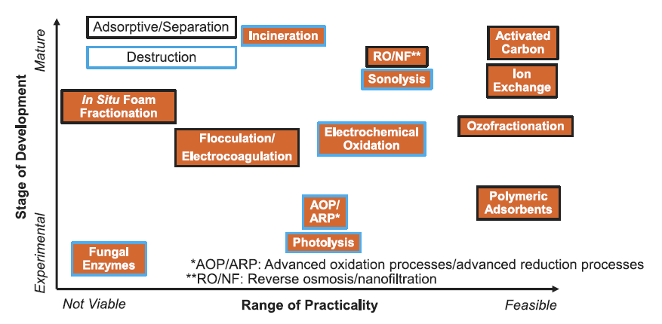
Liquid Phase Remediation

Slide 8
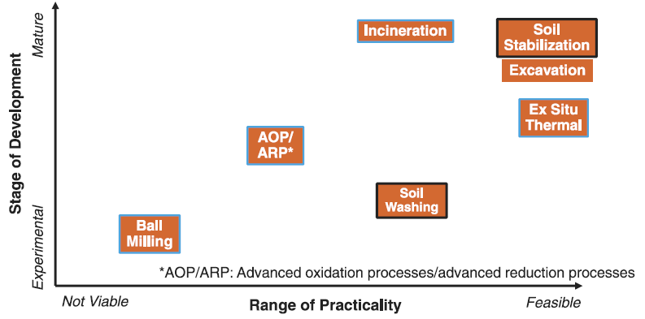
Soil/Solid Phase Remediation

Slide 9
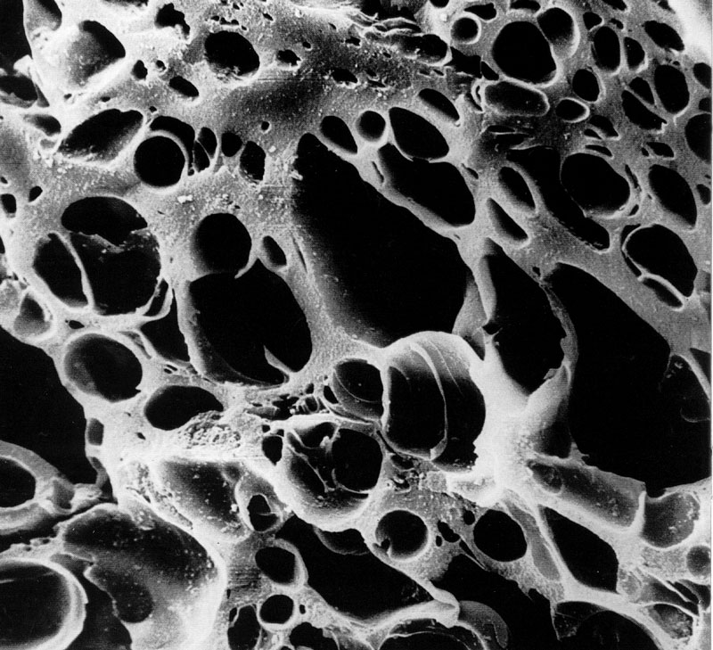
Granular Activated Carbon (GAC)

Slide 10
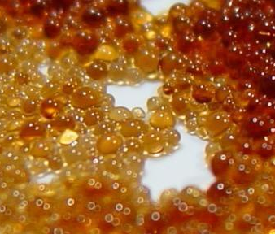
Ion Exchange

Slide 11
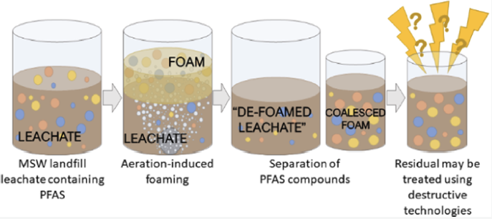
Aerated Foam Separation

Slide 12
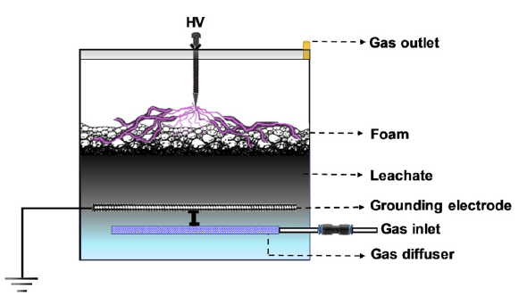
Plasma Reactor

Slide 13
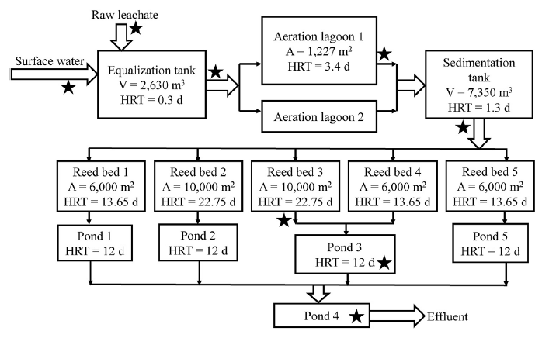
Engineered Wetland Systems

Slide 14
Conclusions and Questions

