Slide 1
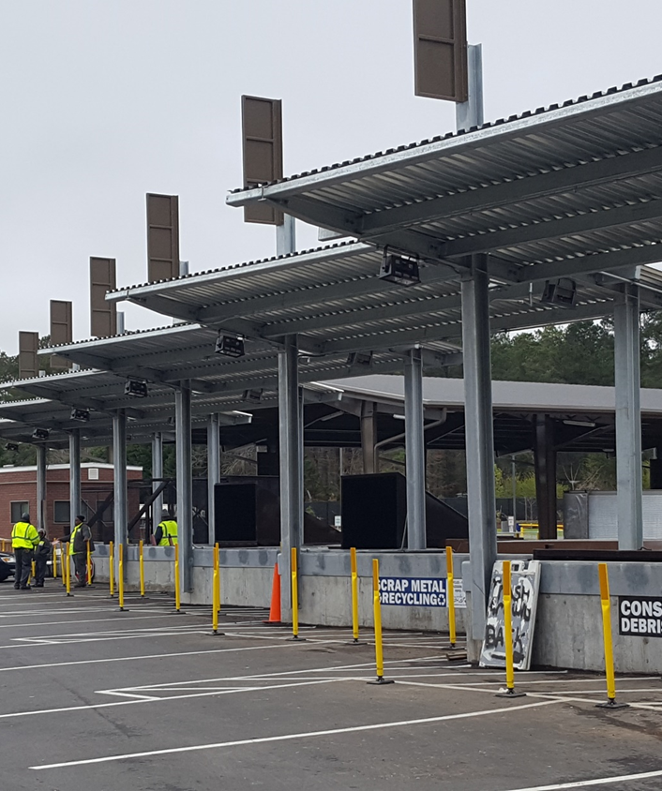
Re-Inventing Your Convenience Site Program
Friday, August 27, 2021 8:00 – 8:30 am
Jeffrey Murray | PE, BCEE, HDR Landfill Practice Lead
Joseph Fitzpatrick | Wake County Recycling and Compliance Coordinator
Chrissie Koroivui | Durham County Solid Waste Program Manager
Panel Discussion
Notes:
Ask questions via Chat and we can answer them at the end

Slide 2
AGENDA
01
Wake County Program
04
Challenges
02
Durham County Program
05
Lessons Learned
03
Improvements
06
Questions

Slide 3
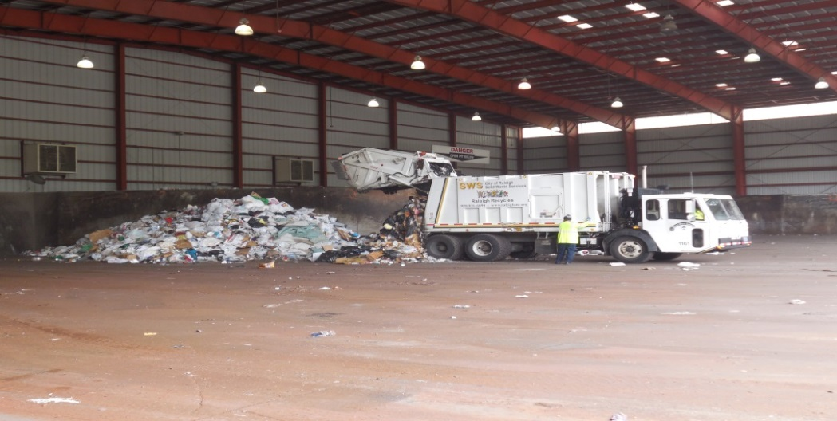
Wake County, North Carolina Facilities
The Solid Waste Management Division manages 19 facilities serving over 1.1 million people:
11 Convenience Centers
3 Household Hazardous Waste Facilities (HHW)
3 Multi-Material Recycling Facilities (MMRF)
1 Active (MSW) Landfill and 1 Transfer Station
Monitors and Maintains 4 Closed Landfill Facilities
Notes:
Enterprise funded
Operations outsourced

Slide 4
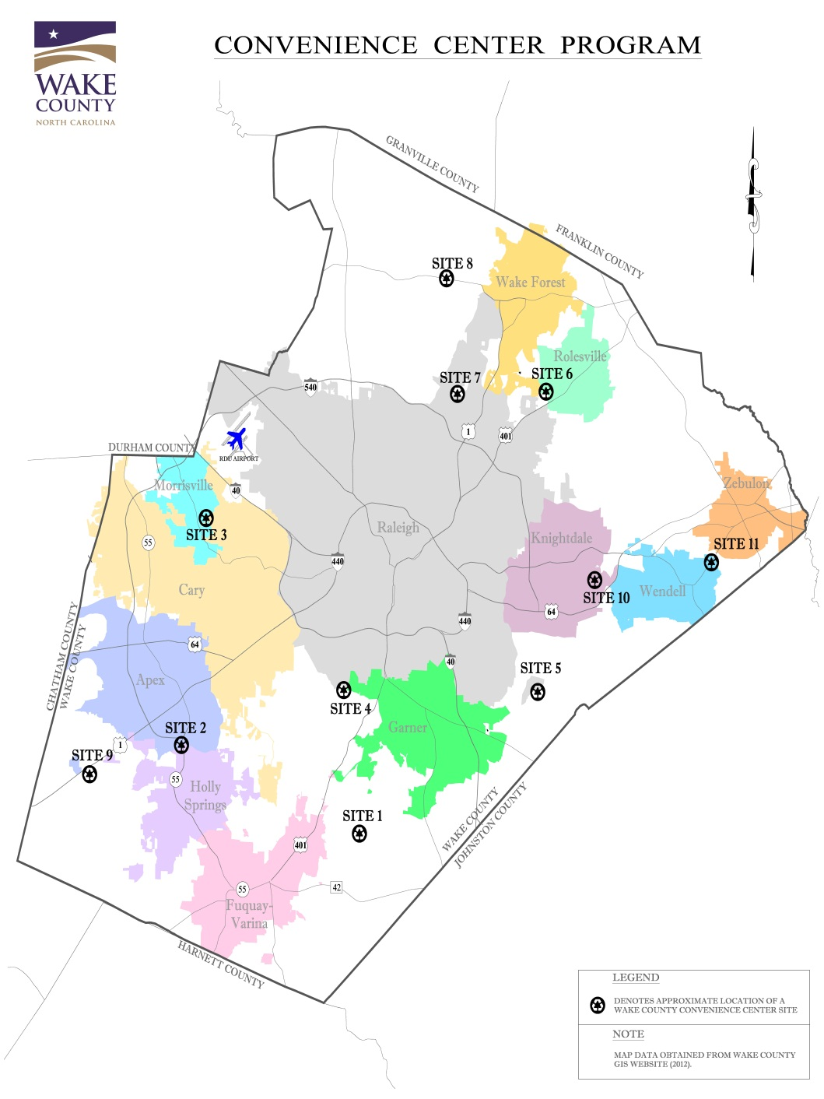
Convenience Centers
11 Convenience Centers
Sites were located, designed and constructed in the early to mid 1980’s
Minimize illegal dumping
Encourage recycling
Open to County & Municipal residents
Six sites accept segregated C&D waste
Two sites accept electronics(weekend)
One site accepts white goods
Funded by residents ONLY ($20/year household fee), so no commercial use allowed

Slide 5
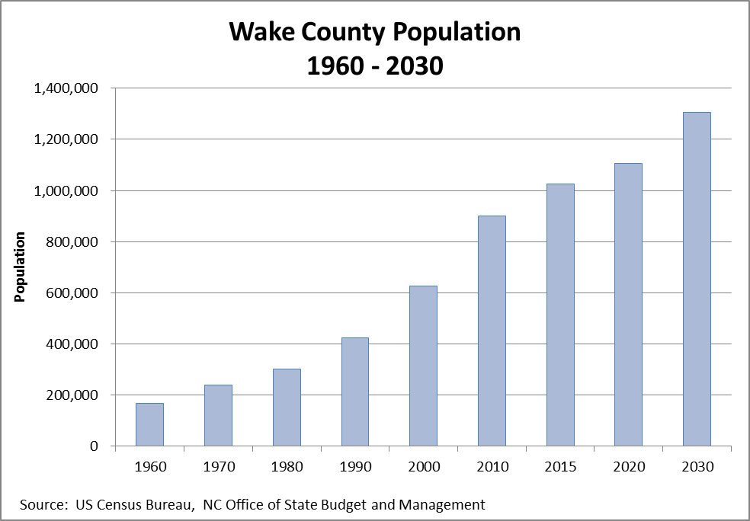
Convenience Centers
Since opening, the County’s population has tripled, and municipal limits have expanded.
In 2005, County began investigating waste disposal demands and functionalities of the sites
Completed 2020 Comprehensive Solid Waste Management Plan
2017 and 2020 user studies conducted

Slide 6
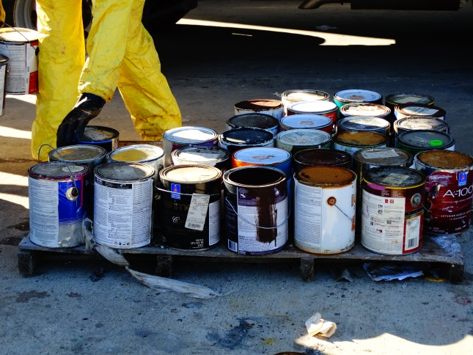
Multi-Material Recycling Facilities
Three sites accepting items banned from landfill (electronics, tires & appliances)
Also takes cardboard, engine oil, rigid plastics, etc…
Open to all Wake County residents and businesses
Household Hazardous Waste Facilities
Three sites built to provide safe disposal of common household hazardous items, such as paints, fluorescent light bulbs, pesticides, batteries and more
Residential-use only

Slide 7
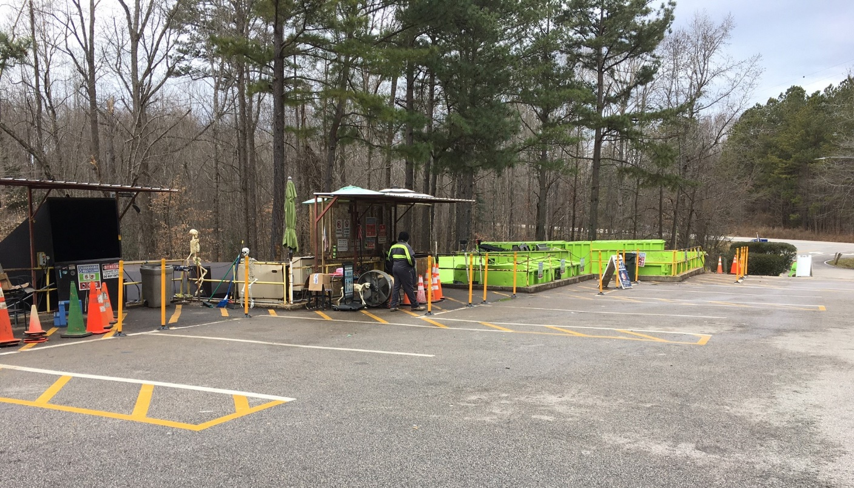
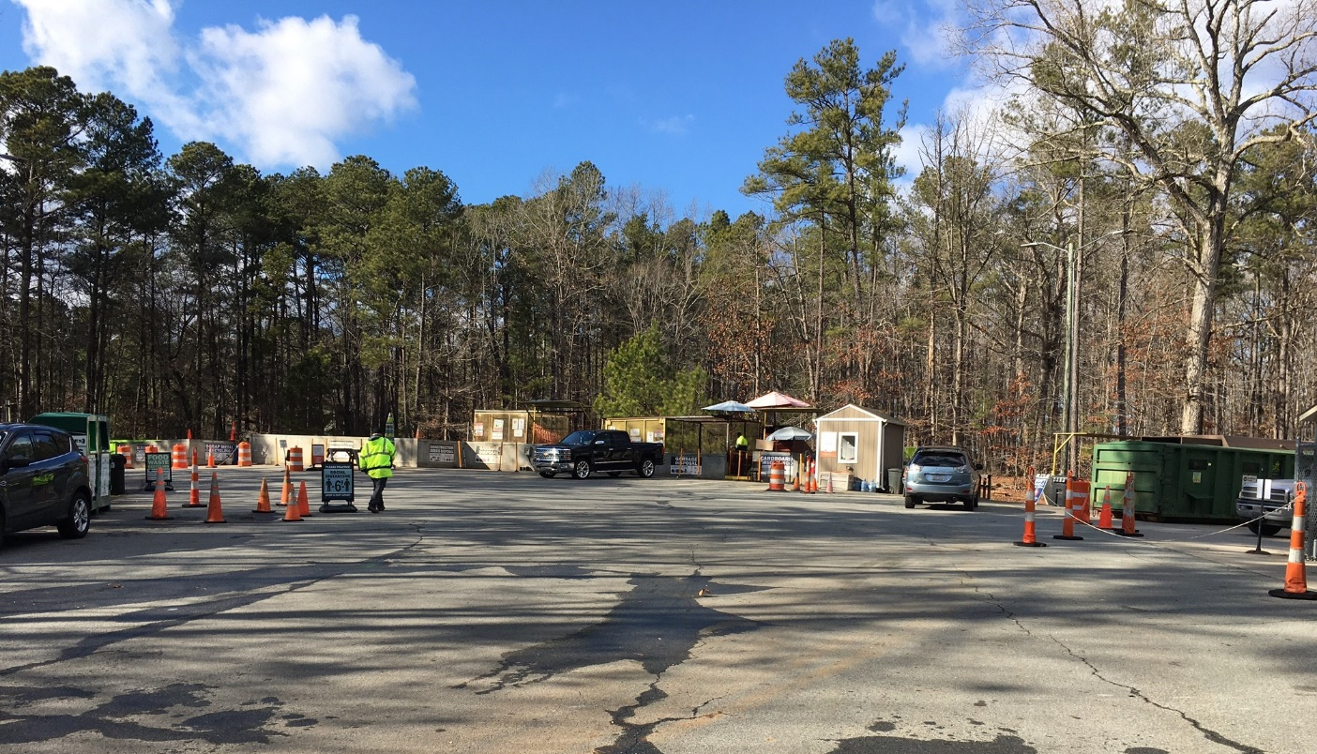
Notes:
Sites are mixed size- limited space
Some owned
Some leased
One or two pre-crusher
Mixed entrance and exit

Slide 8
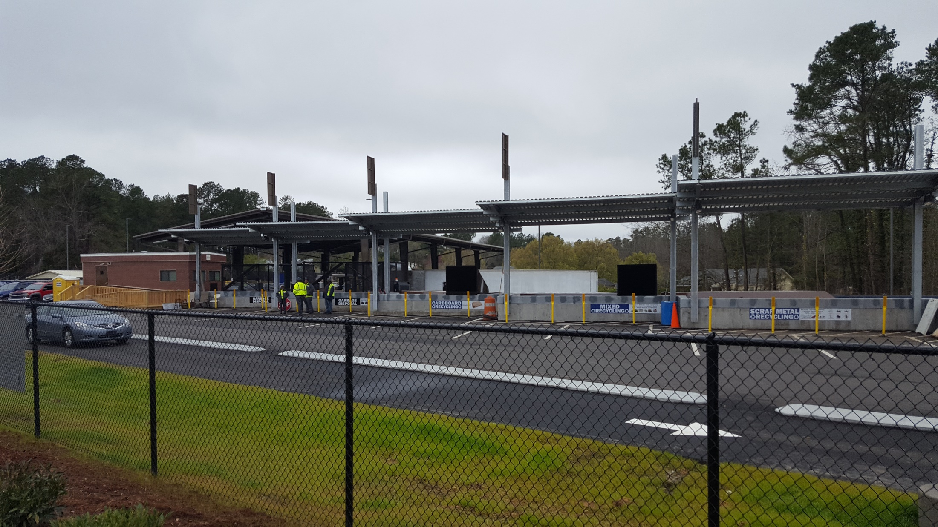
Notes:
3 sites supersized size 2015

Slide 9
Tour of South Wake Improvements

Slide 10
Site 5 Improved Traffic
Congested two-way gate
Only two unloading spaces
Roll-off truck required to make
3-point turn at gate
Separate entrance and exit
Added unloading spaces
More space for backing residents and roll-off truck

Slide 11
Site 3 Future Improvement
Small Convenience Center
Limited materials
Flood issue
No room to expand
Limited container space
Roll-off for Recycling & Metal require straight haul
Congested unloading
Pedestrians must cross over traffic to unload
Two-way gate

Slide 12
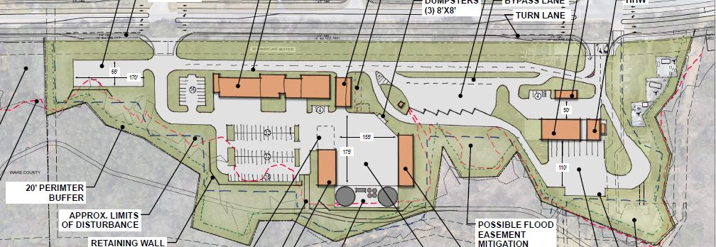
Convenience Center
Multi-Material
Morrisville Public Works
HHW

Slide 13
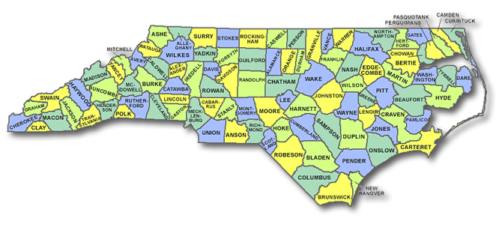
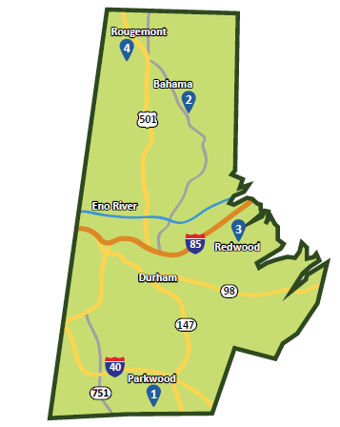
Durham County Solid Waste Division
Unincorporated Durham County
4 Solid Waste Convenience Sites
Curbside Recycling
Litter Control/Solid Waste Code Enforcement
Supported by Solid Waste Fee on unincorporated property tax bills ($164 in FY 22)

Slide 14
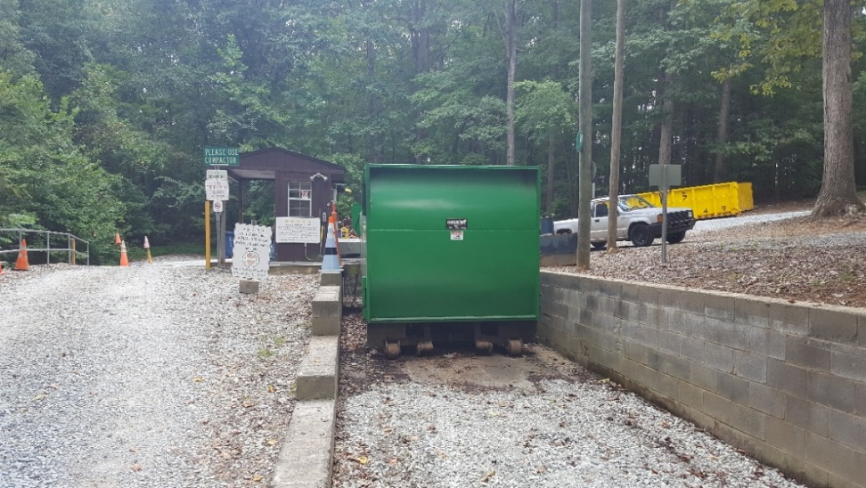
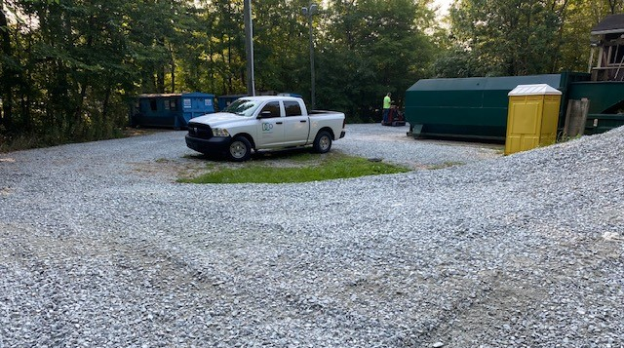
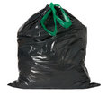
Bahama & Rougemont Sites FY 21
132,000 Customers
1938 tons of MSW
536 tons of recycling
155 tons of yardwaste
Also collect: textiles, motor oil, cooking oil, scrap metal, white goods, & fluorescent bulbs

Slide 15
Current Challenges
Approximately 5 minutes apart
Rougemont Site is very compact and leased from a private landowner
Bahama Site is larger, but poorly laid out and leased from the public school system.
Yard waste platform is one of top complaints.
Gravel driveways require frequent maintenance.

Slide 16
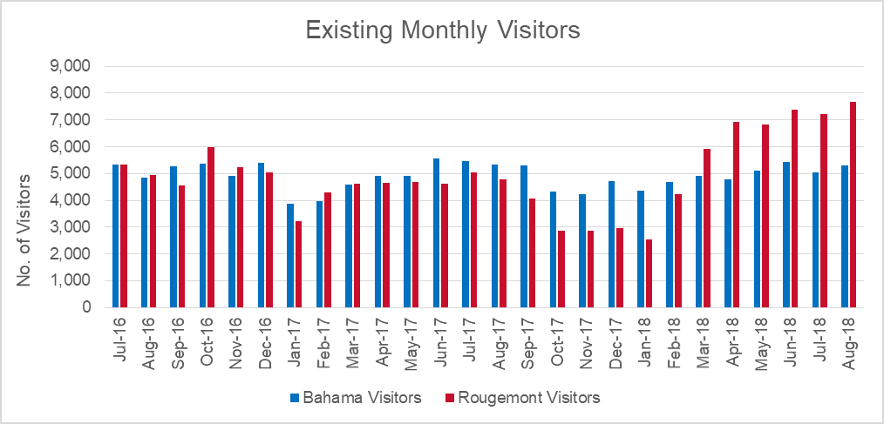
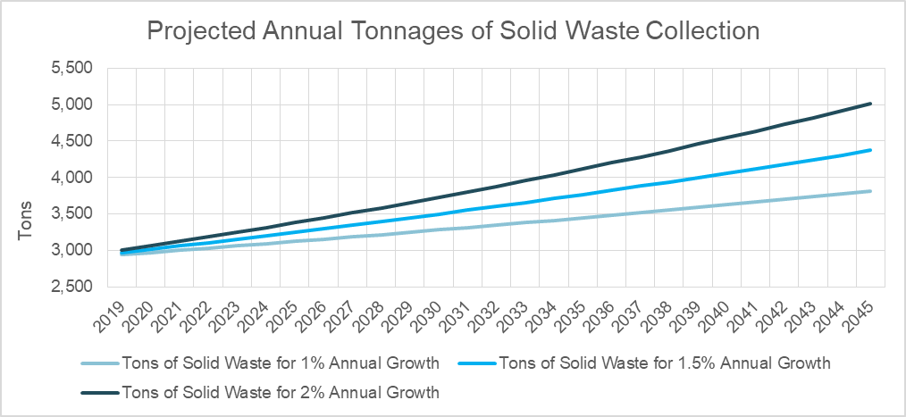
Demand Study
1%, 1.5% and 2% growth
Based of County population change
25-year projections
200,000 visitors
6,550 tons of material
50 lbs waste per visitor
10 lbs recyclables per visitor

Slide 17
Program Optimization
Review existing data
Traffic counts and peak hour
Number of hauls
Community Input
Customer Surveys at the two Sites
Open House with Draft Plans and opportunity for comments

Slide 18
New Northern Convenience Site
New site will be located in between existing locations
Access directly from 15/501 instead of secondary roads
Compaction of MSW, bulky and recyclables
Separate visitor traffic from hauling traffic
Back-in drop-off stalls
Utilize retaining wall as guardrail

Slide 19
New Site Attendant Office
Restroom, Swap Shop, Computers, Observation Area/Meeting Room

Slide 20
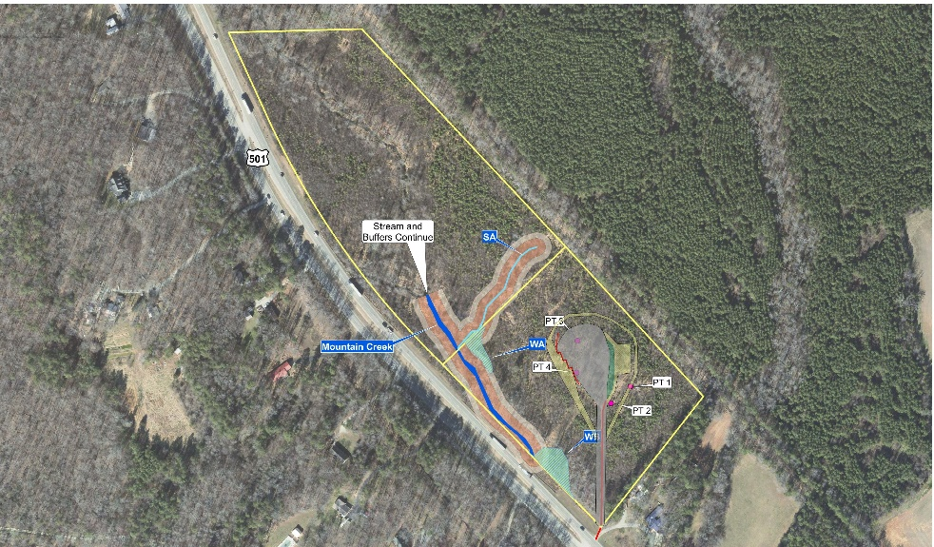
Design Details
2 lots to be combined for single 24 acre parcel
3.5 acres of disturbance
Environmental
No impacts to floodplain or riparian buffer
Proposed < 6% impervious area
Stormwater Control Measures
Maintain pre-development peak flows
Reduce nutrient loading
On-site water supply and septic system

Slide 21
Permitting
Special Use Permit was required for government facility in RR and RS-20 Zone
Conformance with special requirements
0.85 opacity buffer provided
175’ between site and south property line
150’ riparian buffer
Harmony with surrounding properties
Right-turn lane incorporated
Existing median crossing utilized
Coordinated with abutting property owner
No adverse affect on public or property values

Slide 22
Construction
Groundbreaking in April 2021
Completion anticipated January 2022
Current sites will operate until new site opens, then demolition will begin on the previous sites
Challenges include delayed delivery of equipment due to Covid, excess rock, and removal of tires

Slide 23
Questions
Jeffrey S. Murray, PE, BCEE
Associate Vice President & Landfill Practice Lead
E: Jeffrey.Murray@hdrinc.com
P: 919.232.6682

