Slide 1
From Disaster To Opportunity SWANA Region 6 Multi-State Conference

Slide 2
Our Story
The SPSA Regional Landfill was opened in January of 1985.
Facility handles 300,000 + tons of MSW per year.
Facility features:
Administration Building
Equipment Maintenance Garage
Scale House
Transfer Station
Tire Processing Facility
HHW Facility
Metal Collections Area

Slide 3
Our Story (cont.)
On April 2, 2020 at approximately 6:30 PM a fire was reported at the SPSA Regional Landfill Administration Office.
There was significant damage to the Administrative Offices and Equipment Maintenance Shop.
Power to the facility was shut off. No water, no network, no land lines, no repair shop.
The facility had to re-open the following morning to accept the regions waste.

Slide 4
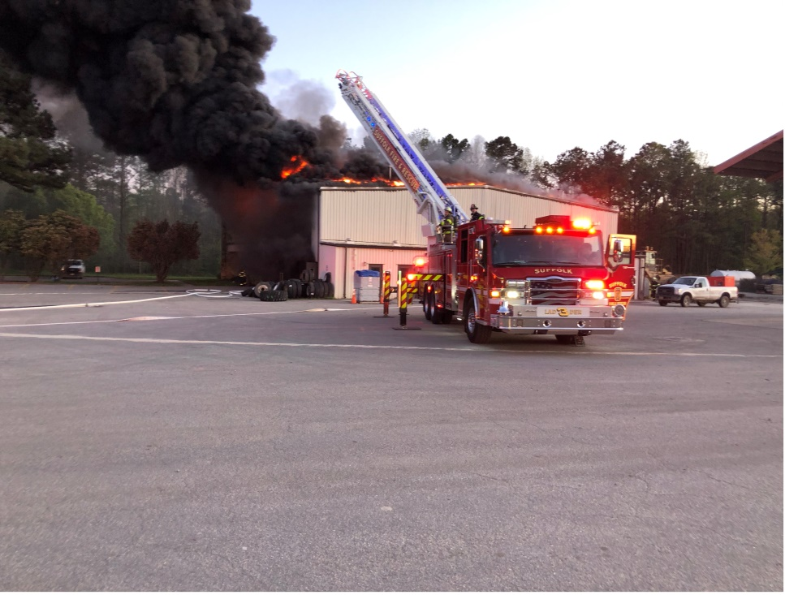
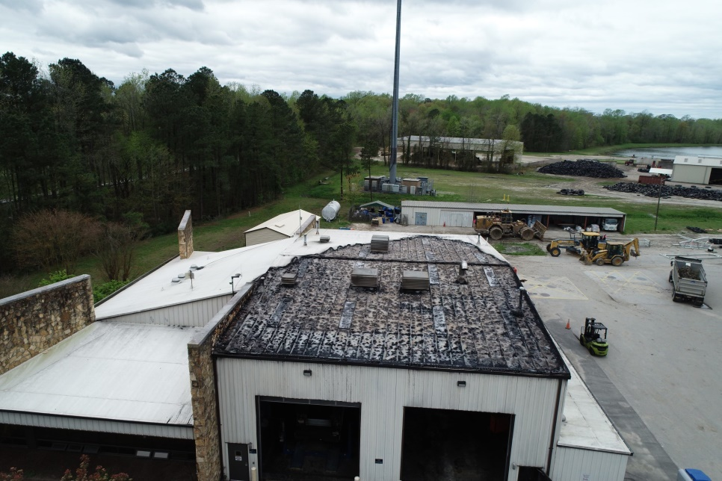

Slide 5
When Disaster Strikes
Preparation
Happens prior to the event.
Response
Happens immediately after the event.
Recovery
Long Term

Slide 6
Preparation
Every disaster provides different opportunities to prepare.
Understand the critical needs of your operation.
Have a Continuity of Operations Plan (COOP) in place.

Slide 7
Our Response
Restored electricity where possible and connected generators to critical loads with no power.
Used wireless service to get network operational.
Relocated offices and files to a meeting room on the facility.

Slide 8
Our Response (cont.)
Rented portable trailer for restrooms and mobile office for breakroom.
Moved maintenance shop to a recently renovated building on site.
All critical services were back in operation by 8:00 AM the following morning.
Began to assess the damages and document the loss.

Slide 9
Our Recovery
Worked with insurance company to determine the value of our loss.
Discussed the long term needs of the organization with employees affected by the loss.
Evaluated each program at the RLF to determine if their current facilities were adequate.
Began to discuss the “what-if’s” with our insurance carrier.

Slide 10
Our Recovery (cont.)
Ultimately the insurance carrier determined the building to be a total loss and valued the building at $1.2 million.
The question immediately turned to how to best utilize the insurance proceeds.
Reconstruct using the existing footprint
OR
Evaluate how the insurance proceeds could be used to address the many needs at the facility

Slide 11
Opportunities
Provide adequate lunch room, restroom and lockers for employees.
Improve laboratory space for our environmental staff.
Provide adequate storage for environmental files.
Provide larger work areas for equipment mechanics.
Relocate HHW facility to a safer location for customers.

Slide 12
Opportunities (cont.)
Provide a clean, conditioned space for SCADA and other network equipment.
Provide a transfer switch for back-up power supply.
Provide adequate storage to protect valuable equipment that was stored outside.
Consolidate landfill staff and environmental staff to improve efficiency and improve environmental performance.
Use existing Z Wall to streamline metals recycling.

Slide 13
Admin Building

Slide 14
Admin Building
Includes staff restrooms and a lunch room, as well as locker and shower facilities for both male and female employees.
Includes a clean area to prepare and pack samples for laboratory testing.
Includes a data room for SPSA network servers and SCADA with generator capabilities.
Consolidates Environmental offices with Landfill Operations to improve efficiency.

Slide 15
Drive Through HHW

Slide 16
Drive Through HHW
Located near scales to minimize mixing of commercial and residential traffic.
Provides a covered area for customers to drive through.
Provides for improved storage of HHW.
Equipped with state of the art safety enhancements.
Provides a loading area for pick-up of bulked HHW.

Slide 17
Addition to Fleet Maintenance

Slide 18
Fleet Maintenance
Adds three large bays to handle repairs to large tracked equipment historically repaired outside in the elements.
Floor will be designed to handle tracked equipment without damage.
Improved LED lighting for mechanics.
Building will be equipped to handle a 10 ton bridge crane for repairing heavy equipment.

Slide 19
Storage Facility

Slide 20
Storage Facility

Slide 21
Project Delivery
Design Build
“A method to deliver a project in which the design and construction services are contracted by a single entity known as the design – builder or design – build contractor.”

Slide 22
Owners Representative
HDR Engineering has provided engineering services to SPSA for many years through an annual services contract.
HDR Engineering has a vast amount of experience design build services.
SPSA selected HDR to serve as the “Owners Representative” for the design – build contract.
Engineer of Record (EOR) Jeff Murray – Associate Vice President, Waste Sector Landfill Practice Leader HDR Engineering

Slide 23
Why Choose Design Build?
Saves time.
Provides enhanced opportunities for value engineering.
Provides for transparency in pricing.
The owner and contractor works as a “Team” to ensure a successful project.

Slide 24
Key To Delivering A Successful Design-Build Project ?
Putting Together The Right Team!

Slide 25
Project Timeline
Fire occurred on April 2, 2020.
Design / Build project was approved by the SPSA Board on May 26, 2021.
Contract was signed June 2021.
Construction is scheduled for completion December 2022.

Slide 26
QUESTIONS/COMMENTS

