Slide 1
PCB Pollutant Minimization Plans – A tool towards meeting TMDLs
Sri Nathella, PE, Principal
SWANA Region 6 Conference
Roanoke, VA
August 25, 2021

Slide 2
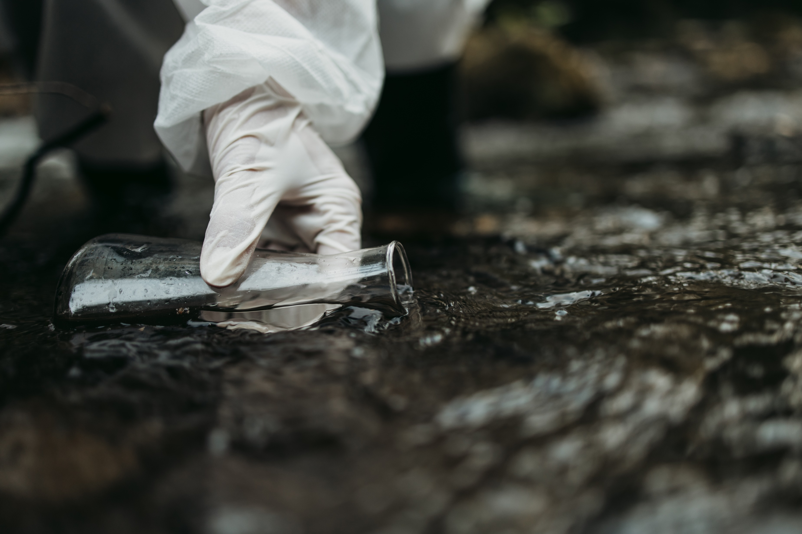
Overview
What are TMDLs
What are PCBs
What Environmental Programs Drive PCB PMPs
What is and involved in a PMP
Timelines
Who needs a PCB PMP?

Slide 3
Total Maximum Daily Load (TMDL)
A TMDL is the calculation of the maximum amount of a pollutant allowed to enter a waterbody so that the waterbody will meet and continue to meet water quality standards for that particular pollutant.
A TMDL determines a pollutant reduction target and allocates load reductions necessary to the source(s) of the pollutant.
Source: USEPA https://www.epa.gov/tmdl/overview-total-maximum-daily-loads-tmdls

Slide 4
Total Maximum Daily Load (TMDL)
Sum of waste load allocations
Margin of safety
TMDL
Sum of load allocations
Source: USEPA https://www.epa.gov/tmdl/overview-total-maximum-daily-loads-tmdls

Slide 5
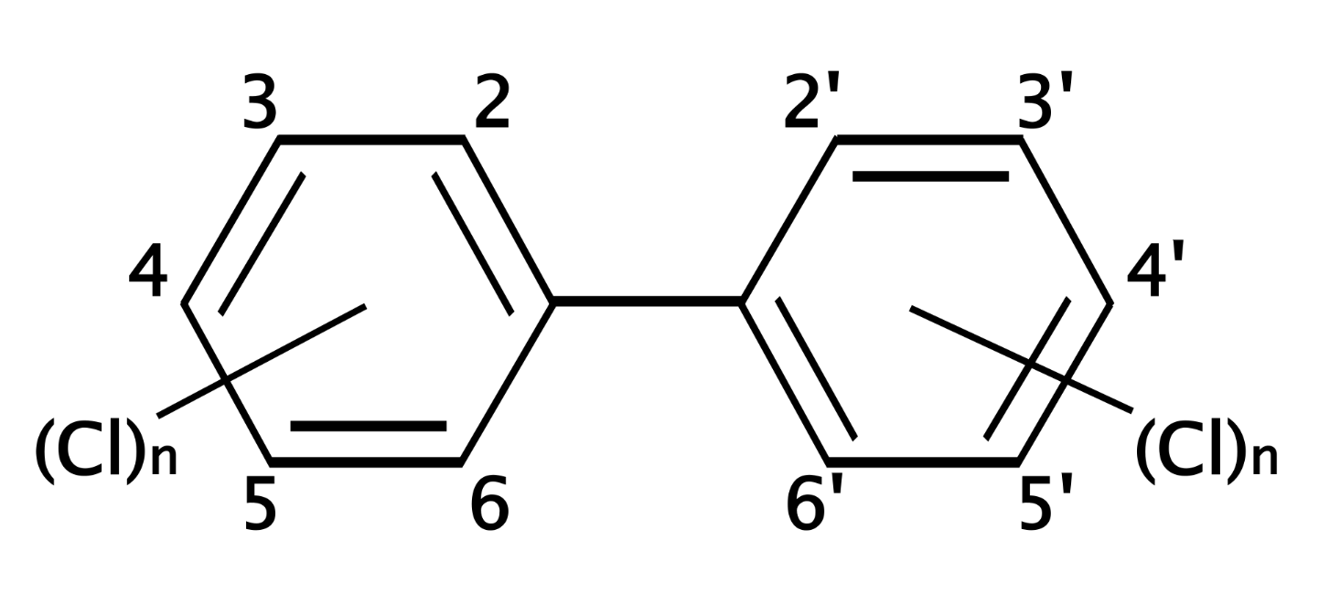
Polychlorinated Biphenyls (PCBs)
PCBs are a family of similar organochlorine compounds with properties that made them ideal for use in various industrial applications from 1920s until 1979, when they were banned.

Slide 6
Polychlorinated Biphenyls (PCBs)
PCBs have confirmed and suspected toxicity and can be cancer causing
PCBs are very stable and persist in the environment for a long time
PCB breakdown products can also be toxic, in some cases more toxic than the parent PCB

Slide 7
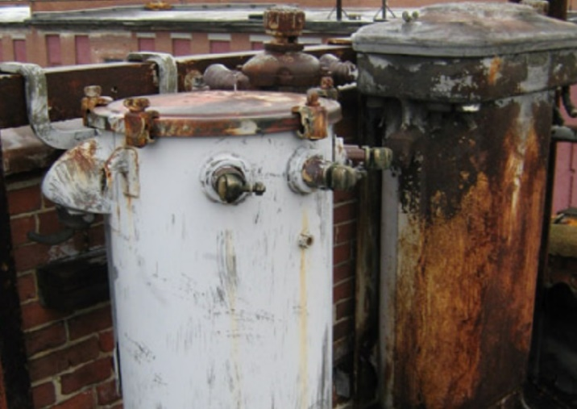
Polychlorinated Biphenyls (PCBs)
PCBs release from improper storage, handling, disposal.
PCBs also release from leaks, releases, burns or other damage to legacy PCB containing structures such as transformers.

Slide 8
PCB Pollutant Minimization Plans (PMP)
With increasing knowledge of the harmful health effects of PCBs, state agencies have been incorporating PCB management related requirements into permits.
Virginia Pollutant Discharge Elimination System (VPDES) permits are adding requirements for some facilities to develop and implement a PCB PMP.

Slide 9
Virginia Watersheds with approved TMDLs
EPA and Virginia have been working to develop Total Maximum Daily Loads (TMDLs) for PCBs in watersheds across the state.
The following watersheds in Virginia have approved TMDLs for PCBs:
Shenandoah River
Roanoke River
Levisa Fork watershed including Garden Creek and Slate Creek
New River
Potomac River
Notes:
Callie, can we add a nice picture of any one of these rivers?

Slide 10
Highlights of a PCB PMP
Pollutant Minimization Plans aim to:
Assess/investigate facility, identify, and inventory PCB sources
Assess effectiveness of previous minimization activities, if any
Develop and implement a results-based, iterative PCB minimization Plan
Propose minimization activities and an implementation schedule
Ultimate Goal is to reduce PCBs in the watershed and accomplish the TMDL within a planned timeframe!

Slide 11
Highlights of a PCB PMP
Pollutant Minimization Plans aim to:
Develop monitoring, measurement plan
Measure and demonstrate effectiveness
Low-level (ppt) measurement methods in accordance with VDEQ guidance PCB Source Monitoring Guidance No. 09-2001
Report progress periodically, as required by the permit
Include methods for continuing assessment of progress and plan revisit and recalibration as needed
Ultimate Goal is to reduce PCBs in the watershed and accomplish the TMDL within a planned timeframe!

Slide 12
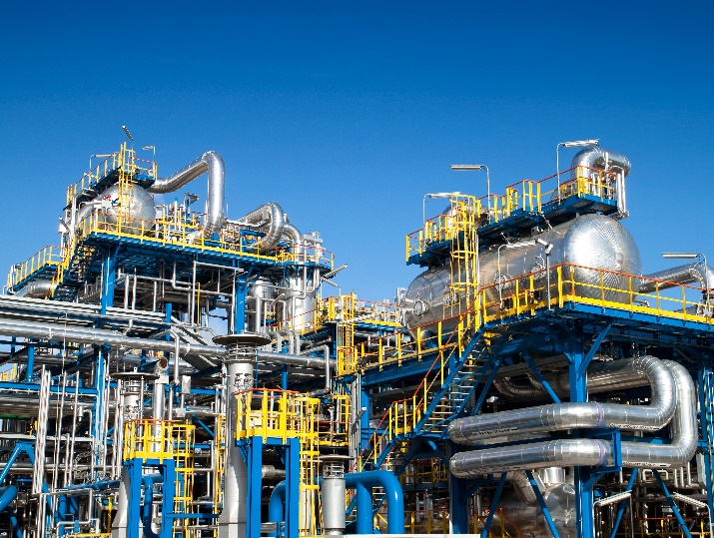
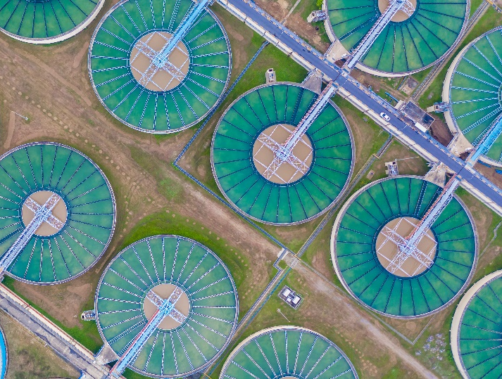
Who needs a PMP?
Any facility that has been notified by VDEQ (or other agency) as a potential or actual contributor of PCBs to the watershed, e.g.:
Landfills
Industries
Wastewater treatment plants
Any other commercial facility

Slide 13
Contact:
Sri Nathella, PE
Principal
snathella@daa.com
540.557.1318
Will Mason-Deese
Operations Manager
wmason-deese@daa.com
540.557.1396

