Slide 2
Per- and Polyfluoroalkyl Substances (PFAS)
Jeffery Steers
Virginia Department of Environmental Quality
September 18, 2019

Slide 3
PFAS – The Basics
Lead agency is United States Environmental Protection Agency (EPA)
Virginia Department of Environmental Quality is following developments closely (DEQ)
None of these substances are presently listed as a hazardous substance by EPA
EPA has plans to list them
No Maximum Contaminant Levels (MCL’s, or drinking water standards) currently
EPA planning to promulgate MCL’s
Some states promulgating their own Alternate Concentration Levels (ACL’s)

Slide 4
PFAS – The Basics
Current groundwater analytical method is a modified drinking water method
A true groundwater analytical method now out for public comment by EPA
No promulgated soil sampling method or sampling standard operating procedure
Only 2 of 3000+ PFAS compounds have lifetime health advisory values (70 parts per trillion each or in the aggregate)
DEQ established a PFAS working group across all media (air, water and land) to keep current and help provide information
Notes:
70 ppt individually or in the aggregrate
Workgroup: Leslie R, Prina, Ashby, Lisa, Chris

Slide 5
What are PFAS?
Man-made chemicals – commonly referred to as
Generally referred to as PFAS, or Per- and polyfluoroalkyl substances
Most common species currently:
Perfluorooctanoic acid, or PFOA
Perfluorooctanesulfonic acid, Or PFOS
GenX
Manufactured & used around the globe; in the United States since 1940
PFOA and PFOS most extensively produced & studied
Both are persistent in the environment & human body
Evidence that PFAS can lead to adverse human health effects*
*Source: https://www.epa.gov/pfas/basic-information-pfas
Notes:
Persistent – don’t break down and can accumulate over time.

Slide 6
General Chemical Properties of PFAS
Comprised of a carbon backbone of varying lengths with fluorine occupying most of the branches
Extremely strong chemical bond between carbon & fluorine
High solubility
Highly mobile in groundwater

Slide 7
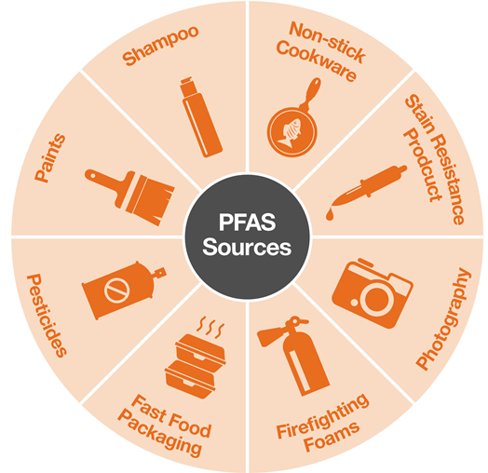
Where do I encounter PFAS?
PFAS are used world wide in many consumer products

Slide 8
Why Are PFAS of Concern?
Distributed globally in the environment
Can travel great distances in aquifer systems
Average residence time in the human body is ~5 years
Primary target organ is the liver

Slide 9
PFAS Impacted Sites to Drinking Water in Virginia
Fentress Air Base (Fentress)*
Oceana Naval Air Station (Virginia Beach)*
Northwest Annex (Chesapeake)*
NASA Wallops Island (Wallops Island)*
DuPont Spruance (Richmond)**
DOD is sampling active military installations in Virginia
*Installation providing bottled water to affected residents
*Not effecting any drinking water sources

Slide 10
What is EPA Doing?
Plans to add PFOA & PFOS to the list of Superfund Hazardous Substances
Preparing a true groundwater analytical method
Committed to establishing an MCL
Developing both a groundwater & a soil sampling method

Slide 11
What is DEQ Doing?
As a support Agency to EPA at CERCLA sites, DEQ is following the lead of EPA & adhering to PFAS strategies as they unfold
Virginia is the lead Agency overseeing ongoing remedial action at DuPont Spruance
Developing long and short term strategies in coordination with the Virginia Department of Health and the SNR
Goal to develop a proactive plan for Virginia across air water and land programs

