Slide 1
John Barnes | October 18, 2018 | SWANA Regulatory Training
DISASTER RECOVERY
Hurricane Matthew at the Virginia Beach Landfill and Resource Recovery Center
1

Slide 2
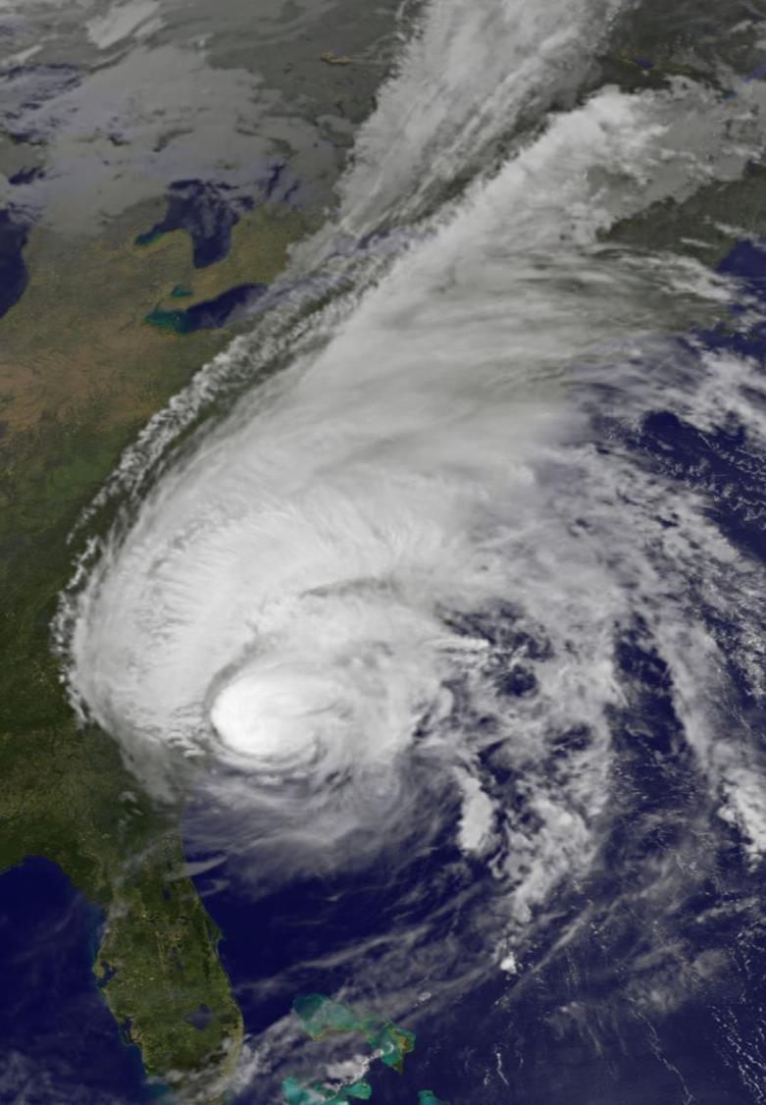
OUTLINE
1. Landfill & Resource Recovery Center
2. Rainfall
3. Citywide Impact
4. Landfill Damage
5. Recovery
6. FEMA/Costs
7. Mitigation
8. Questions
2

Slide 3
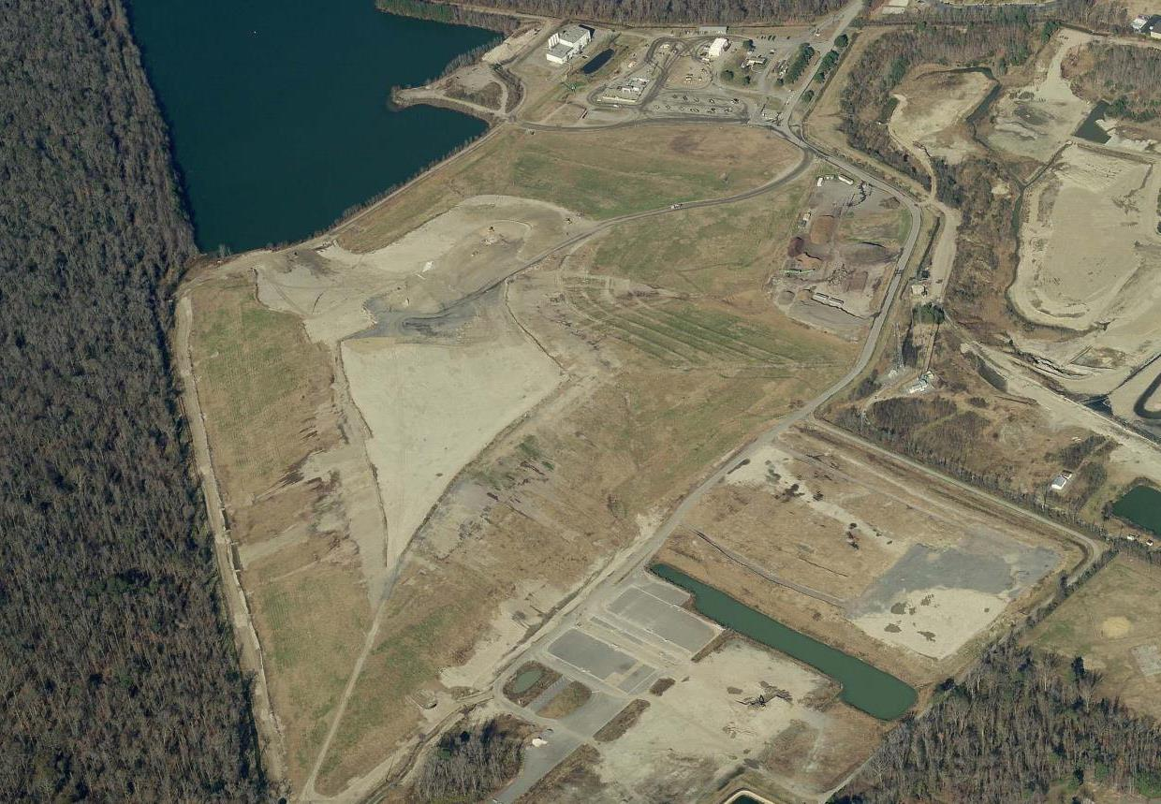
LANDFILL & RESOURCE RECOVERY CENTER
3
Notes:
The City Landfill and Resource Recovery Center is a municipal solid waste facility that is highly regulated through the Environmental Protection Agency (EPA) and The Virginia Department of Environmental Quality (DEQ).
The Virginia Beach Landfill and Resource Recovery Center of­fers a wide range of services for responsible waste disposal and recycling. The facility is a valuable asset to the residents of Virginia Beach where professional staff­ take great pride in o­ffering quality services.

Slide 4
LANDFILL & RESOURCE RECOVERY CENTER
3
Notes:
The City Landfill and Resource Recovery Center is a municipal solid waste facility that is highly regulated through the Environmental Protection Agency (EPA) and The Virginia Department of Environmental Quality (DEQ).
The Virginia Beach Landfill and Resource Recovery Center of­fers a wide range of services for responsible waste disposal and recycling. The facility is a valuable asset to the residents of Virginia Beach where professional staff­ take great pride in o­ffering quality services.

Slide 5
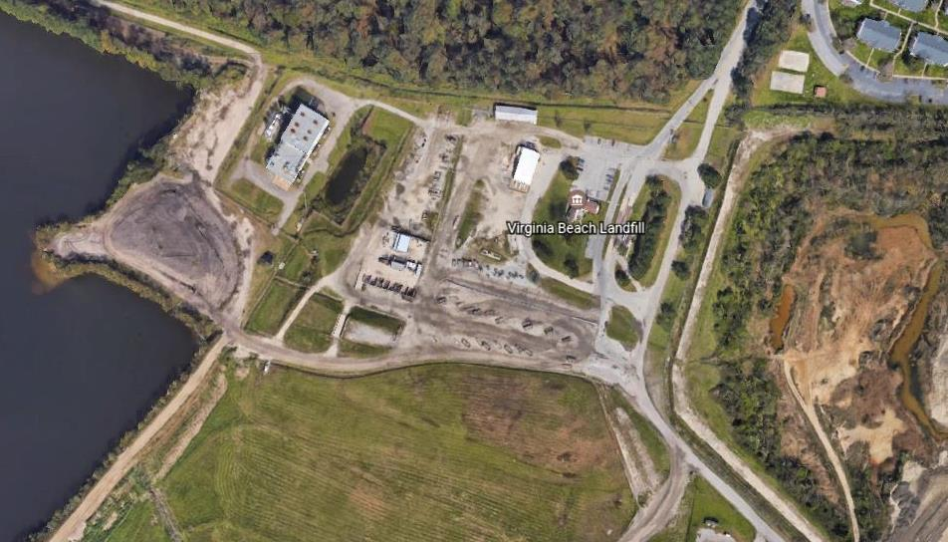
LANDFILL & RESOURCE RECOVERY CENTER
LANDFILL & RESOURCE RECOVERY CNTER
Ditch
Lake BMP
HHW
Office
Borrow Pit
Convenience Center
4

Slide 6
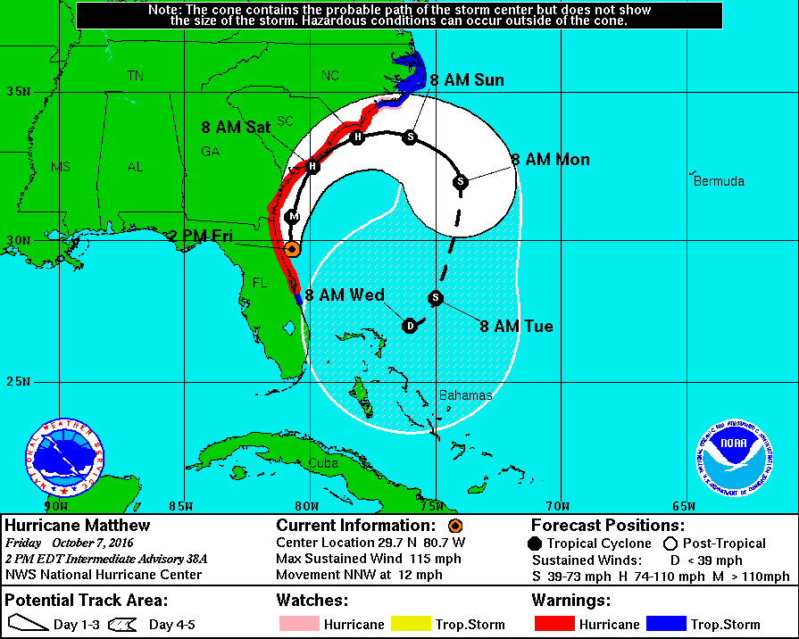
RAINFALL
SETTING THE STAGE - RAINFALL
Storm | Date | Rainfall
Tropical Storm Hermine | September 3-4 | 5”
Tropical Depression Julia | September 19-22 | 15.5”
Hurricane Matthew | October 8-9 | 13”
5
Notes:
Hurricane Matthew incorrectly projected to turn away – October 7

Slide 7
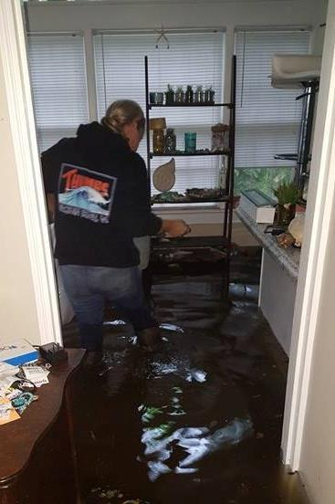
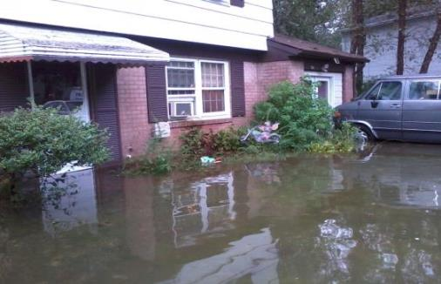
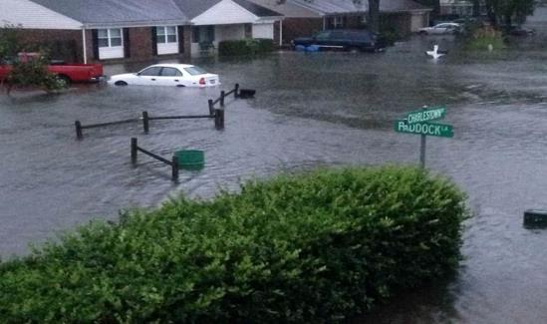
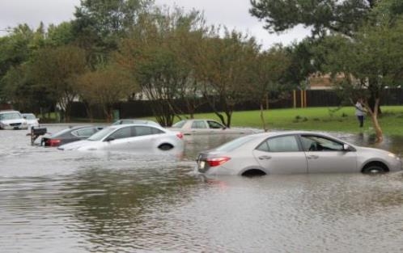
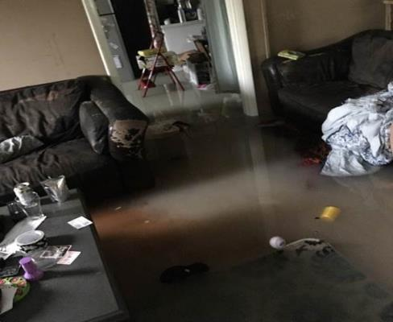
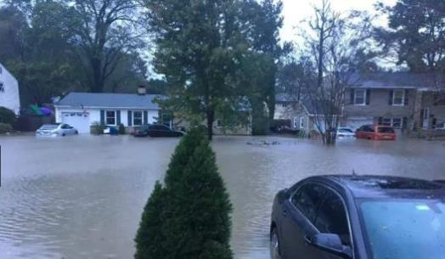
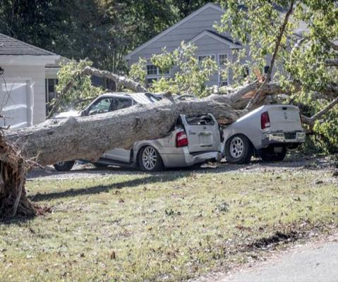
CITYWIDE IMPACT
SETTING THE STAGE - RAINFALL
- 2,500 properties affected
- 1,400 properties flooded
- 18 to 24 inches of water in homes
- $40 million private property damage
- $14 million public property damage
6

Slide 8
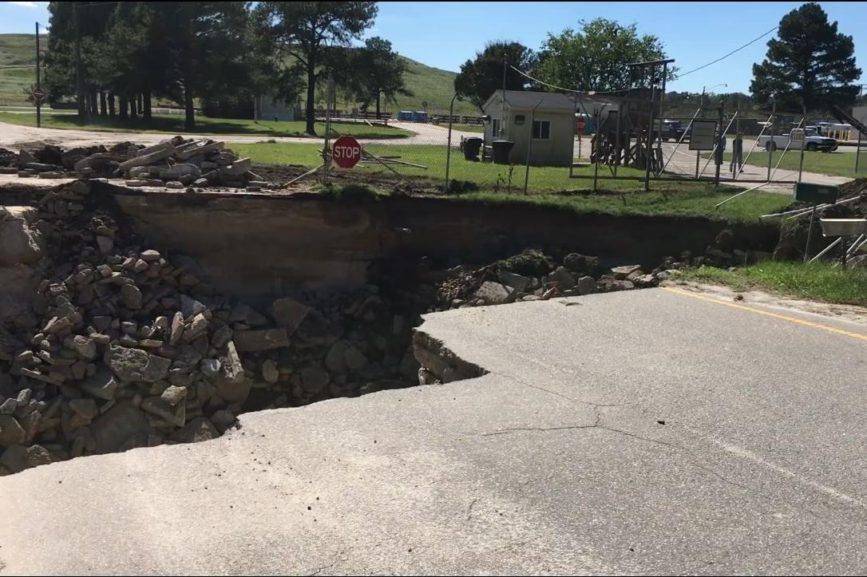
HURRICANE MATTHEW LANDFILL DAMAGE
7

Slide 9
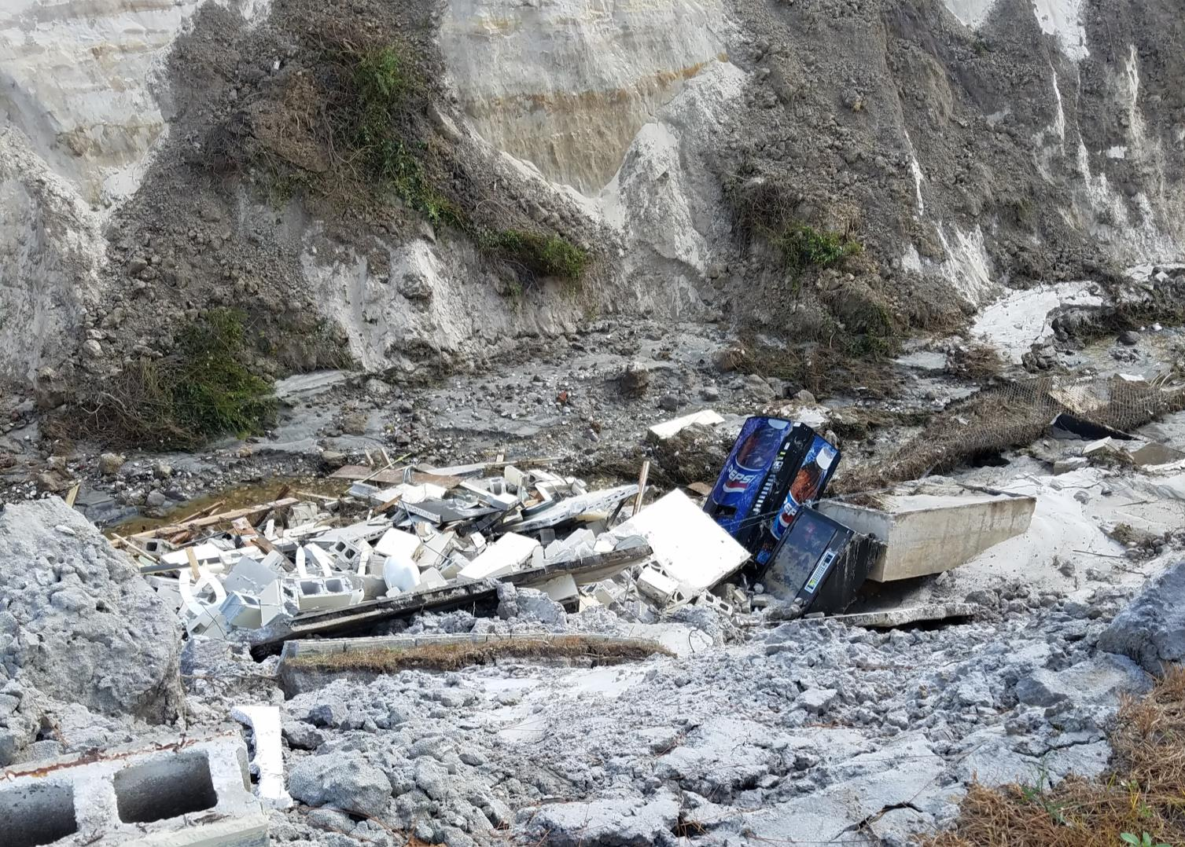
HURRICANE MATTHEW LANDFILL DAMAGE
8

Slide 10
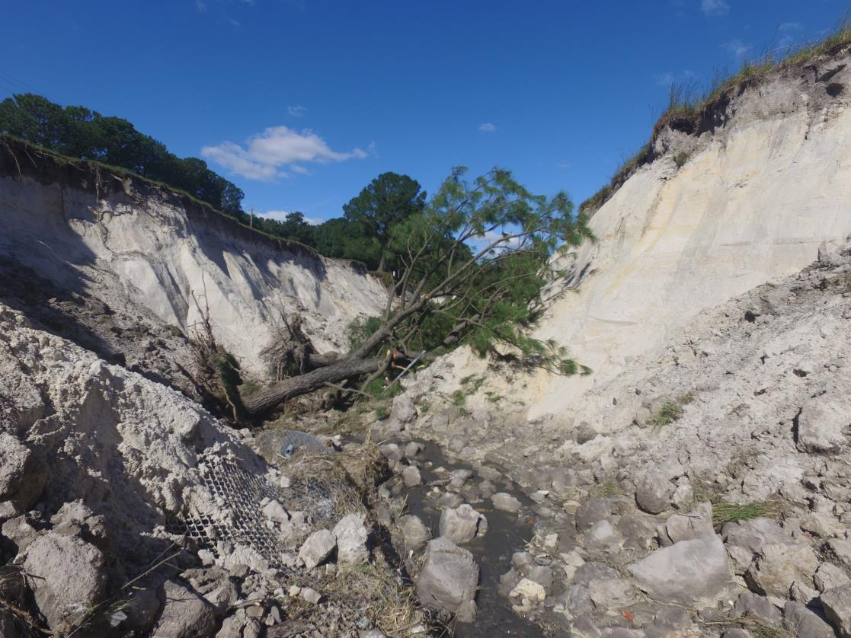
HURRICANE MATTHEW LANDFILL DAMAGE
9
Notes:
Canyon measured – 1,000-foot length, 35-40 foot deep, 35-40 foot wide
Estimated to be 70,000 CY

Slide 11
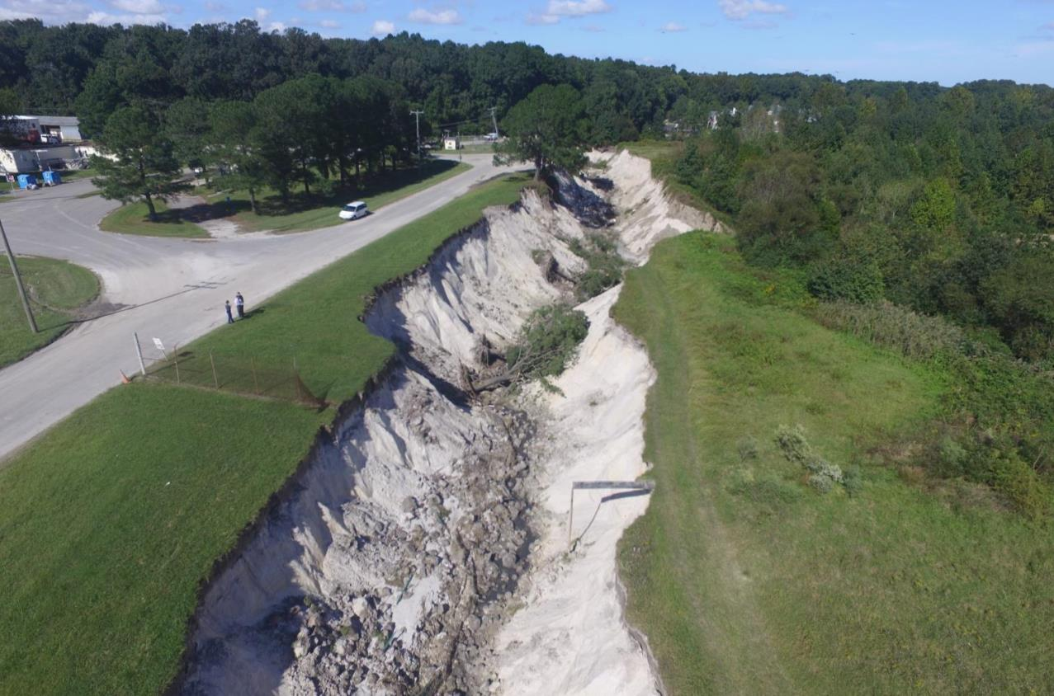
HURRICANE MATTHEW LANDFILL DAMAGE
10
Notes:
An erosion channel developed and became a deep canyon in the sandy soils

Slide 12
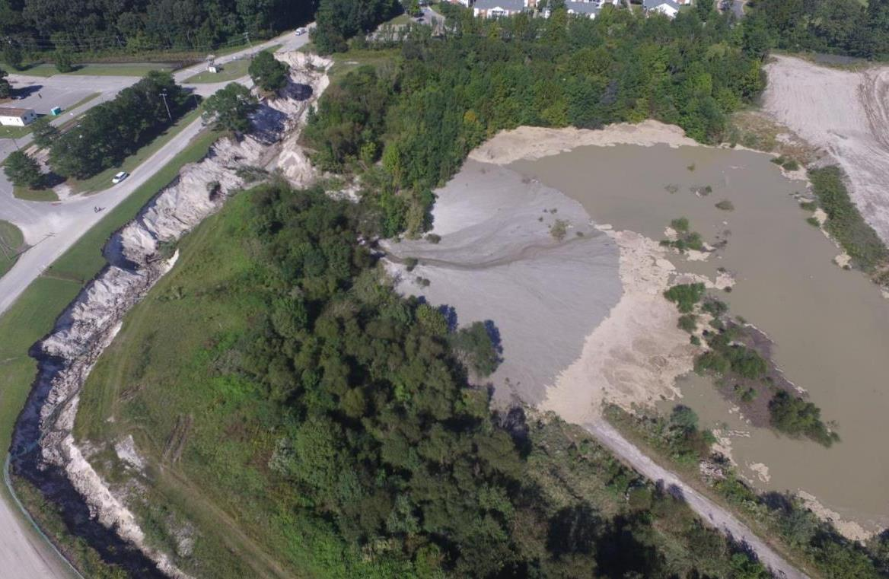
HURRICANE MATTHEW LANDFILL DAMAGE
11
Notes:
Flood waters built up enough and overflowed the land between perimeter channel and adjacent borrow pit

Slide 13
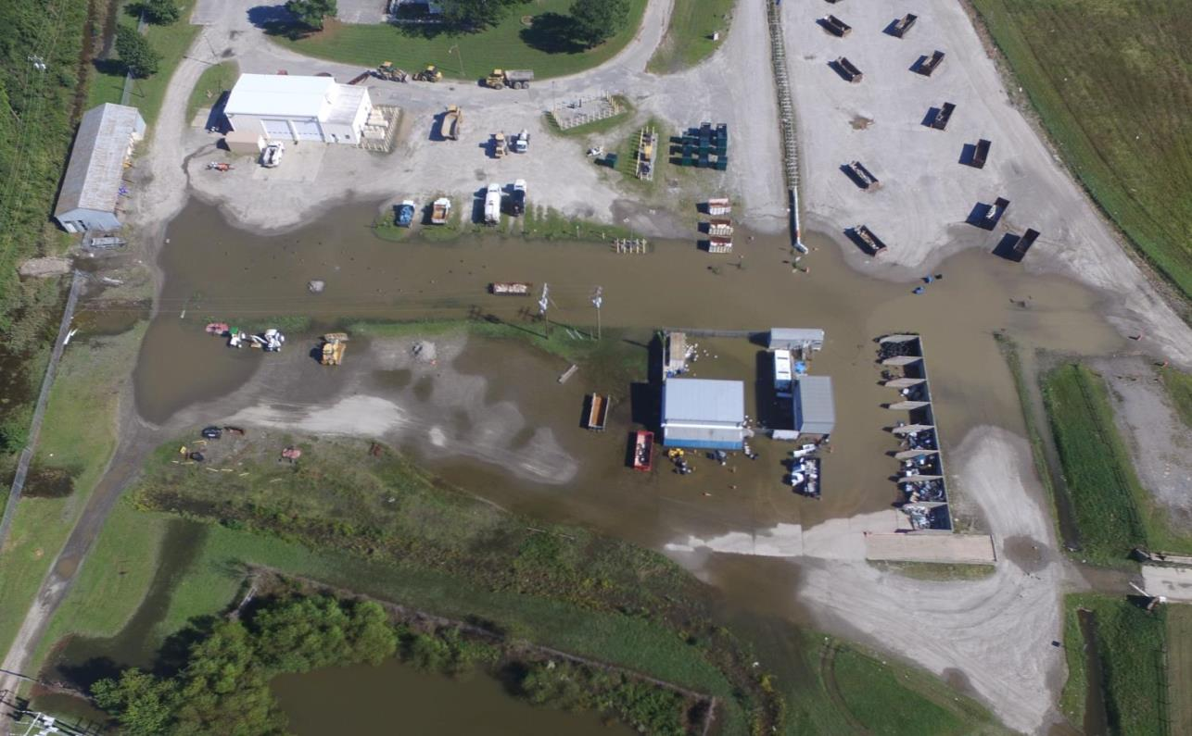
HURRICANE MATTHEW LANDFILL DAMAGE
12
Notes:
Excess hurricane runoff developed over night between Saturday, October 8 and Sunday October 9, 2016. Storm water pond overflowed and flooded HHW storage areas.

Slide 14
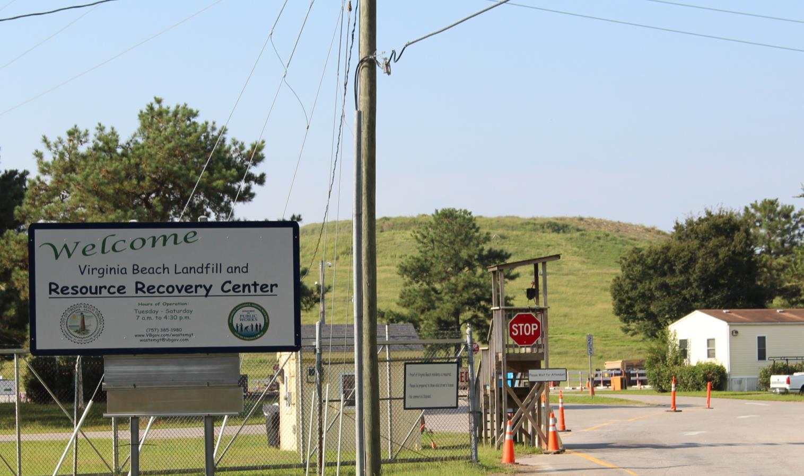
RECOVERY
RECOVERY
6 DAYS AFTER HURRICANE – OPEN FOR BUSINESS
13

Slide 15
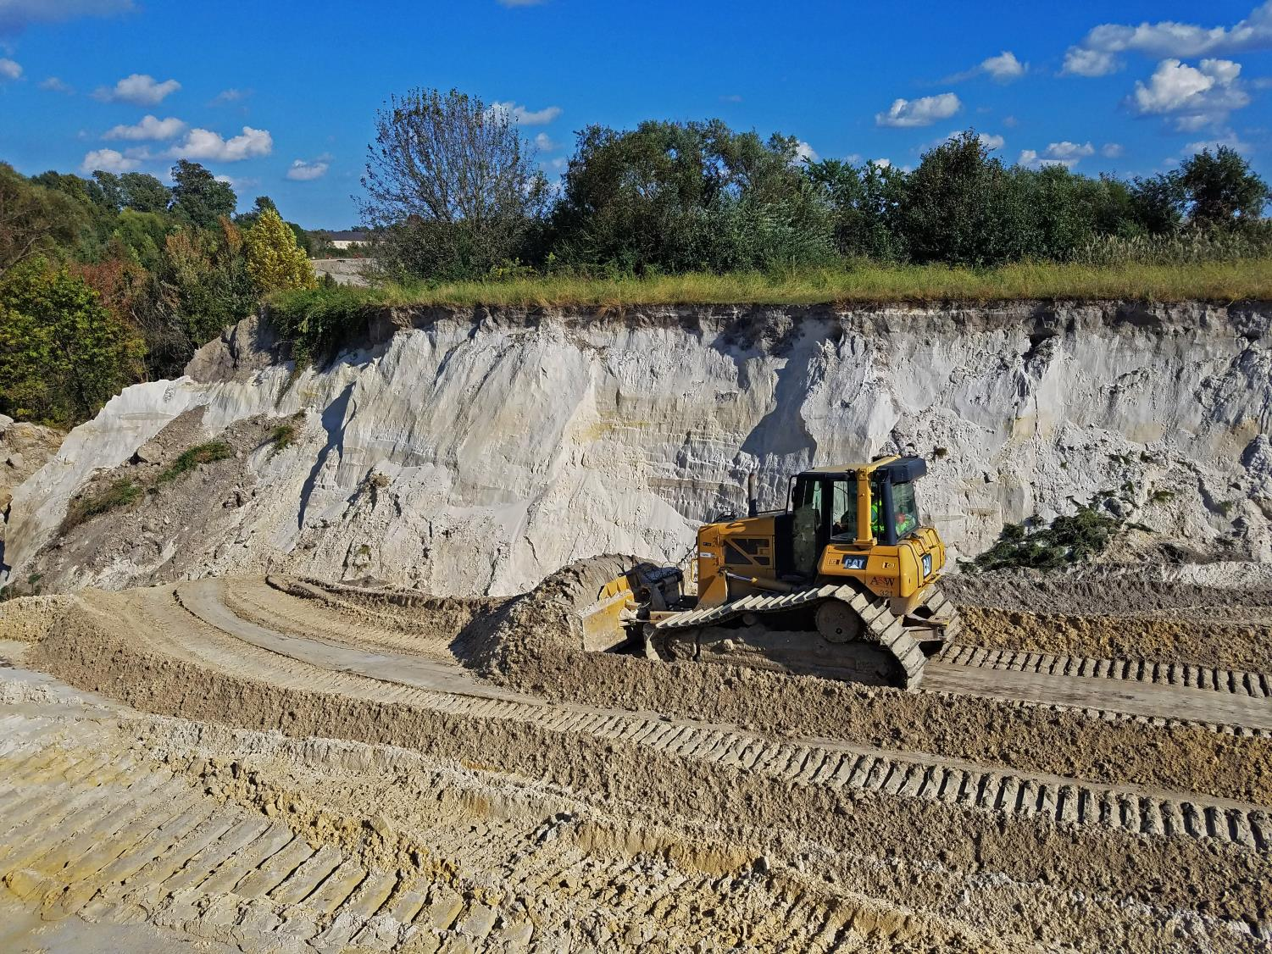
RECOVERY
RECOVERY
7 DAYS AFTER HURRICANE
14

Slide 16
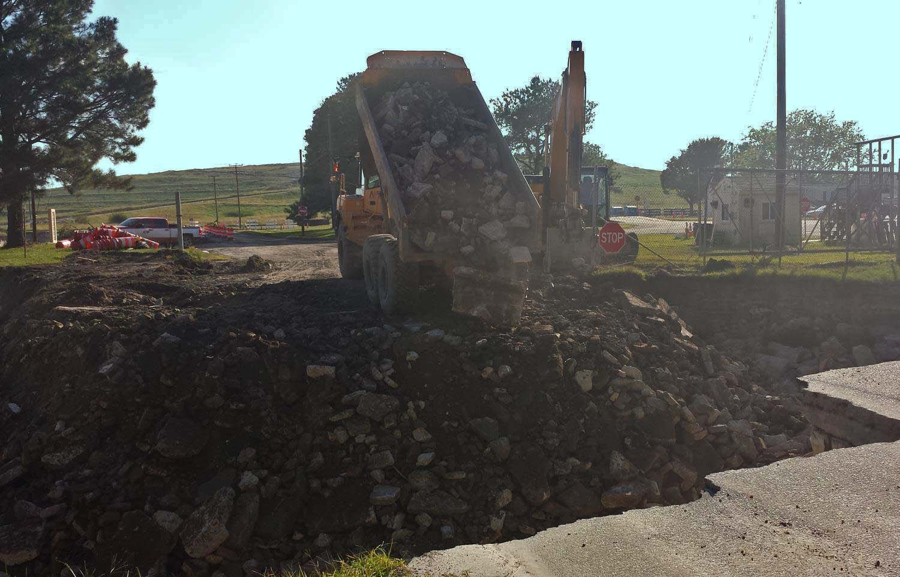
RECOVERY
RECOVERY
8 DAYS AFTER HURRICANE
15

Slide 17
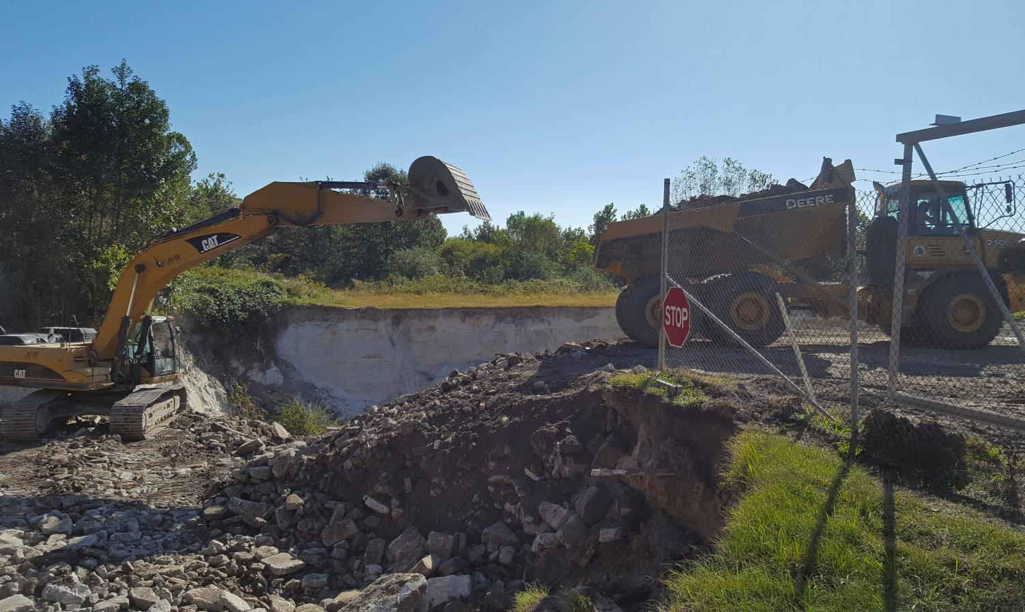
RECOVERY
RECOVERY
9 DAYS AFTER HURRICANE
16

Slide 18
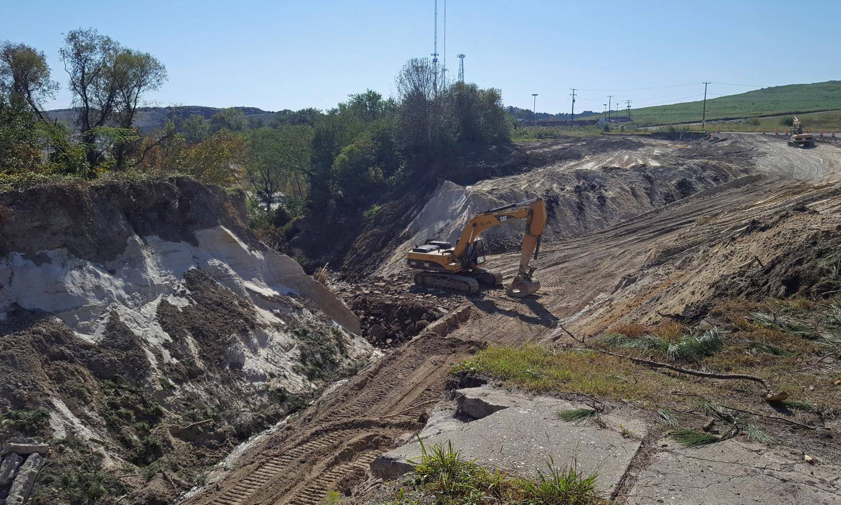
RECOVERY
RECOVERY
10 DAYS AFTER HURRICANE
17

Slide 19
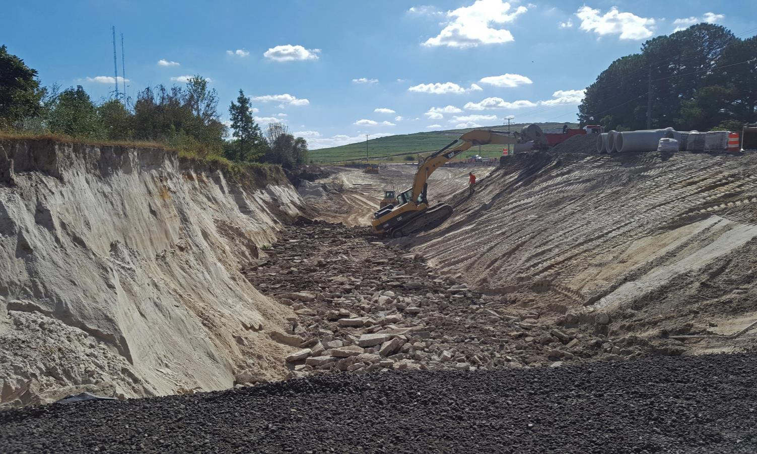
RECOVERY
RECOVERY
11 DAYS AFTER HURRICANE
18

Slide 20
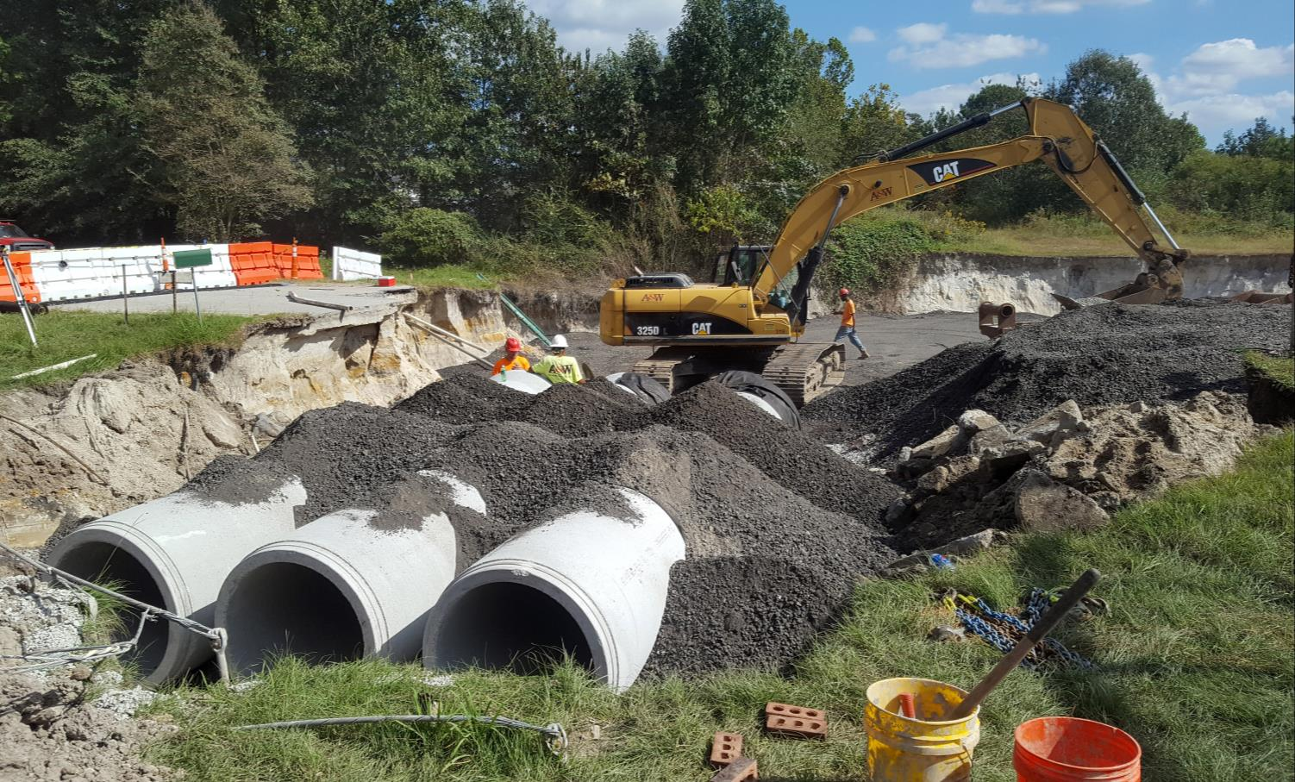
RECOVERY
RECOVERY
11 DAYS AFTER HURRICANE
19

Slide 21
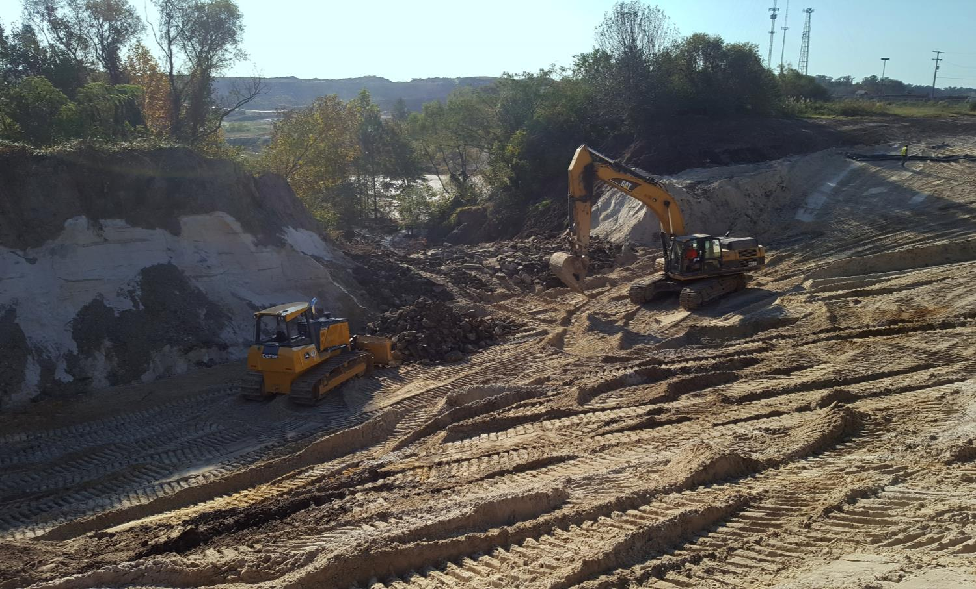
RECOVERY
RECOVERY
12 DAYS AFTER HURRICANE
20

Slide 22
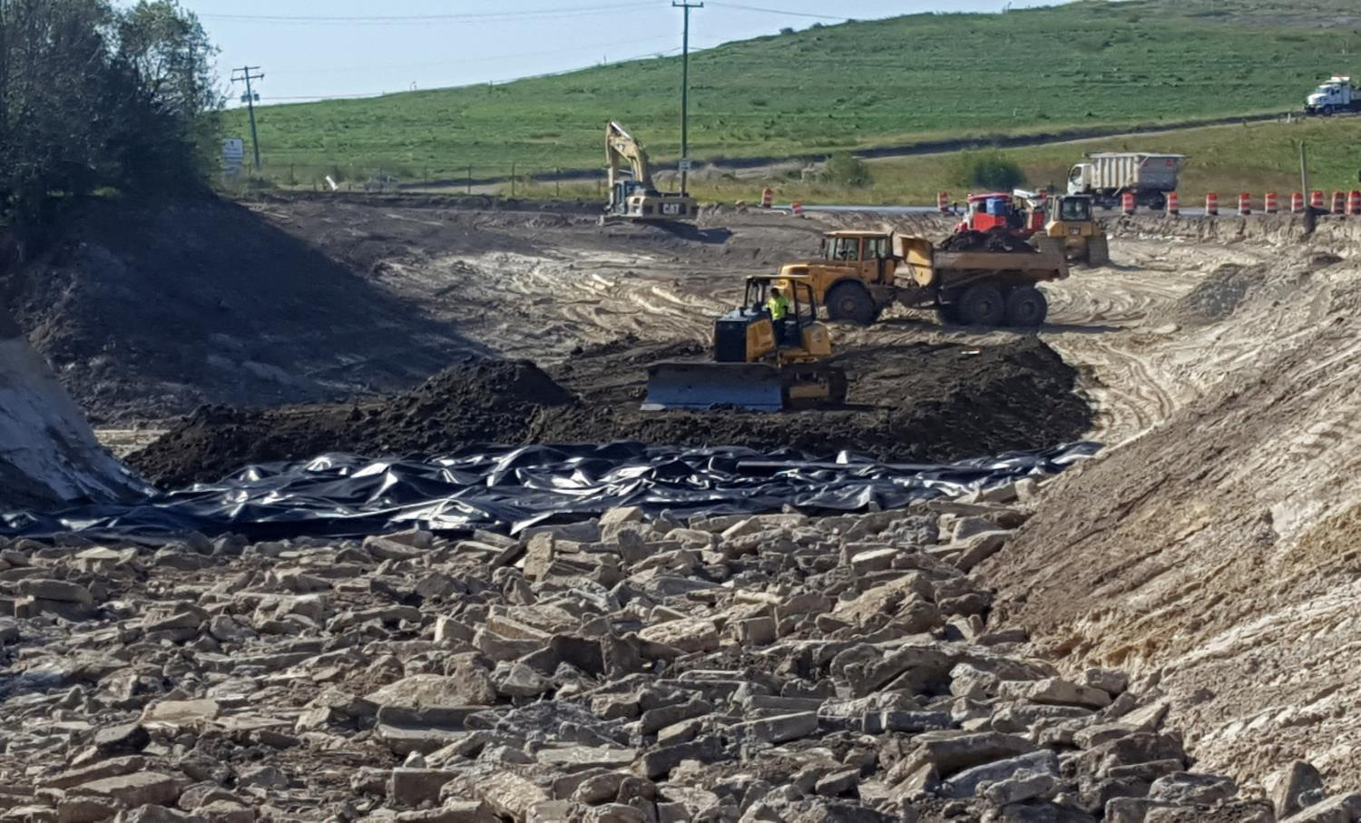
RECOVERY
RECOVERY
15 DAYS AFTER HURRICANE
21

Slide 23
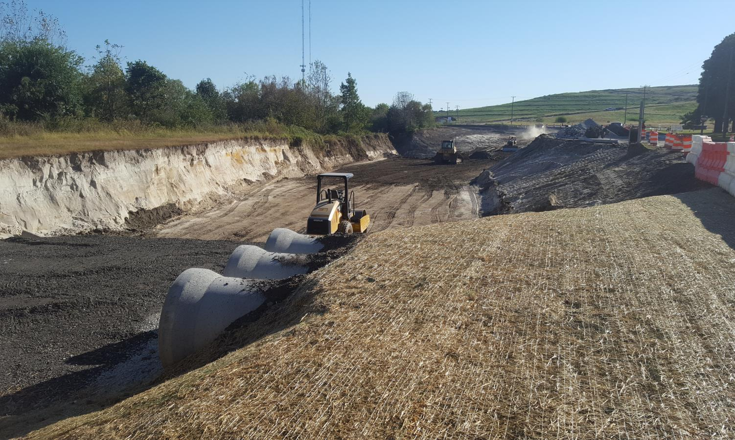
RECOVERY
RECOVERY
16 DAYS AFTER HURRICANE
22

Slide 24
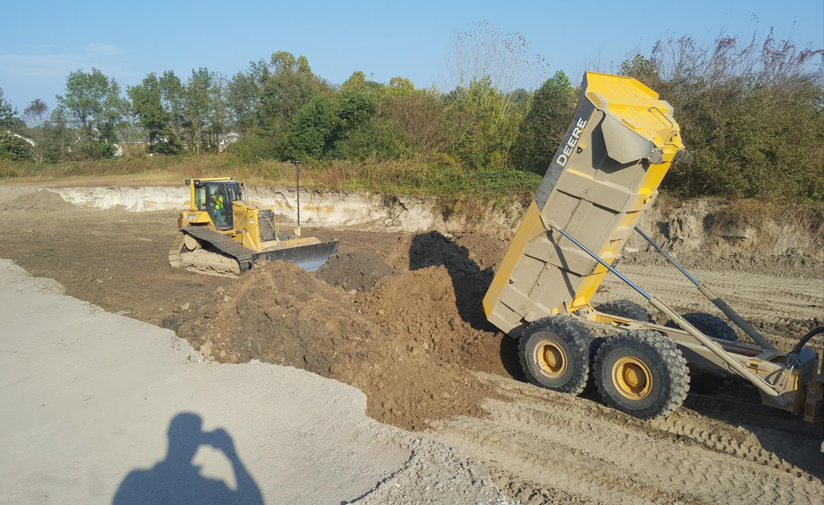
RECOVERY
RECOVERY
22 DAYS AFTER HURRICANE
23

Slide 25
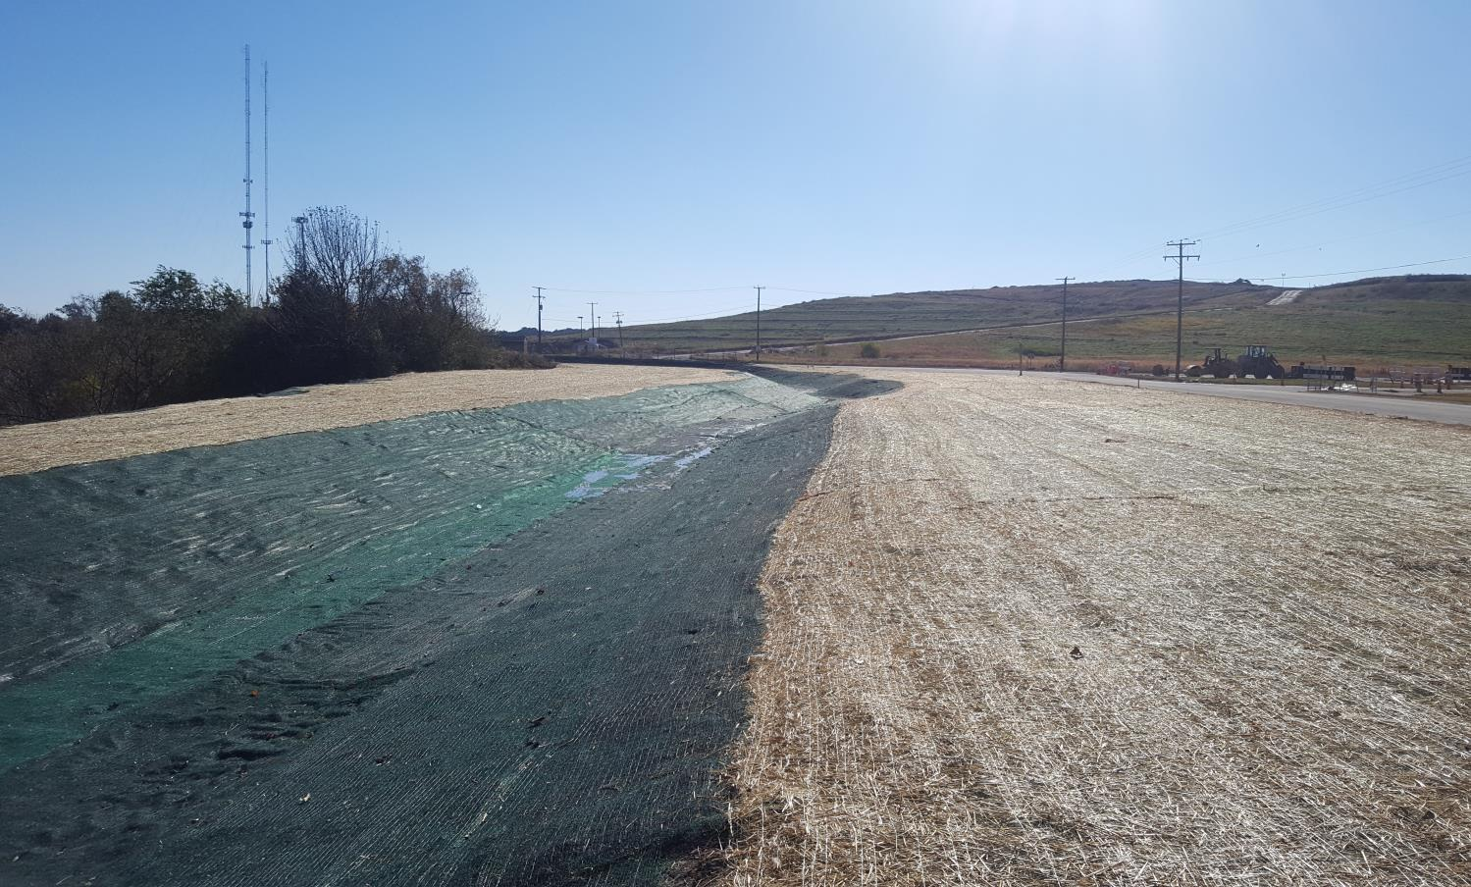
RECOVERY
RECOVERY
37 DAYS AFTER HURRICANE
24

Slide 26
FEMA
Costs
COST
Description | Amount*
Access road and embankments | $720,000
Road culvert | $203,000
Damaged water and sewer lines, lost pump | $83,000
Bathroom | $60,000
Protective measures | $33,000
HHW trailer and secondary containment | $19,000
Total | $1,118,900
Mitigation | TBD
*Amounts include staff time, equipment hours, engineering services
PROJECT WORKSHEETS
Landfill
Citywide – Debris, Collection and Disposal
25

Slide 27
MITIGATION
1. PIPE SIZING
2. HYDROLOGY STUDY UNDERWAY
26

Slide 28
QUESTIONS?
27

